Slide 1
Virginia Passenger Rail Authority
Board Meeting
December 14, 2020
For technical assistance, call Michael Henderson (804) 592-7985

Slide 2
Workshop Agenda | Presenter | Estimated Time Allotted
Board Chair Update | Jennifer Mitchell, Chairperson | 10 mins
Transforming Rail in Virginia – Major Capital Projects | Michael McLaughlin, Chief of Rail – DRPT | 20 mins
Virginia Passenger Rail Authority Organizational Structure | Jennifer Mitchell, Chairperson | 20 mins
Draft VPRA Budget – Operating and Capital | Steve Pittard, Chief Financial Officer – DRPT | 30 mins
Virginia Railway Express – Decades of Transformation | Rich Dalton, CEO – Virginia Railway Express | 15 mins
Closed Session |  | 30 mins
Break - Lunch |  | 60 mins
Draft VPRA Personnel Policy | Jeremy Latimer, Director of Rail Programs – DRPT | 15 mins
Virginia Passenger Rail Authority Administrative Items | Steve Pittard, Chief Financial Officer – DRPT | 10 mins
Public Comment
Action Agenda | Presenter | Estimated Time Allotted
Public Comment |  | 10 mins

Slide 3
Board Chair Update
Jennifer Mitchell, Chairperson

Slide 4
Transforming Rail in Virginia
Major Capital Projects
Michael McLaughlin, Chief of Rail – DRPT

Slide 5
Transforming Rail in Virginia Capital Program
Of the $3.7 Billion TRV Program, $3.2 billion is for capital projects.
The projects will be constructed in phases:
  Phase 1 to be completed ~ 2026
  Phase 2 to be completed ~ 2030
Virginia is close to finalizing the definitive legal agreements with CSX, Amtrak, and VRE on the $3.7 billion TRV Program.

Slide 6
Completion of Phases Correspond with New Passenger Service
Proposed Future Virginia Railway Express (VRE) Service Plan

Slide 7
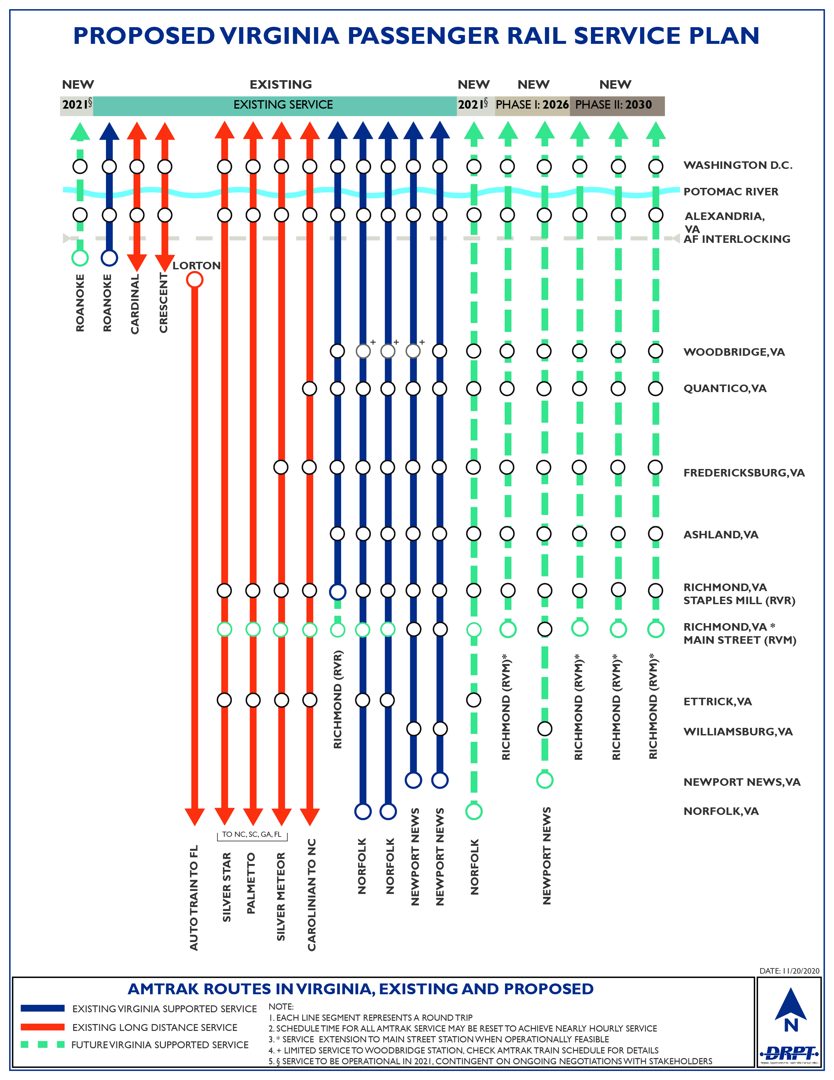
Proposed Future Amtrak Service Plan

Slide 8
Acquisition
The acquisition map stretches from the nation’s capital to the Allegheny Mountains to North Carolina.
Phases 1 and 2 are concentrated on the RF&P from Washington to Richmond

Slide 9
Northern Virginia and DC Projects

Slide 10
Central RF&P Area Projects

Slide 11
Southern RF&P Area Projects

Slide 12
Individual Project Profiles

Slide 13
Long Bridge
In order to add more freight and passenger rail, the biggest rail bottleneck on the East Coast – Long Bridge – needs to be addressed.
Long Bridge carries almost 80 trains a day over a 100-year old 2-track bridge.
The bridge is at 98% capacity during peak hours.
Environmental clearance started in 2016 and was finalized in September 2020; names Virginia as the lead on design and construction.

Slide 14
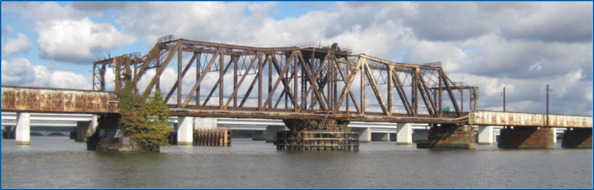
Current Status and Next Steps
Estimated $1.9 billion cost
Project is currently at 15% design –Virginia is close to hiring a contractor to complete 30% Preliminary Engineering.
In 2021 Virginia will apply to enter the FTA’s “Project Development” phase for its 5309 “Core Capacity” program – this could fund up to 50% of the project’s transit component (~$800 million).
During Preliminary Engineering Virginia will determine the procurement method for construction – i.e. Design-Bid-Build or Design-Build or an alternative method.
Virginia is also working with other stakeholders such as the District of Columbia Department of Transportation (DDOT), Amtrak, and VRE to coordinate various engineering and construction issues.
PE will take 2 years and Final Design and Construction is estimated to be complete by 2030.

Slide 15
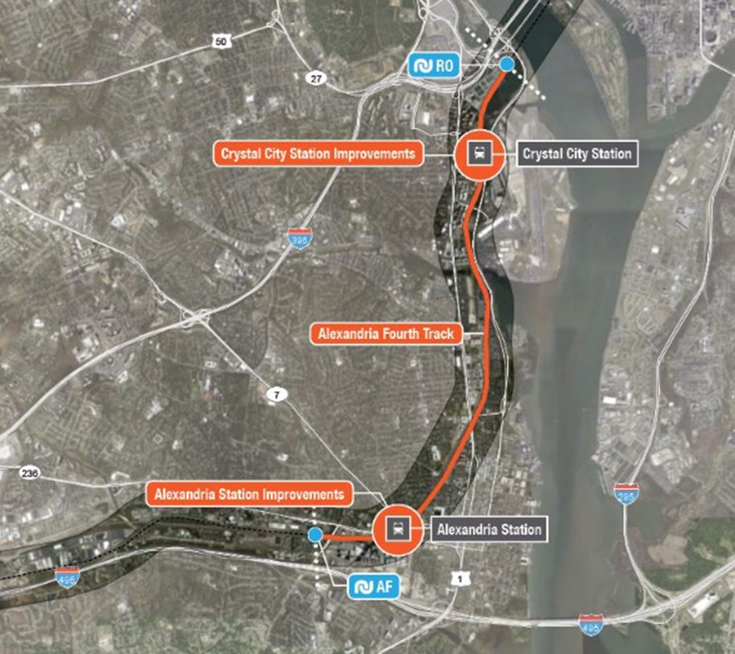
4th Track Project: “AF to RO”
3 Fredericksburg line tracks and 2 Manassas line tracks – which carry all of the Commonwealth’s VRE and Amtrak passenger trains in addition to freight traffic – converge into 3 tracks at the AF interlocking in Alexandria.
The project will design & construct 6 miles of fourth track between the AF (Alexandria) and RO (Rosslyn) Interlockings.
The new track will be coordinated with the Crystal City Station and Alexandria Station projects performed by VRE.
Project received a $45 million FASTLANE grant from US DOT in 2016.
When complete CSX will convey an existing track on the west to Virginia.

Slide 16
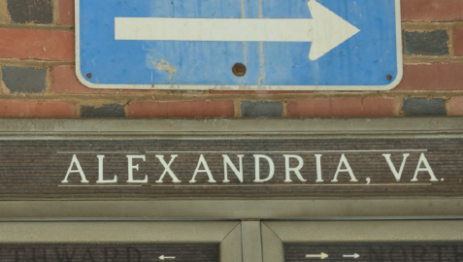
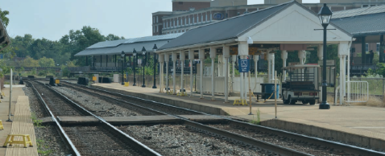
Project Status and Next Steps
$161 million estimated project cost.
DC2RVA Tier II EIS complete in Sept. 2019 - environmental clearance for AF to RO achieved through DC2RVA project.
PE plans were completed for the full DC2RVA project corridor and DRPT is close to finalizing AF to RO PE Signature Plans.
Early works PE design plans for a Crash wall at Airport Access Road – will satisfy the grant requirement of construction start w/in 18 months of DOT grant agreement execution.
CSX will be leading final design and construction as the right of way to build the project is on the east on CSX land.
When complete CSX will convey an existing track on the west to Virginia.
Final Design estimated to be complete in 2022 and Construction estimated for 2025 completion

Slide 17
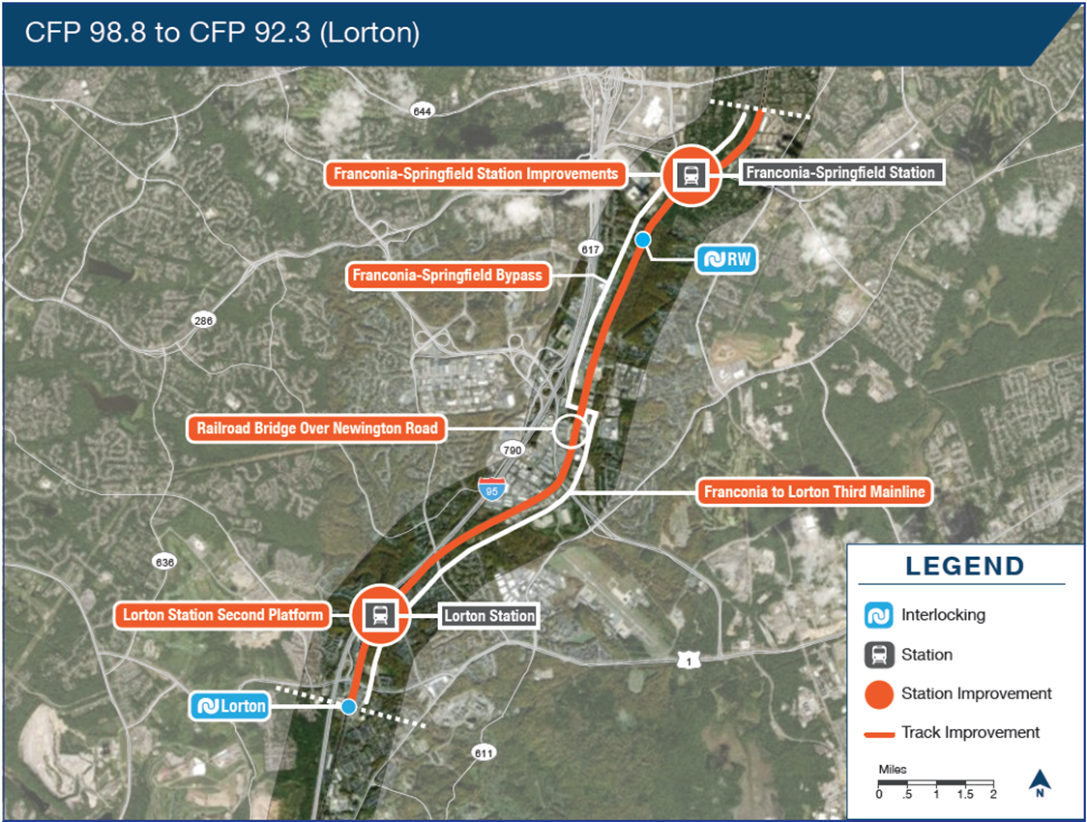
Franconia to Lorton Projects
Franconia to Lorton 3rd track is a 6+-mile Segment that will extend the 3rd track that is currently from Franconia to Alexandria.
Franconia Bypass just south of the Franconia Station will allow passenger trains to crossover to serve VRE Stations on the west north of Franconia and on the east south of Franconia.

Slide 18
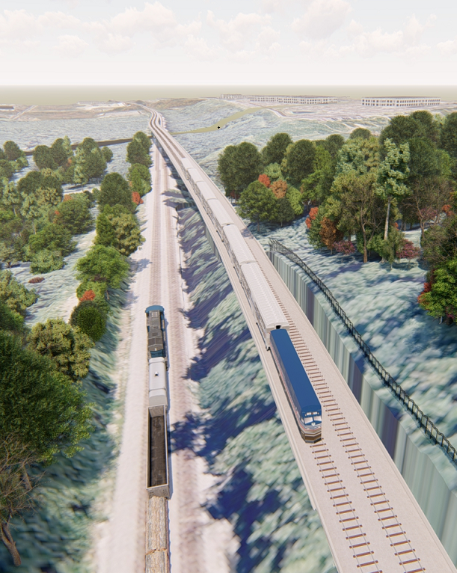
Project Status and Next Steps
3rd Track
$162 million cost
PE complete
Environmental Clearance in-progress: Categorical Exclusion
Final Design will begin in 2021 and construction will begin in 2023 with completion in 2025
Bypass
$340 million cost
Concept Level design
Environmental Clearance in-progress: Categorical Exclusion
Design to begin in 2021 and construction will begin in 2023 with completion in 2026

Slide 19
DC to Richmond Sidings
The Phase 1 and 2 sidings are located from Woodbridge to Hanover County are approximately 3-4 miles in length and will allow for strategically placed 3rd tracks that will allow freight and passenger trains to utilize the sidings to fluidly move from Washington, DC to Richmond.
6 sidings:
Siding A: Potomac Creek near Leeland Station
Siding B: Woodford Milford in Caroline County
Siding C: Hanover Siding north of Ashland
Siding D: Neabsco Creek south of Rippon
Siding E: Aquia Creek north of Brook Station
Siding F: Crossroads south of Spotsylvania
4 of these sidings, when combined with other 3rd tracks on the ground or in development, will be the start of a dedicated 3rd track passenger corridor (to be completed in Phases 3 and 4) from Alexandria to Spotsylvania, which is the end of the VRE Territory.

Slide 20
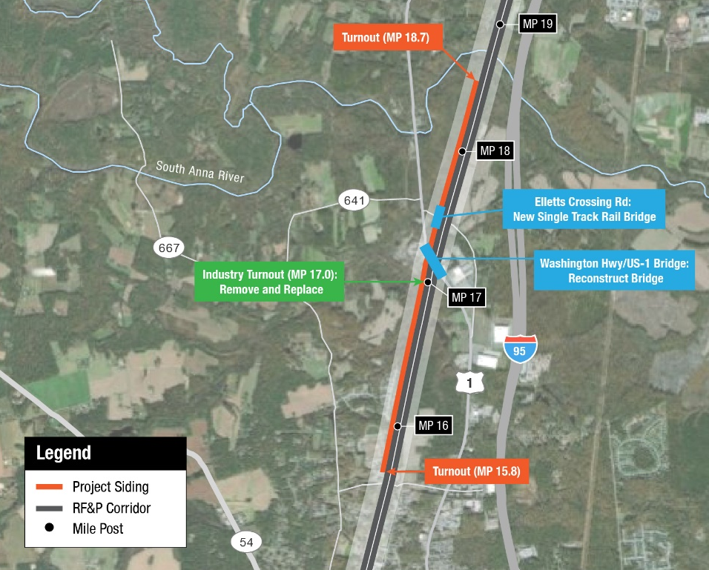
Project Status and Next Steps
Estimated cost of $472 Million.
All sidings were cleared environmentally by DC2RVA, as was 30% design for most of the sidings.
Of the 3 sidings that are part of “Phase 1”, final design procurement will begin in 2021.
The other 3 sidings in “Phase 2” will begin final design in 2026.
Construction Dates: 2022-2025 for Phase 1 sidings; 2027-2030 for Phase 2 sidings
Siding C: Hanover County

Slide 21
Future Phases
As identified in the CSX agreement there are future phases that would complete a 3rd track from DC to Spotsylvania.
The CSX agreement also identifies the goal of Virginia building a 4 track corridor from Washington to Richmond in the future, with 2 tracks dedicated to passenger rail.
4 tracks would allow for skip stop service and reverse-flow VRE trains
Additional projects are in planning for:
  Main Street Station in Richmond - to allow all Amtrak trains to serve Main Street
  The Commonwealth Corridor utilizing the Buckingham Branch
  The S-Line from Petersburg to North Carolina
  Roanoke to Christiansburg

Slide 22
Questions?
Michael McLaughlin
michael.mclaughlin@drpt.virginia.gov
www.drpt.Virginia.gov
www.drpt.virginia.gov/rail/transforming-rail-in-virginia/

Slide 23
VPRA Organizational Structure
Jennifer Mitchell, Chairperson

Slide 24
VPRA DRAFT Management Organization
Executive Director
Chief Operating Officer
Director of Construction & Engineering
Director of Procurement
Board Secretary
Director of Planning & Programming
Chief Administrative Officer
Human Resources Director
Chief Financial Officer
Director of Rail Contracting & Management
Director of IT
Chief of External Affairs
Chief of Legal Services
Executive Management
Attorney General of Virginia
Note: “Chief” and “Director” nomenclature is used to illustrate common reporting levels within the management structure but may not hold in all cases as positions are better defined in future phases of the organizational design.

Slide 25
VPRA DRAFT Expanded Management Organization
Executive Director
Chief Operating Officer
Director of Construction & Engineering
Director of Procurement
Board Secretary
Director of Planning & Programming
Chief Administrative Officer
Human Resources Director
Chief Financial Officer
Director of Rail Contracting & Management
Director of IT
Chief of External Affairs
Chief of Legal Services
Manager of Programming
Manager of Planning
Program Manager
Manager of Design Services
Manager of ROW / 3rd Party
Construction Manager
Manager of Rail Contracts
Manager of Real Estate Management
Director of Government Affairs
Director of Marketing & Media Relations
Director of Budget & Financial Planning
Director of Accounting & Reporting
Director of Treasury & Cash Management
Construction Contracting
Real Estate Contracting
Attorney General of Virginia
Executive Management Team

Slide 26
FY2022 Draft Operating and Capital Budget
Steve Pittard, Chief Financial Officer – DRPT

Slide 27
Code of Virginia
The law establishing the Virginia Passenger Rail Authority (VPRA) also established that the CTB should prescribe the form of the VPRA operating plan and budget.
33.2-298. Annual budget.
  The Authority shall prepare and submit a detailed annual operating plan and budget to the Transportation Board by February 1 of each fiscal year. The Authority shall also prepare and submit for approval any proposed capital expenditures and projects for the following fiscal year to the Transportation Board by February 1. The Transportation Board shall have until May 30 to approve or deny any capital expenditures, and, in the event the Transportation Board has not approved or denied the Authority's proposed capital expenditures by such deadline, such expenditures shall be deemed approved. The operating plan and budget shall be in a form prescribed by the Transportation Board and shall include information on expenditures, indebtedness, and other information as prescribed by the Transportation Board.

Slide 28
VPRA Budget Requirements
By February 1st of each year, submit an annual operating and capital budget to the CTB
The CTB has until May 30th each year to approve or deny any capital expenditures in the budget
CTB provided the ability to prescribe the format and contents of the operating budget

Slide 29
Basic Assumptions – Operating Budget
One year budget (FY2022); will include an estimate for FY2021 for comparison
Based on anticipated expenditures as accrual basis required
Zero-based estimate for FY2022
Two main elements of Operating Budget:
  Amtrak Operations Costs
  VPRA Administration

Slide 30
Draft VPRA Operating Budget
Project Description | FY21 (Millions) | FY22 (Millions)
Administrative Budget | $ 2.3 | $ 5.2
Roanoke Service - Amtrak Route 46 (1 daily roundtrip)
Operating Support | 3.5 | 6.0
Capital Equipment Charge | - | -
Subtotal | 3.5 | 6.0
Newport News Service - Amtrak Route 47 (2 daily round trips)
Operating Support | 6.5 | 12.0
Capital Equipment Charge | 1.2 | 1.2
Subtotal | 7.7 | 13.2
Norfolk Service - Amtrak Route 50 (2 daily roundtrips)
Operating Support | 2.9 | 7.5
Capital Equipment Charge | 2.4 | 2.4
Subtotal | 5.3 | 9.9
Richmond Service - Amtrak Route 51 (1 daily roundtrip)
Operating Support | 0.8 | 6.0
Capital Equipment Charge | 0.9 | 1.0
Subtotal | 1.7 | 7.0
Future Roanoke/NRV Operations
Operating Support | - | 6.0
Capital Equipment Charge | - | -
Subtotal | - | 6.0
Future Norfolk Train 3 Operations
Operating Support | - | 2.2
Capital Equipment Charge | - | 0.5
Subtotal | - | 2.7
Bedford Amtrak Thruway Intercity Bus Connector | 0.3 | 0.3
Amtrak Marketing Costs | 0.9 | 0.9
Total Operating Budget | $ 21.7 | $ 51.2

Slide 31
Amtrak State-Supported Operating Budget
Presents the costs of the six state-supported Amtrak trains
Includes funding for marketing, train operating costs, and for Virginia’s share of contributions for Amtrak equipment
Presents net subsidy required by route

Slide 32
VPRA Administration Budget
TOTAL PAYROLL
TELECOMM SERVICE
VOICE/DATA TRANS. EQUIP
COMPUTER SYSTEMS & SUPPORT
MOBILE CLIENT COMPUTERS
NETWORK COMPONENTS
OTHER COMP. EQUIPMENT
COMPUTER SOFTWARE PURCHASES
COMPUTER OPERATING SUPPLIES
TOTAL INFORMATION TECHNOLOGY
CLERICAL SERVICES
AUDITING SERVICES
CONSULTING SERVICES
PERSONNEL MANAGEMENT SERVICES
LEGAL SERVICES
MANUAL LABOR SERVICES
TOTAL OUTSIDE SUPPORT SERVICES
EMPLOYEE INCENTIVES
EMP TRNG COURSE,WKSHP, CONF
TRAVEL, SUBSISTENCE AND LODGING
ORG. MEMBERSHIPS
FOOD AND DIETARY SERVICES
APPAREL SUPPLIES
TOTAL TRAINING TRAVEL OTHER
PROPERTY INSURANCE
BUILDING RENTALS
OFFICE APPURTENANCES
OFFICE FURNITURE
CONSTRUCTION, BLDG IMP
TOTAL OFFICE BUILDING & RELATED
PUBL. SUBSCRIPTIONS
OFFICE SUPPLIES
PRINTING SERVICES
EQUIP. REPAIR & MAINT.
POSTAL SERVICES
TOTAL OTHER ADMINISTRATIVE
TOTAL FY2022 BUDGET
Developed at general ledger account level using DRPT’s current chart as a base
Present using a roll-up by certain classifications of expenditures. For example:
  Payroll includes base salaries and all fringes
  IT includes telecomm, network, hardware, software and maintenance

Slide 33
Draft VPRA Administration Budget
Payroll includes 28 potential employees at an average employment length for the year of 75%
Training Travel Other includes: employee training, conferences, work travel to oversee projects; employee incentives - bus pass subsidy or tuition reimbursement; organizational memberships; work apparel; food and dietary costs
Outside support services include professional services (audit, legal) and consultants needed for the standup of the organization
Information Technology includes the purchase / install / maintenance of ERP financial system
After organization standup period some categories should decrease

Slide 34
Basic Assumptions – Capital Budget
Will include current year expenditures and (FY2021), budget for following fiscal year (FY2022) and five-year forecast (FY2023-FY2027)
Based on cash flows - approximate accrual based expenditures
Includes existing projects (~30 projects) and planned future efforts (Transforming Rail Initiative)
Two sections:
  Capital Projects section: VPRA-managed projects
  Capital Grants section: Projects managed by external grantees
Will include one-page narrative description with status update on each project

Slide 35
Draft VPRA Capital Projects Budget (in millions)
 | Total Budget | Expenses June 30, 2020 | FY21 | FY22 | FY23 | FY24 | FY25 | FY26 | FY27 | Total FY21 - FY27
New Long Bridge for Passenger Rail | $1,979.3 | $2.6 | $15.8 | $7.5 | $4.0 | $60.7 | $665.1 | $742.8 | $380.7 | $1,876.6
Alexandria 4th Track | 163.8 | 10.4 | 22.2 | 38.4 | 27.6 | 28.4 | 29.3 | 7.5 | - | 153.4
Franconia to Lorton 3rd Mainline | 161.7 | 1.3 | 2.2 | 5.4 | 90.6 | 62.2 | - | - | - | 160.4
Franconia-Springfield Bypass | 342.2 | 3.2 | 5.6 | 23.1 | 35.5 | 90.4 | 121.7 | 62.7 | - | 339.0
Richmond to DC Sidings - Phase 1 | 233.1 | - | 8.4 | 25.1 | 46.5 | 79.1 | 74.0 | - | - | 233.1
Richmond to DC Sidings - Phase 2 | 236.4 | - | - | - | - | - | - | 3.8 | 15.1 | 18.9
TRV Right of Way Acquisition | 525.0 | - | 200.0 | 200.0 | 125.0 | - | - | - | - | 525.0
TRV Other Infrastructure | 116.6 | - | 35.6 | 19.8 | 0.1 | 0.7 | 0.5 | 23.4 | 7.3 | 87.4
Total TRV | 3,758.1 | 17.5 | 289.8 | 319.3 | 329.3 | 321.5 | 890.6 | 840.2 | 403.1 | 3,393.8
Purchase of St. Julian's Yard: Amtrak Train Service Facility | 1.8 | - | - | 1.8 | - | - | - | - | - | 1.8
Total | $3,759.9 | $17.5 | $289.8 | $321.1 | $329.3 | $321.5 | $890.6 | $840.2 | $403.1 | $3,395.6

Slide 36
DRAFT VPRA Capital GRANTS Budget (in millions)
Project Description | Grantee | Total Project Budget | Expenses June 30, 2020 | FY21 | FY22 | FY23 | FY24 | FY25 | FY26 | FY27 | Total FY21-FY27
Crystal City Platform Study | VRE | $ 1.0 | - | - | $ 0.7 | - | - | - | - | - | $ 0.7
L'Enfant Platform Study | VRE | 3.2 | - | - | 1.1 | 1.1 | - | - | - | - | 2.2
Alexandria Station Pedestrian Tunnel | VRE | 6.9 | - | - | 2.3 | 2.3 | 2.3 | - | - | - | 6.9
Brooke/Leeland Road/Potomac Shores Station Improvements: Design & Construction | VRE | 36.0 | - | - | 2.0 | 1.9 | 3.8 | 3.8 | 7.6 | - | 19.1
Broad Run Station & 3rd Track Improvements | VRE | 71.4 | 2.3 | 0.5 | 0.4 | 6.8 | 19.3 | 25.7 | 12.9 | - | 65.6
Lorton Platforms | VRE | 4.0 | - | - | 0.3 | 0.5 | - | - | - | - | 0.8
Manassas Station Platform Extension | VRE | 9.2 | - | - | 2.3 | 4.6 | 2.3 | - | - | - | 9.2
Real Time Multimodal Information | VRE | 3.5 | - | - | - | - | - | 1.7 | 1.8 | - | 3.5
Manassas Park Parking Garage and Bridge | VRE | 23.5 | - | - | 3.9 | 3.9 | 3.9 | 3.9 | 3.9 | 4.0 | 23.5
Quantico Station Improvements | VRE | 19.2 | 0.6 | 1.8 | 2.0 | 11.9 | 1.5 | - | - | - | 17.2
Rolling Road Platform Extensions | VRE | 2.0 | 0.1 | 0.3 | - | - | - | - | - | - | 0.3
Track Lease Payment-Amtrak | VRE | 52.5 | - | 5.8 | 6.4 | 6.4 | 6.4 | 6.4 | 6.4 | 6.4 | 44.2
Track Lease Payment-CSX | VRE | 44.4 | - | 7.1 | 5.0 | 5.0 | 5.0 | 5.0 | 5.0 | 5.0 | 37.1
Track Lease Payment-Norfolk Southern | VRE | 25.7 | - | 2.8 | 3.1 | 3.1 | 3.1 | 3.1 | 3.1 | 3.1 | 21.4
Construction Storage Locations - WAS | VRE | 14.5 | - | - | 1.1 | 1.1 | 1.1 | 1.1 | - | - | 4.4
Rehab Rail Facility - WAS | VRE | 10.0 | - | - | 1.2 | 1.0 | 1.2 | - | - | - | 3.4
Newport News Station Platform | Newport News | 43.9 | - | 5.1 | 5.1 | 5.1 | 5.2 | - | - | - | 20.5
Ettrick Station Improvements | Chesterfield County | 4.6 | - | - | 0.5 | 1.0 | - | - | - | - | 1.5
Amtrak PIDS: Ashland, Richmond Main Street, Staples Mill Station | Amtrak/DRPT | 1.2 | - | 0.4 | 0.4 | 0.4 | - | - | - | - | 1.2
Amtrak Station State-of-Good-Repair | Amtrak | 7.1 | - | - | 1.3 | 1.4 | 1.4 | 1.5 | 1.5 | - | 7.1
Positive Train Control | Amtrak | 7.0 | 0.2 | - | 1.8 | 1.0 | 1.0 | 1.0 | 1.0 | 1.0 | 6.8
Arkendale to Powell's Creek Third Track Construction and Island Platforms | CSX | 101.4 | 77.3 | 5.7 | 5.3 | 6.6 | 6.5 | - | - | - | 24.1
Improvements Lynchburg to Roanoke | Norfolk Southern | 102.1 | 80.1 | 2.0 | 7.5 | 7.5 | 5.0 | - | - | - | 22.0
Route 29 Rail Corridor Improvements | Norfolk Southern | 31.6 | - | - | 7.9 | 7.9 | 7.9 | 7.9 | - | - | 31.6
Total |  | $ 625.9 | $ 160.6 | $ 31.5 | $ 61.6 | $ 80.5 | $ 76.9 | $ 61.1 | $ 43.2 | $ 19.5 | $ 374.3

Slide 37
Next Steps
Late December: complete detailed budget document and provide to VPRA Board
December – Mid January: update budgets based on feedback from VPRA Board and Audit and Budget Committee
Late January: final budgets presented to the VPRA Board for approval to submit to the Commonwealth Transportation Board
February – May: update budgets based on feedback received from CTB and any other significant changes
Early June: final VPRA Board adoption of FY2022 budgets

Slide 38
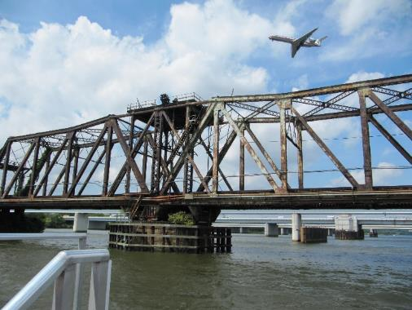
Questions?

Slide 39
VRE Presentation
Rich Dalton, Chief Executive Officer – Virginia Railway Express

Slide 40
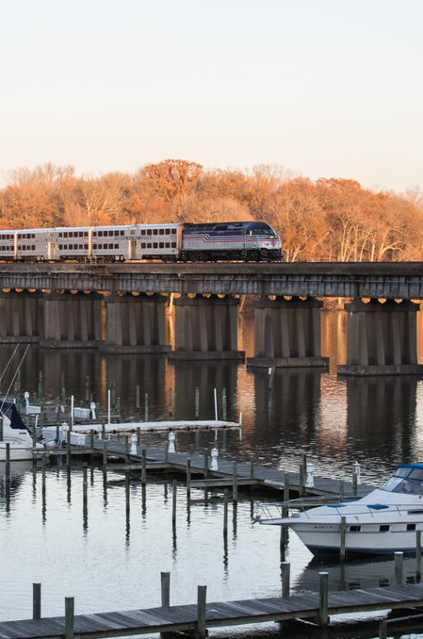

Decades of Transformation
VRE’s Role in the Expansion of
Passenger Rail Service
Presented by
Rich Dalton
Chief Executive Officer
December 14, 2020
via Webex

Slide 41
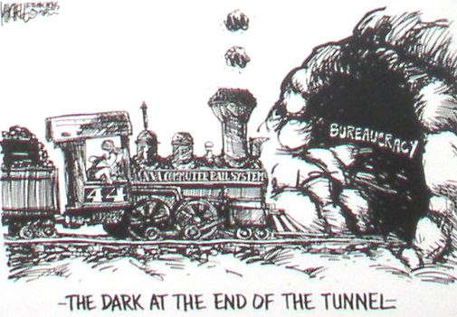
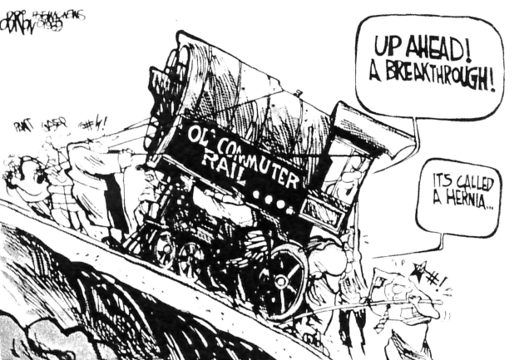
In the Beginning
1950
Commuter rail abandoned in Northern Virginia
1964
Northern Virginia Transportation Commission initiates discussions on reestablishment of commuter rail service
1967-
1984
Numerous studies validate the viability of commuter rail service
* Source: Texas Transportation Institute, Virginia Railway Express Congestion Relief Contribution; 2014

Slide 42


Early Milestones
1984
Planning for commuter rail begins in earnest. Grassroots effort garners community support.
NVTC and PRTC establish the
Virginia Railway Express
Operations Board
1988
1989
NVTC, PRTC and jurisdictions
execute a Master Agreement
* Source: Texas Transportation Institute, Virginia Railway Express Congestion Relief Contribution; 2014

Slide 43




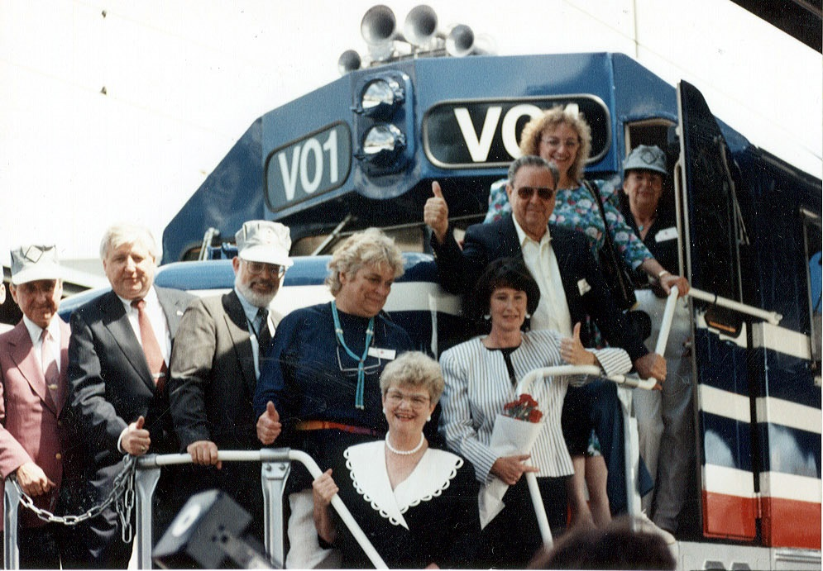
Early Milestones
1989
Operating and storage agreements
are put in place
1992
First locomotive arrives (January)
1992
Inaugural ride with Governor (June)
* Source: Texas Transportation Institute, Virginia Railway Express Congestion Relief Contribution; 2014

Slide 44
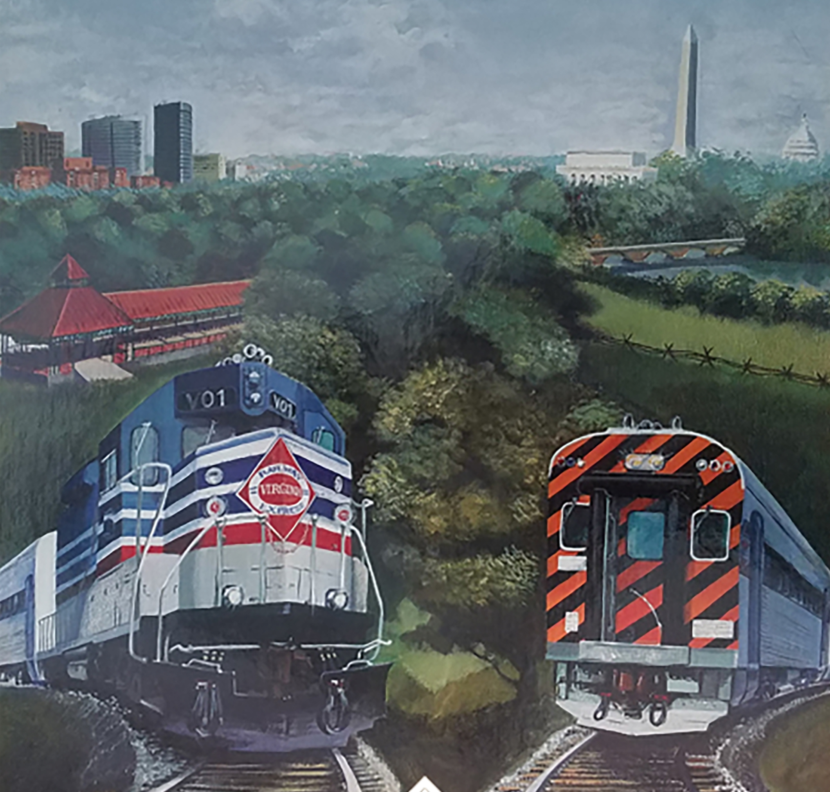
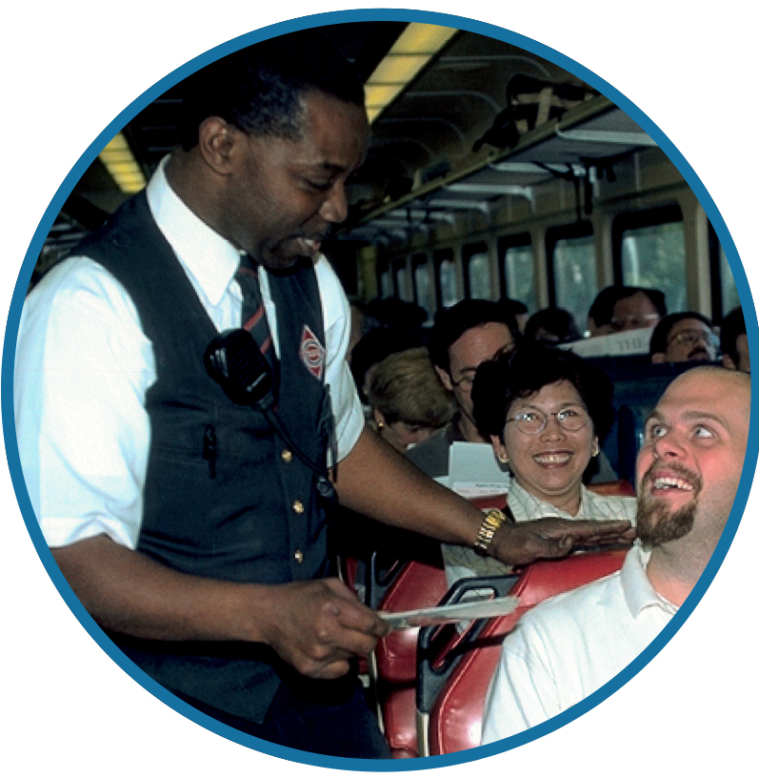
Service Begins
1992
Manassas Line – June 22, 1992
Fredericksburg Line – July 20, 1992
* Source: Texas Transportation Institute, Virginia Railway Express Congestion Relief Contribution; 2014

Slide 45
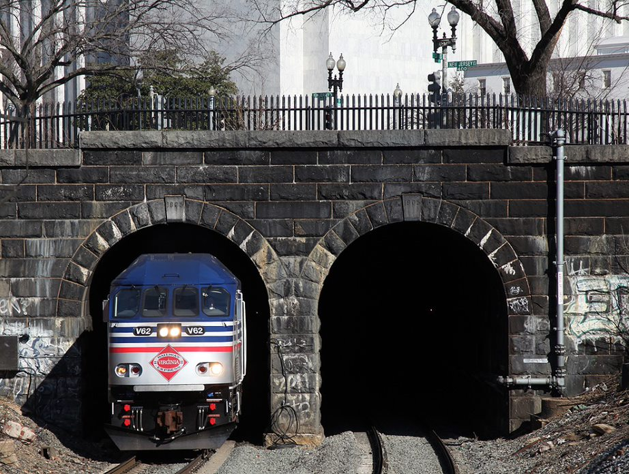
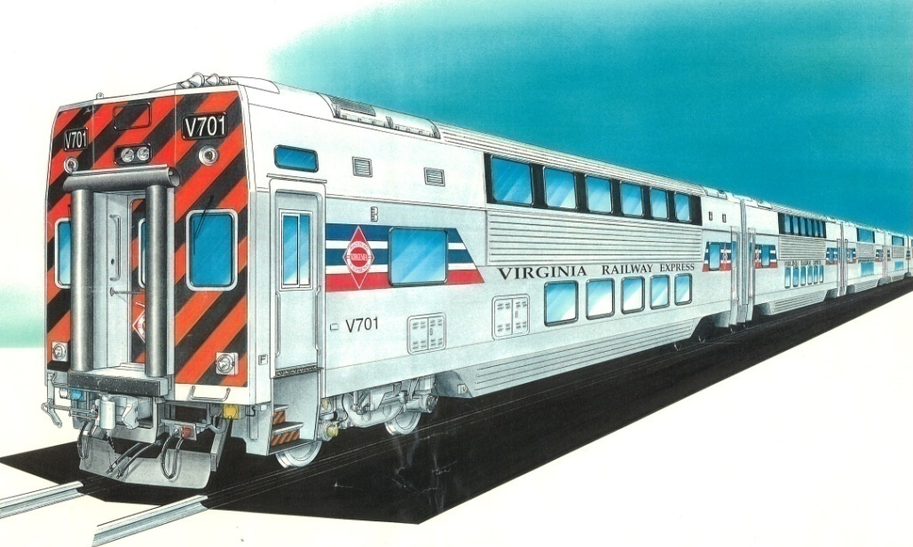
Corridor Infrastructure Improvements
1991
To avoid the retirement of 11.5 miles of track north of Manassas, VRE agrees to pay Norfolk Southern $150,000 annually
To allow VRE to operate bi-level rail cars, an agreement is reached with Amtrak to share in the cost of enlarging the First Street Tunnel under the U.S. Capitol.
1995
* Source: Texas Transportation Institute, Virginia Railway Express Congestion Relief Contribution; 2014

Slide 46
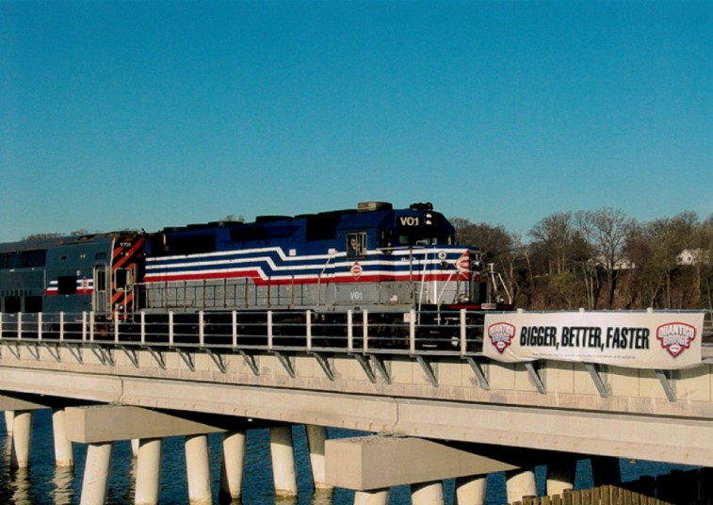
Corridor Infrastructure Improvements
CSX agrees to permit $10 million of state-funded improvements to the AF interlocking near Telegraph Road in Alexandria, plus upgrades to signals north to RW interlocking, and a third mainline track north of Slater’s Lane
1999
VRE completes its largest project to date, a new Quantico Bridge, to provide a double mainline crossing over Quantico Creek and greatly improve operational efficiency.
2007
* Source: Texas Transportation Institute, Virginia Railway Express Congestion Relief Contribution; 2014

Slide 47
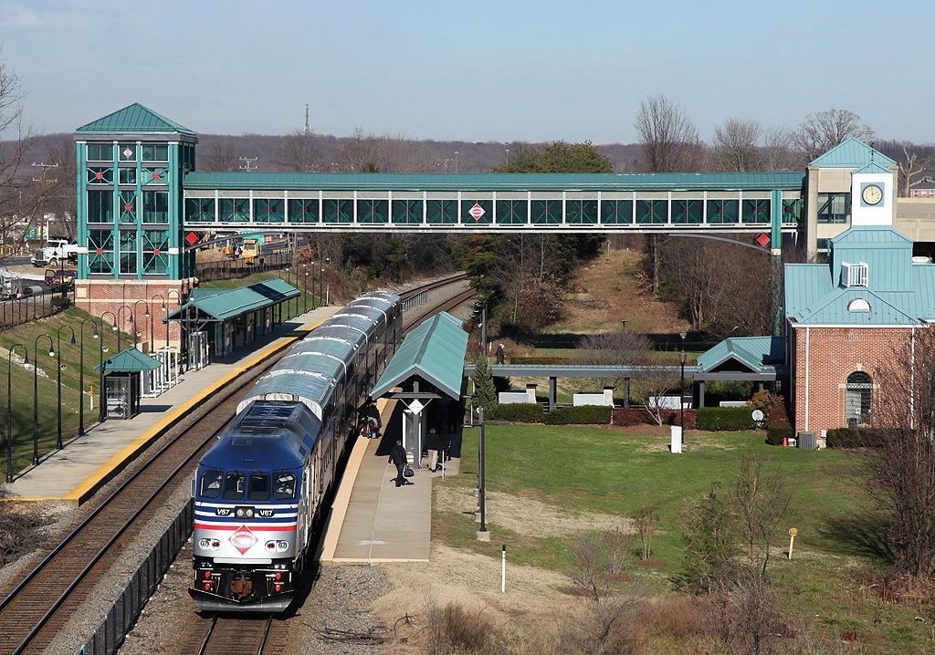
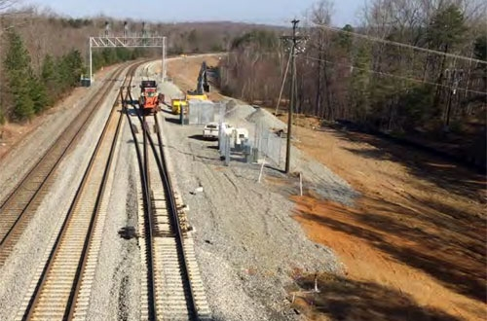
Corridor Infrastructure Improvements
VRE constructs a west platform at its Woodbridge station. The $3.9 million project includes an overhead pedestrian bridge connecting the second platform to the existing parking garage.
2011
VRE constructs 2.5 miles of third track on the CSX right of way from the VRE Crossroads Yard to Hamilton. The project includes a longer yard lead to accommodate the VRE Spotsylvania station.
2015
* Source: Texas Transportation Institute, Virginia Railway Express Congestion Relief Contribution; 2014

Slide 48
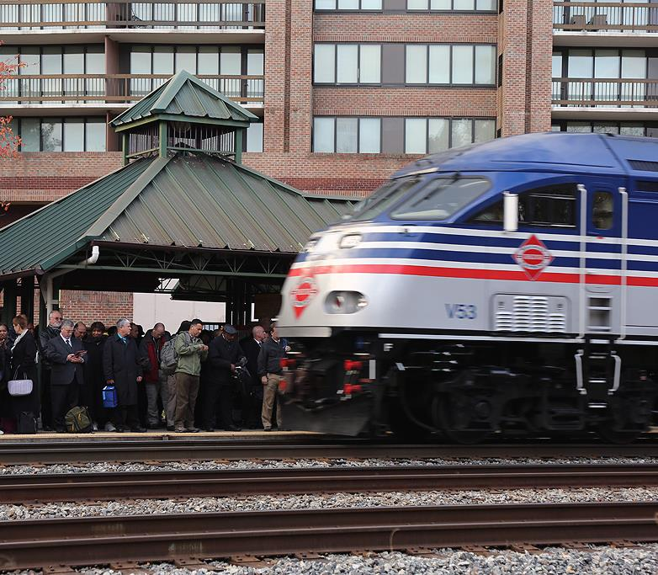
What VRE Is Known For
Safe and Healthy Operations
High Customer Satisfaction
Quality Service
Reliable Service
Strong Partnerships
* Source: Texas Transportation Institute, Virginia Railway Express Congestion Relief Contribution; 2014

Slide 49
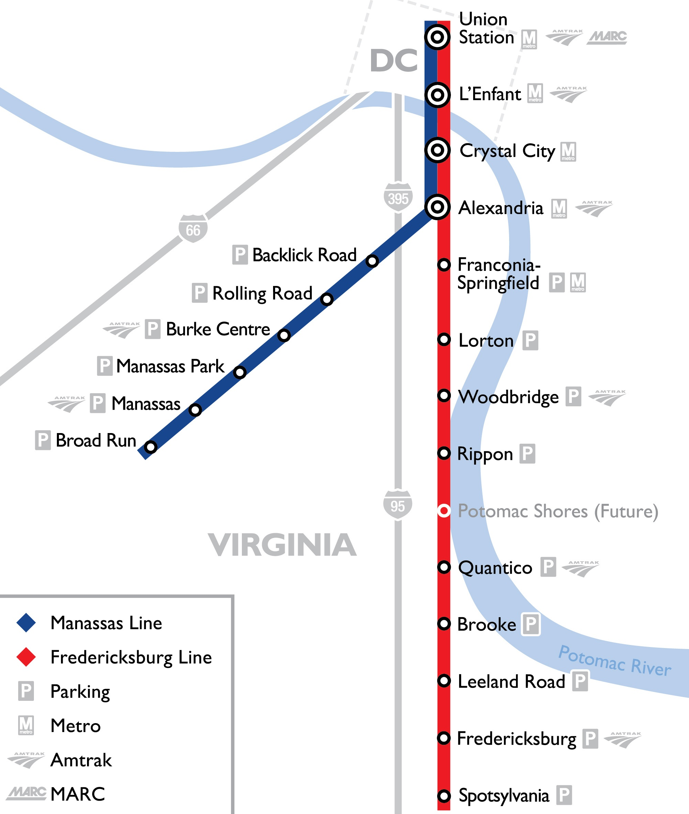
Operations
Service (Pre-Pandemic)
82 route miles of leased track
2 lines
  Fredericksburg
16 trains daily on each line
19 stations
5 stations connect to Metrorail
Staff
50+ at headquarters/warehouse
140+ contracted employees
  Operations (Keolis)
  Station upkeep (Fresh Air)
Manassas
Maintenance (Keolis)
* Source: Texas Transportation Institute, Virginia Railway Express Congestion Relief Contribution; 2014

Slide 50
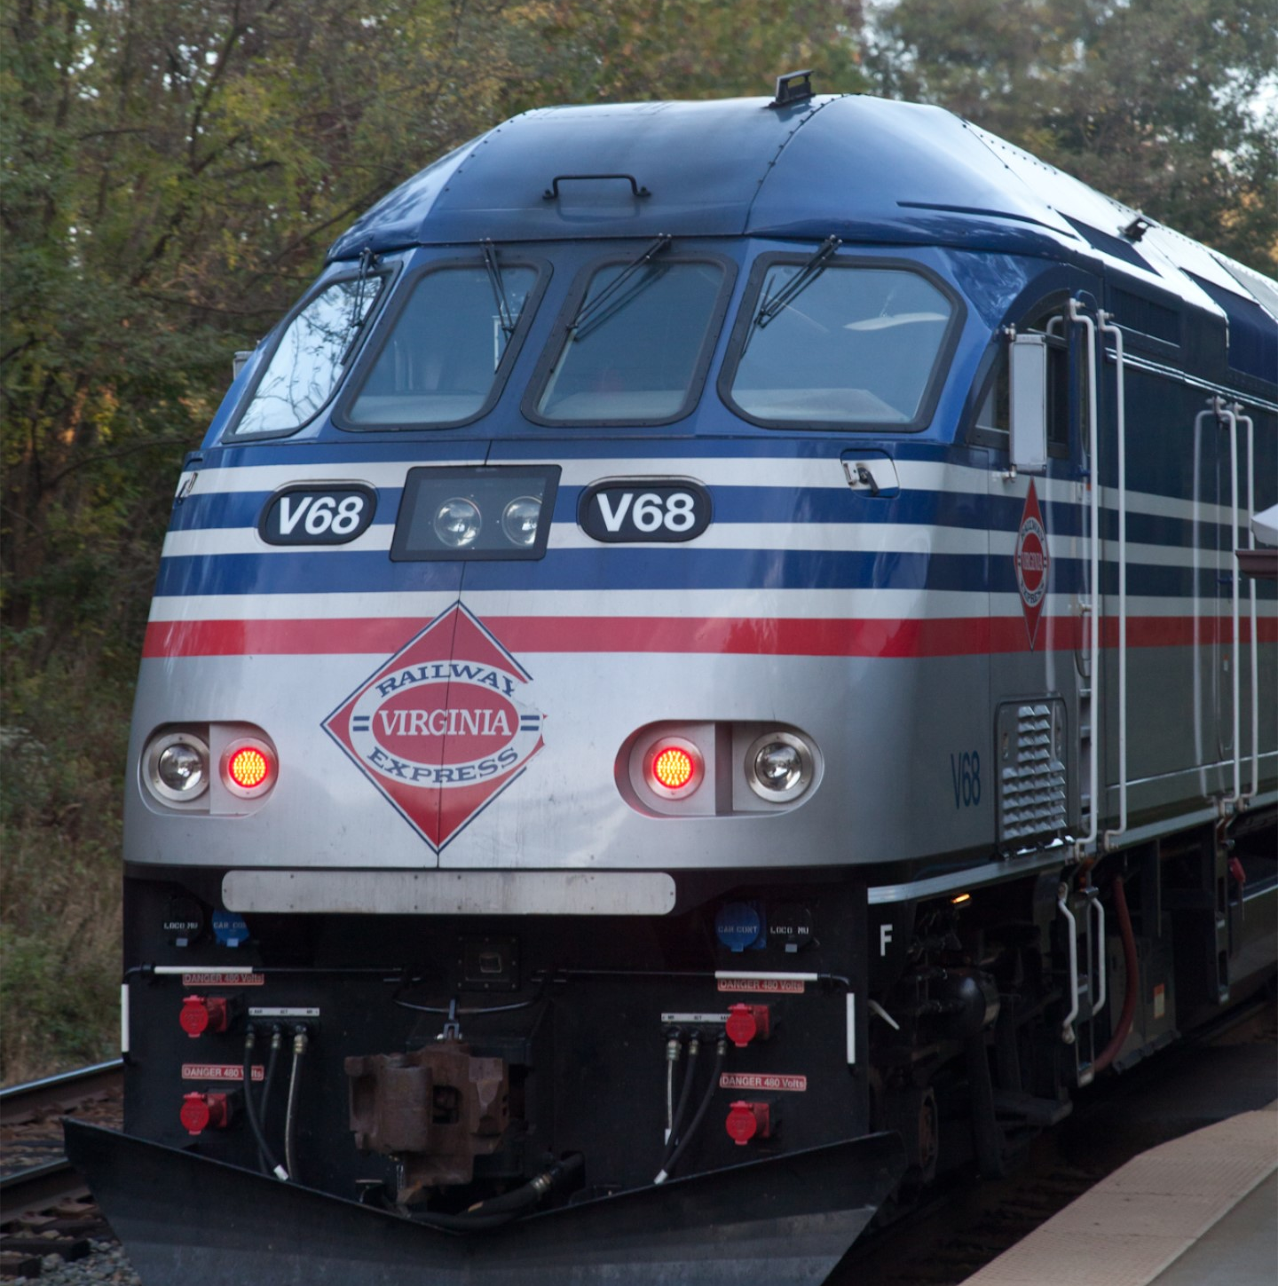
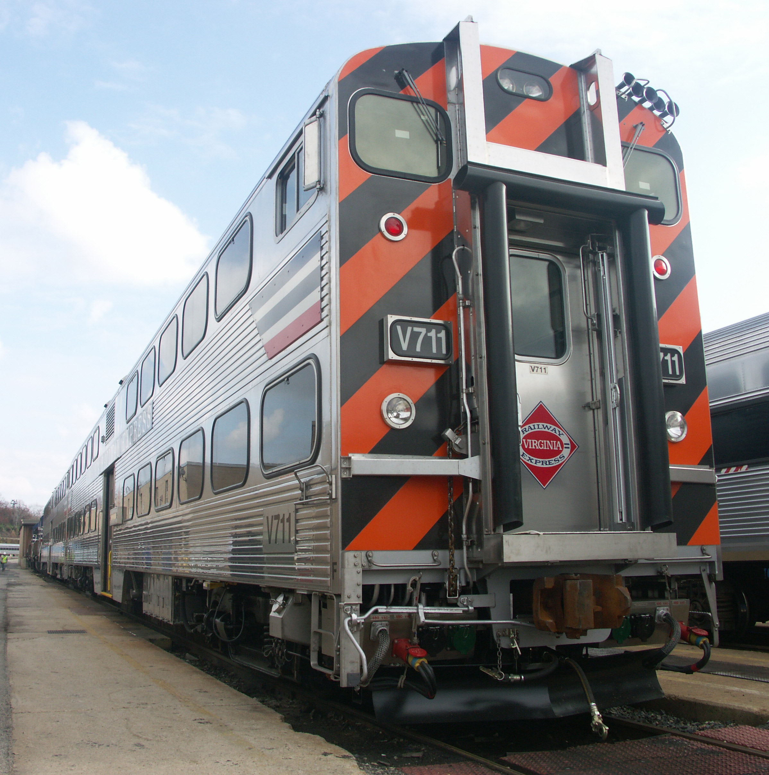
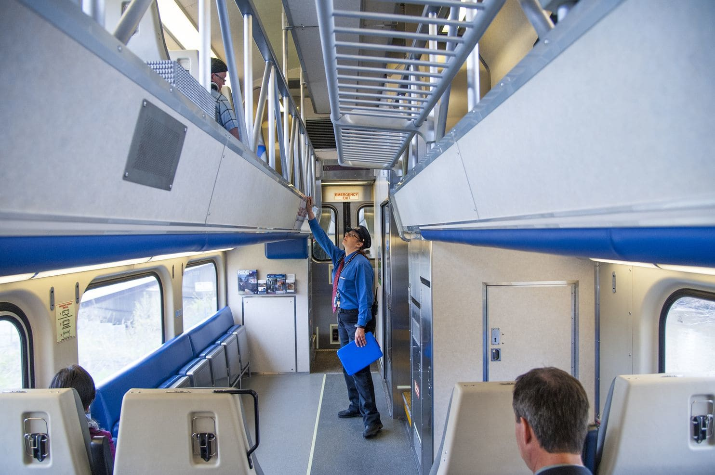
Equipment
49 Gallery IV
trailers with restrooms
(132 seats)
30 Gallery IV
trailers without restrooms
(144 seats)
20 MP36 diesel-electric
locomotives
21 Gallery IV cab cars
(123 seats)
* Source: Texas Transportation Institute, Virginia Railway Express Congestion Relief Contribution; 2014

Slide 51
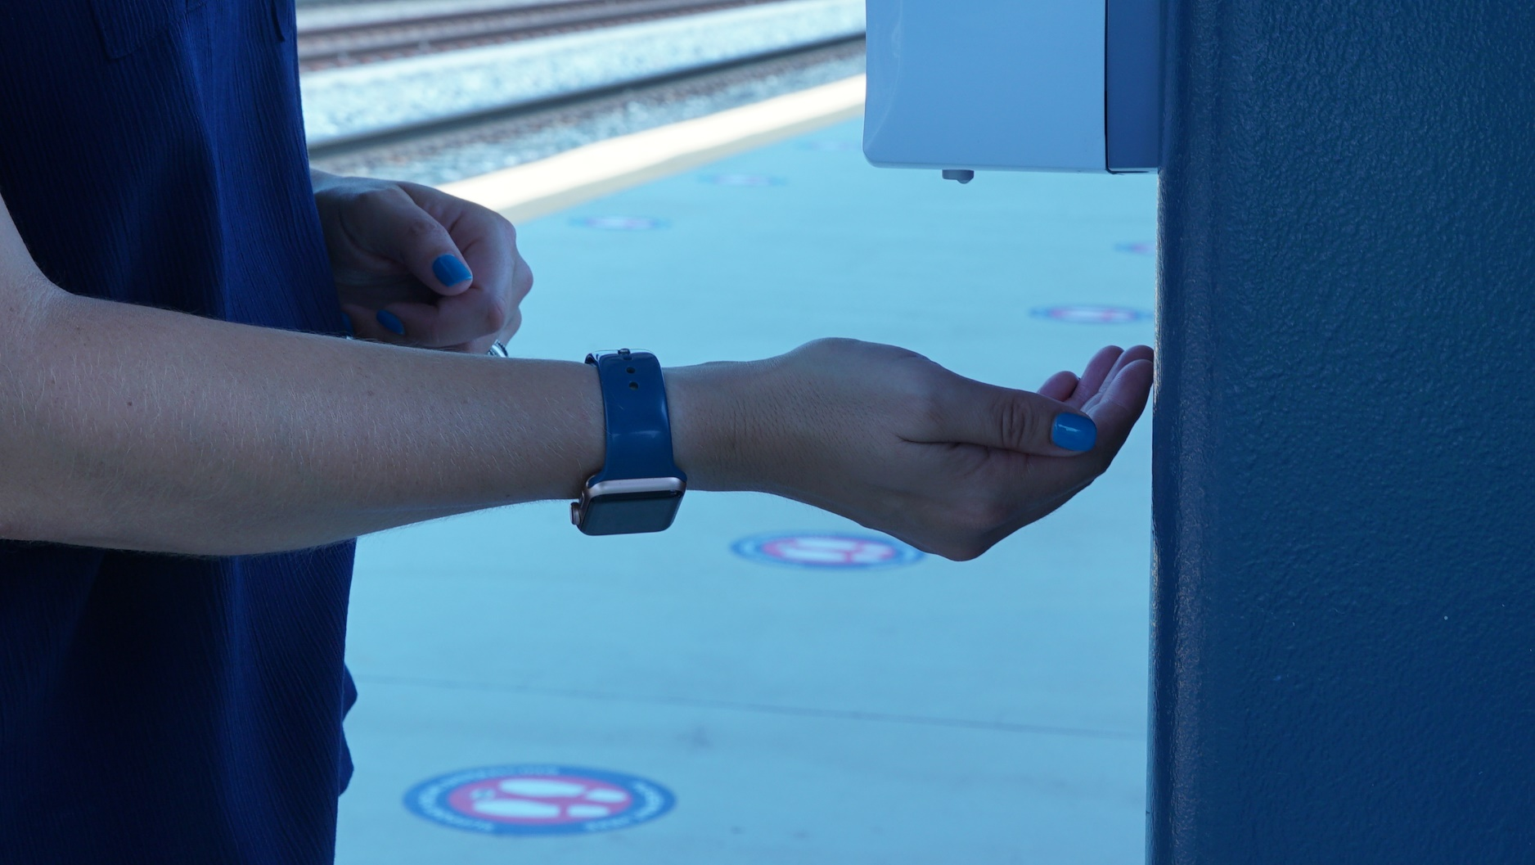
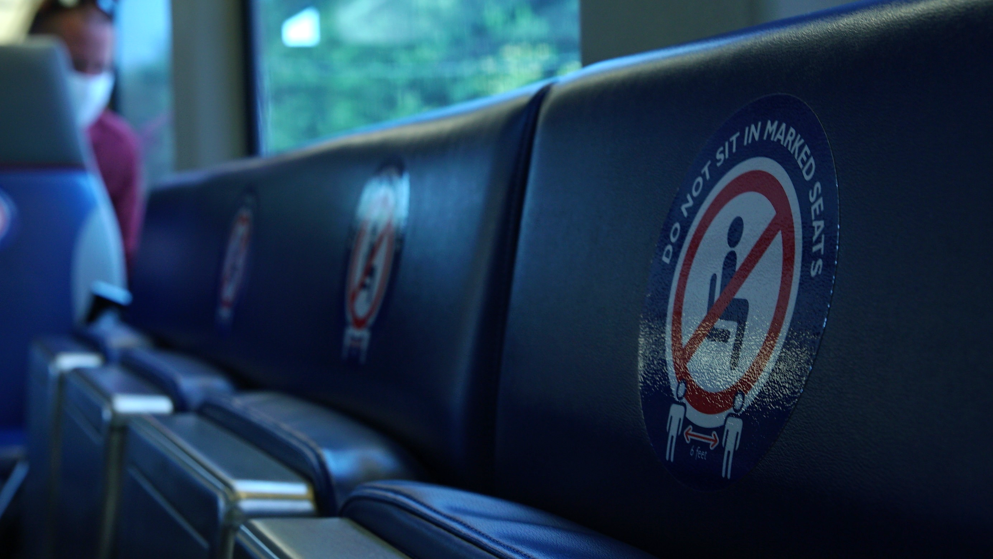

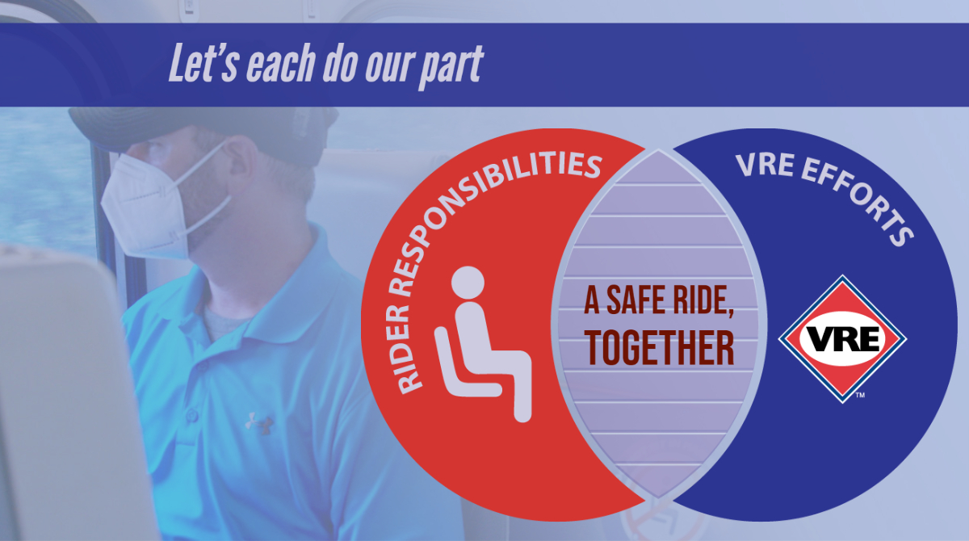
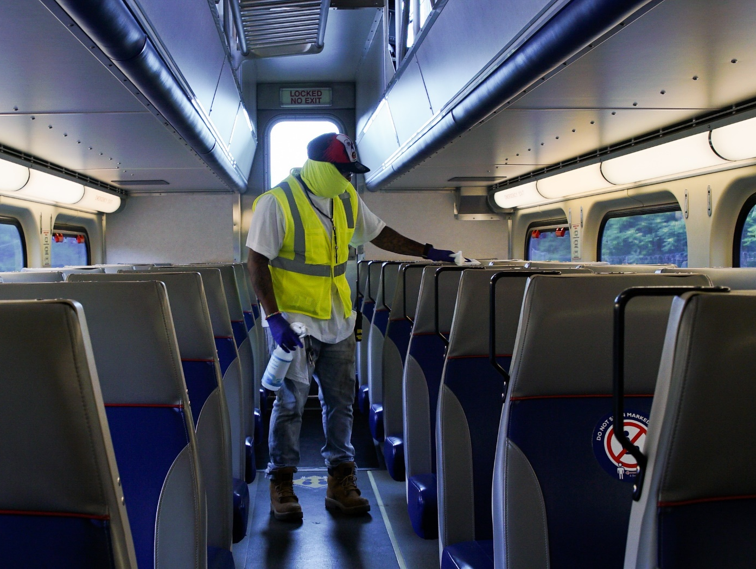
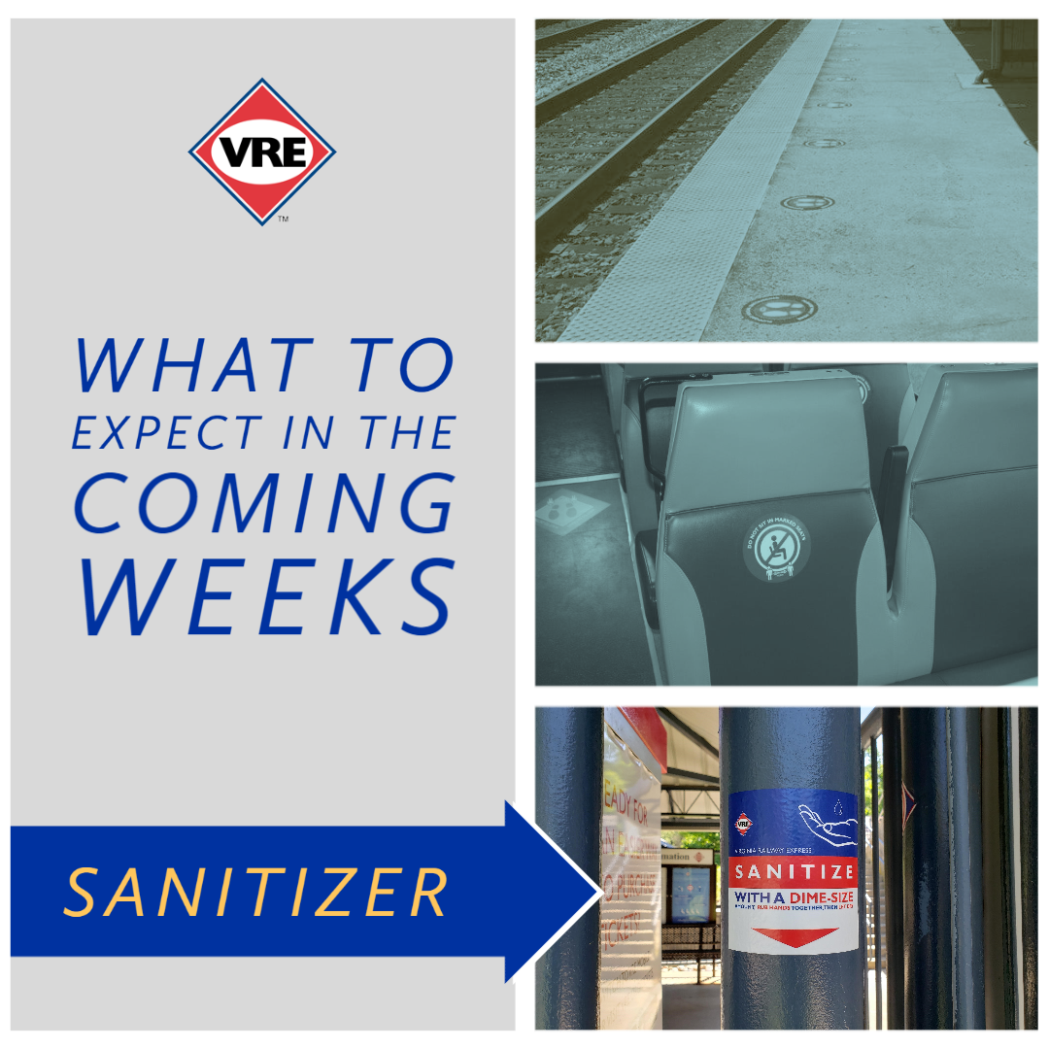

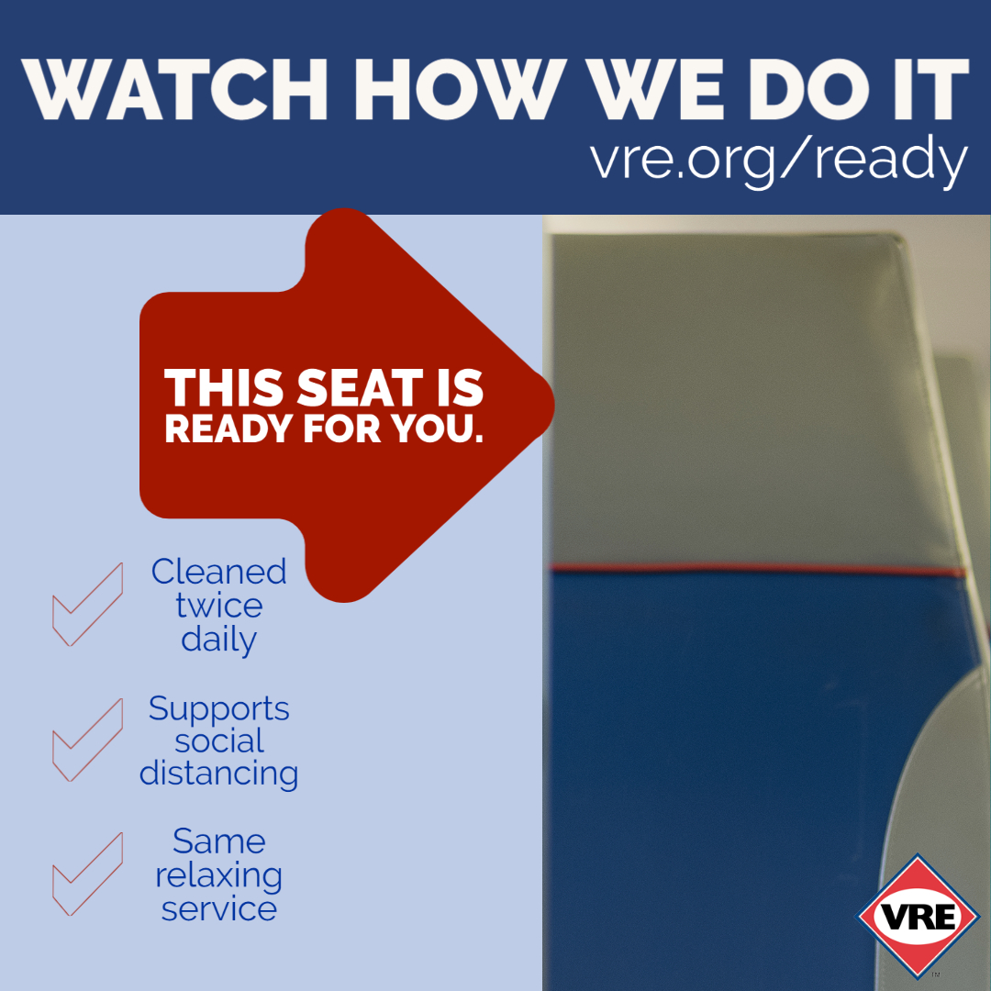
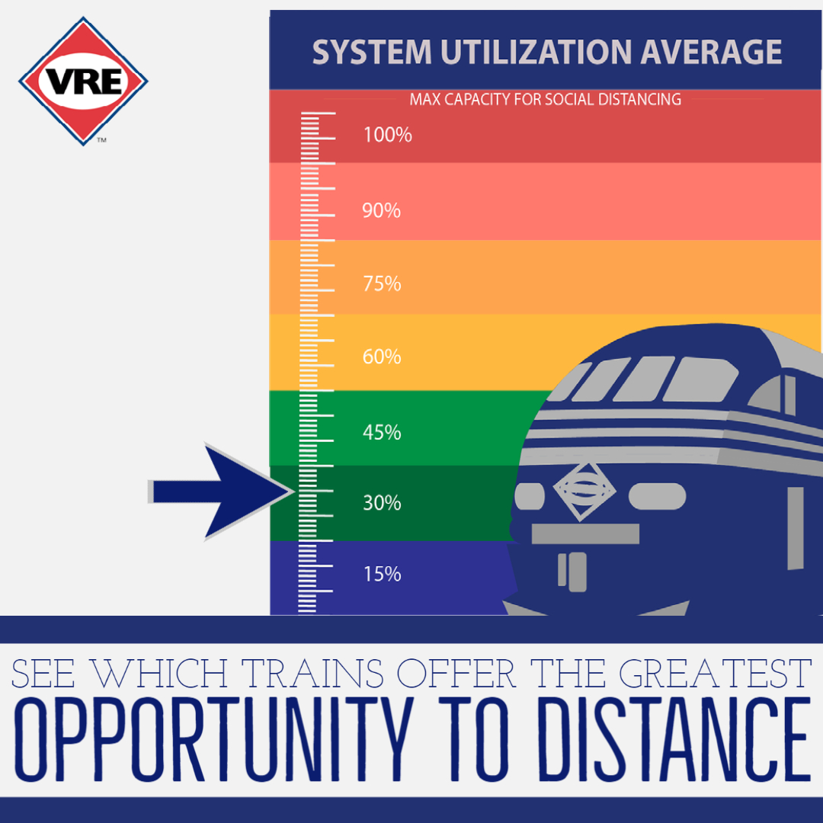
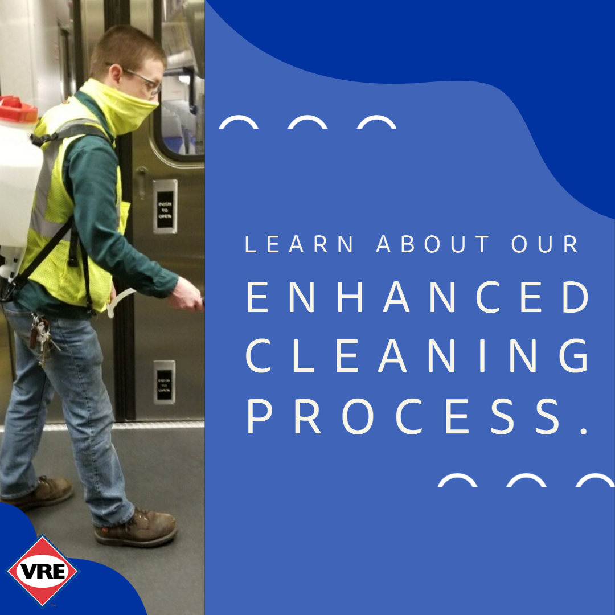
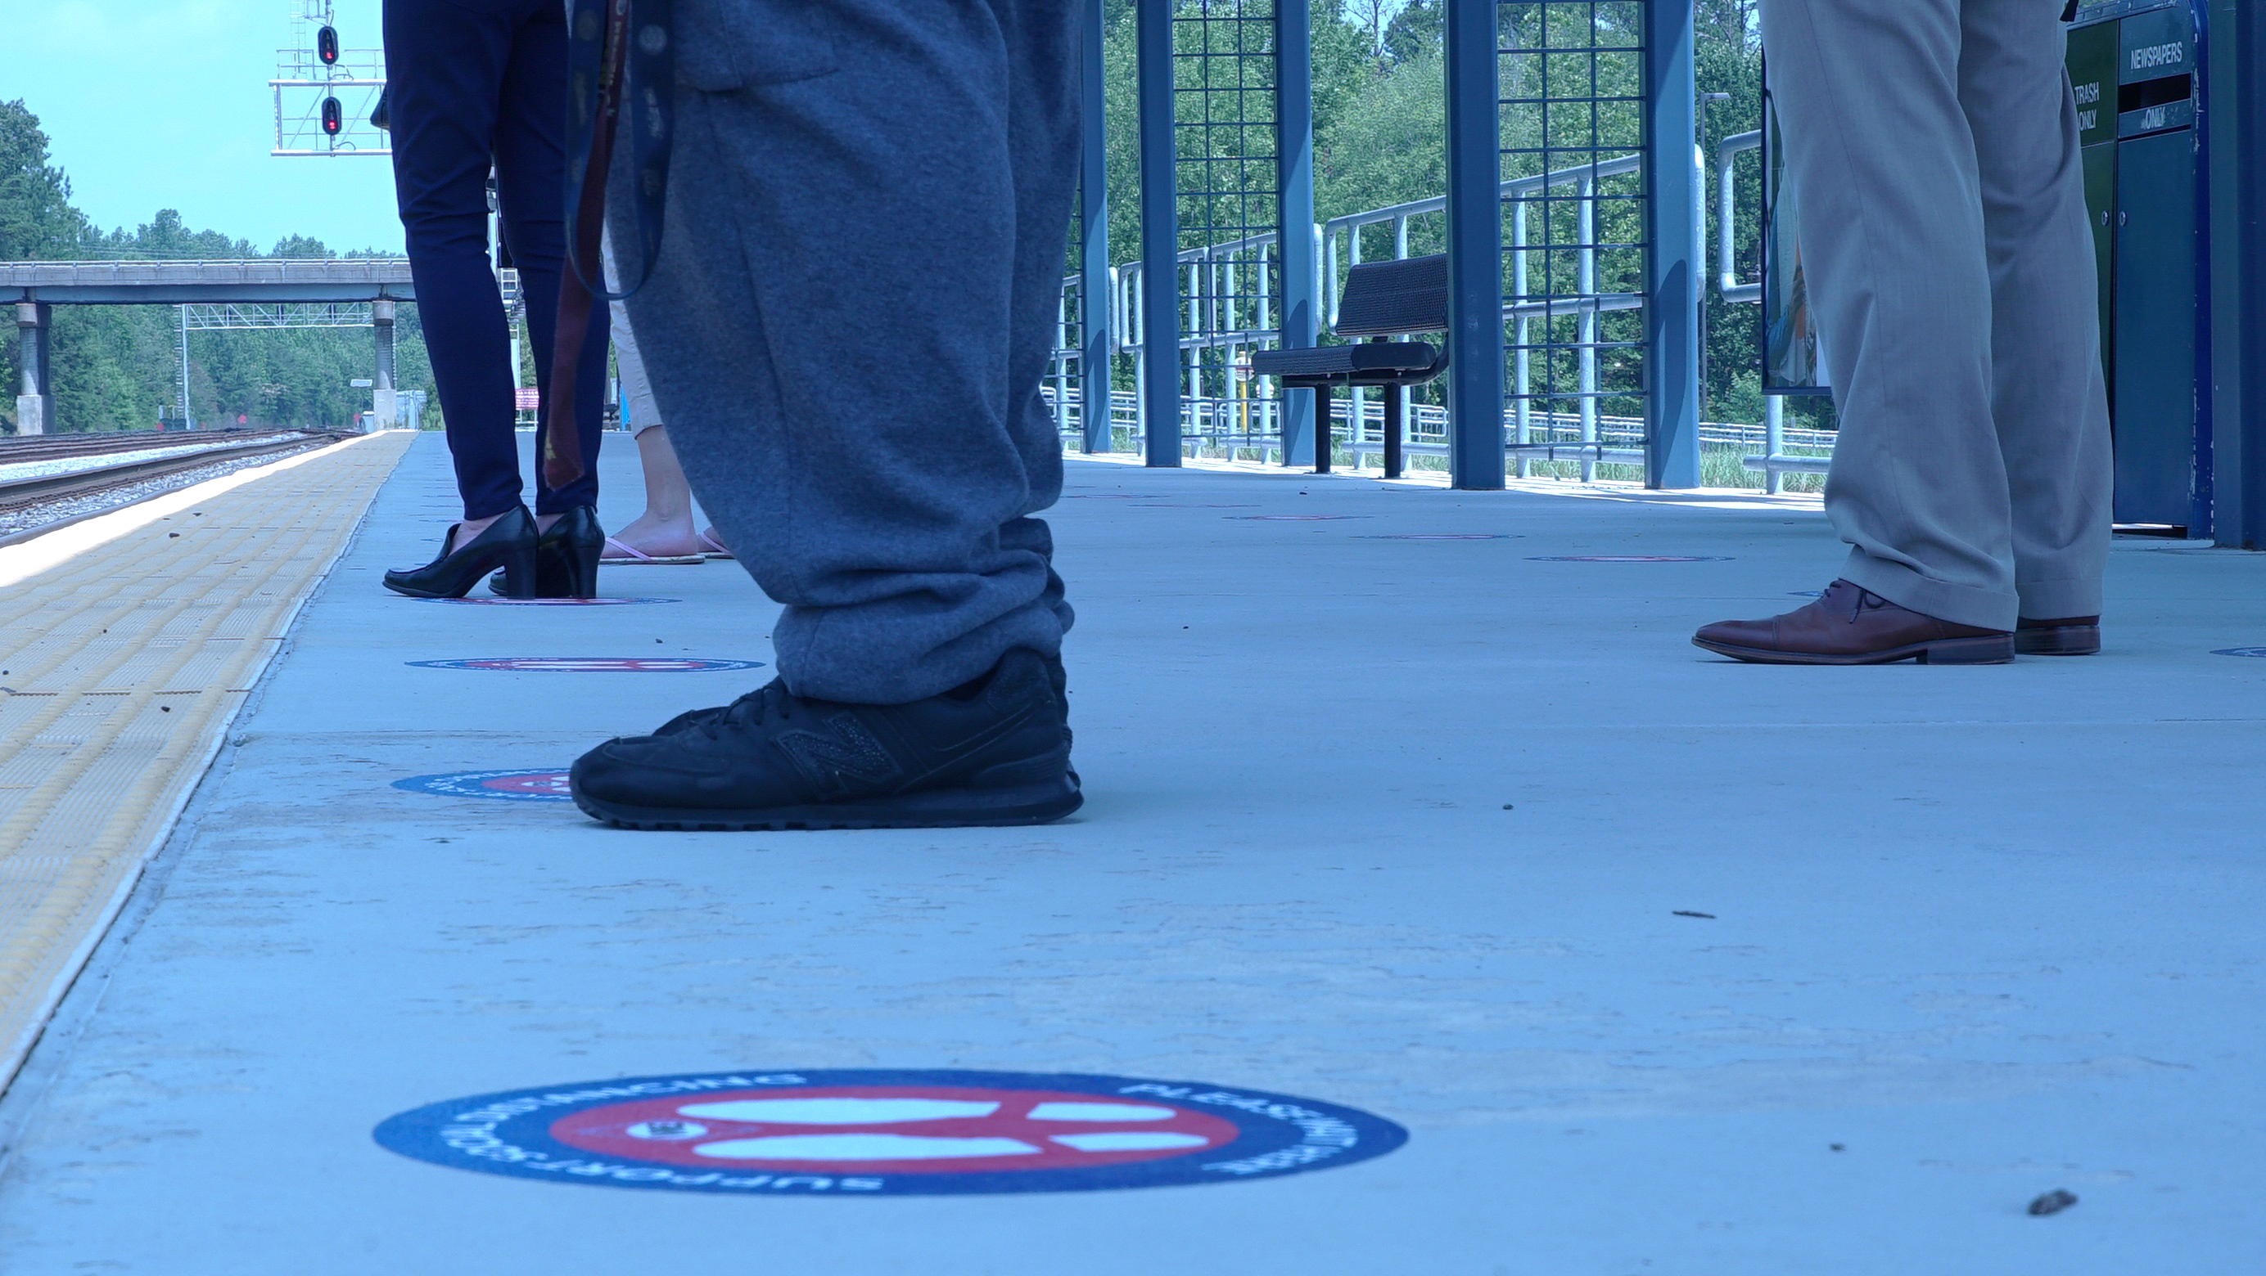
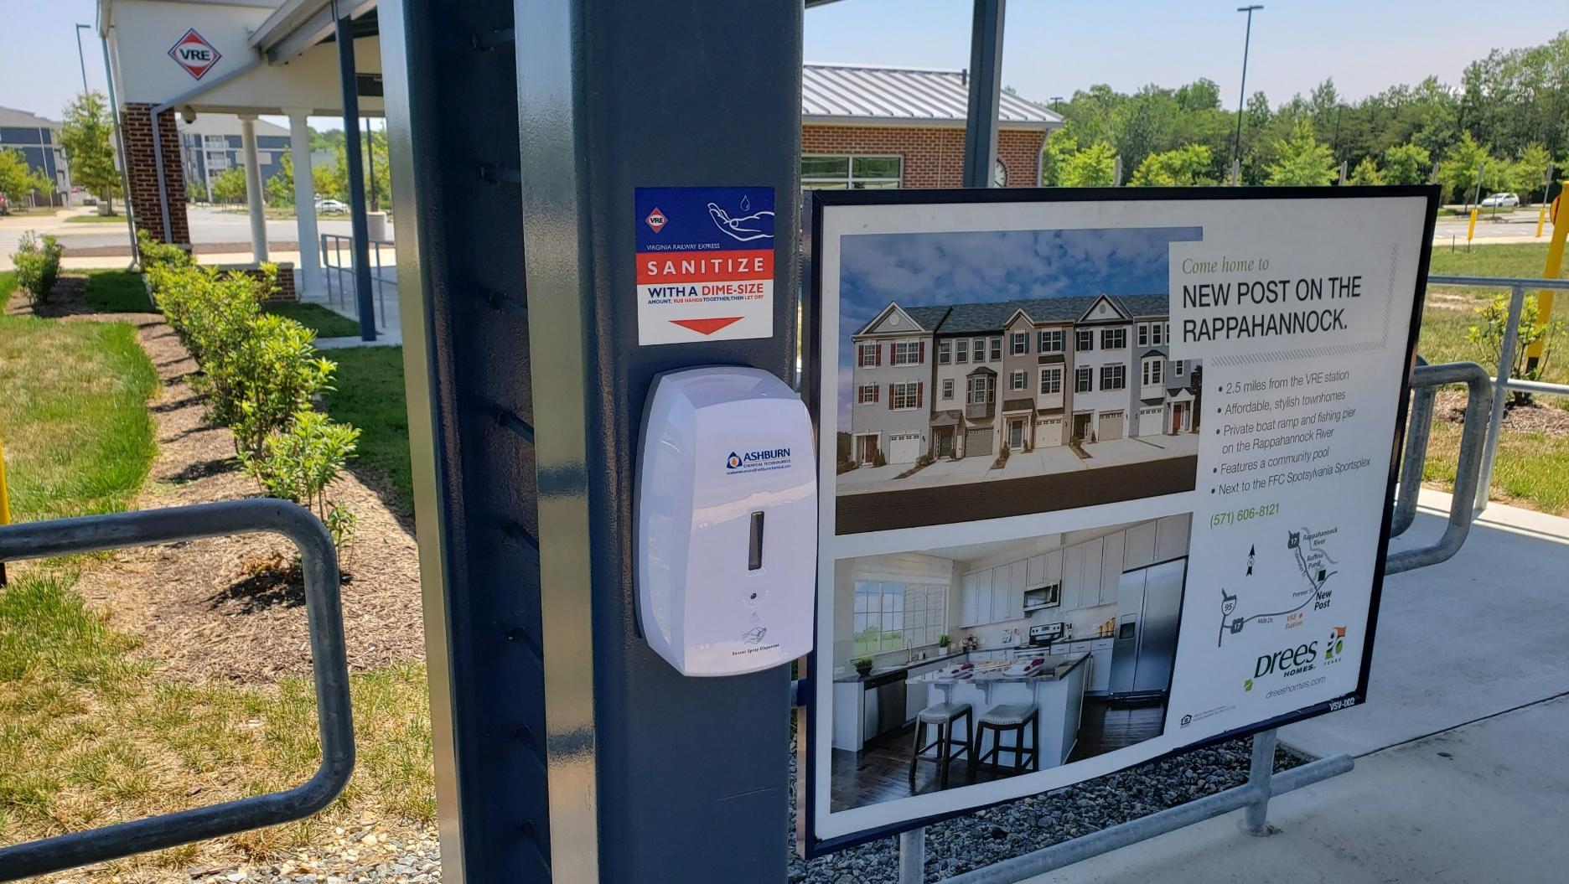
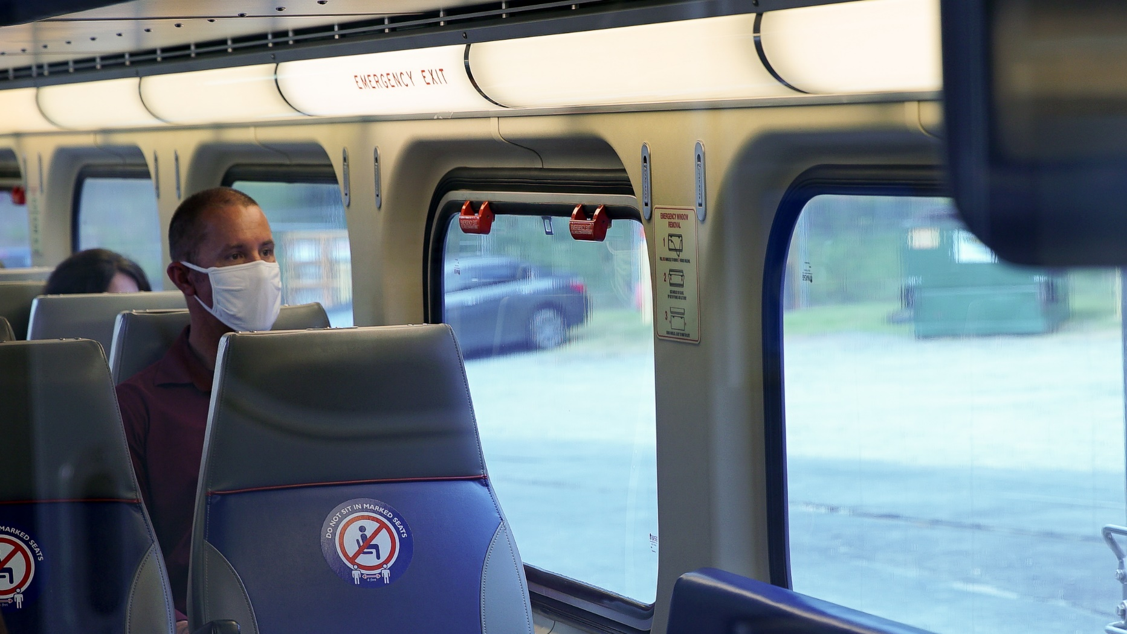
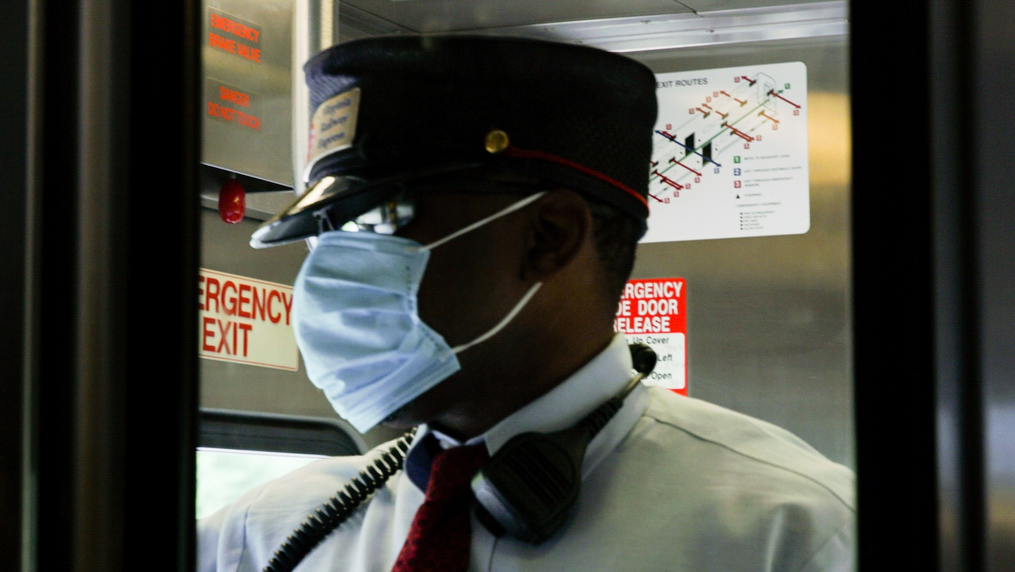
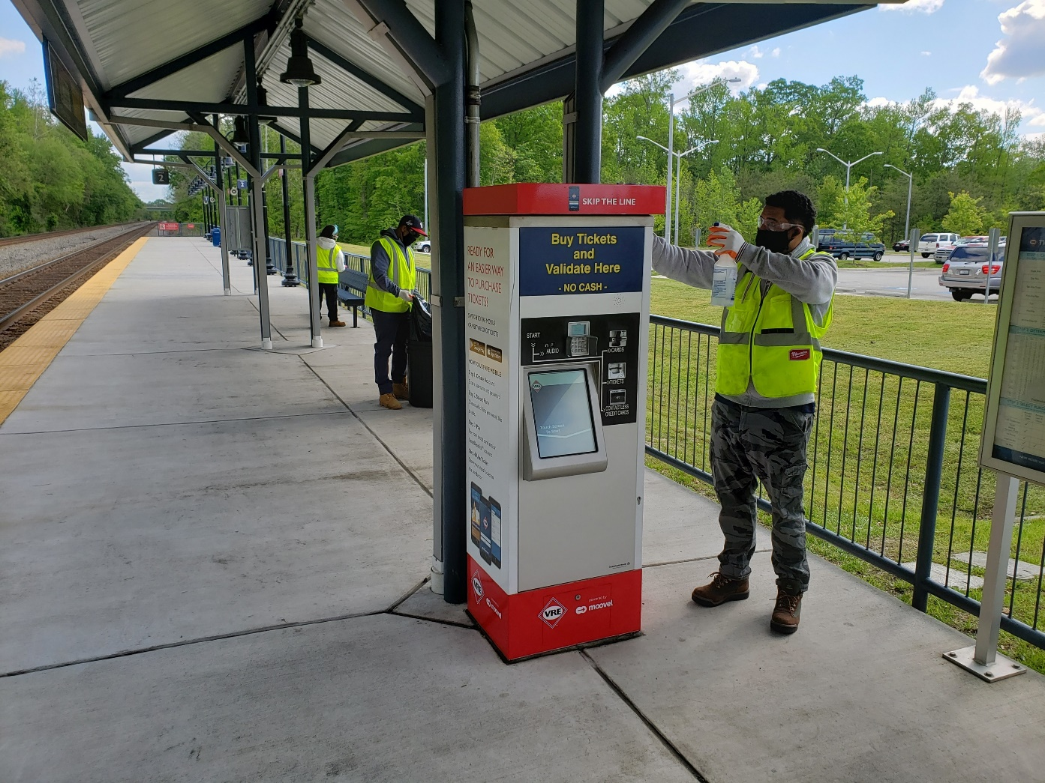
VRE COVID-19 Response
* Source: Texas Transportation Institute, Virginia Railway Express Congestion Relief Contribution; 2014

Slide 52
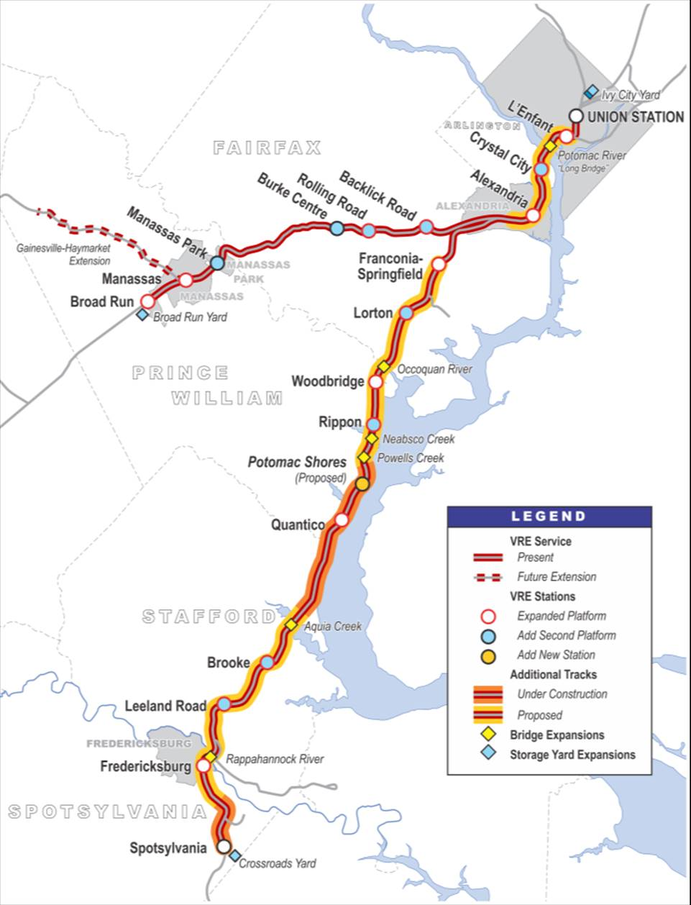
VRE’s Future
As a partner with the commonwealth in improving mobility options in the region, VRE looks forward to working with the Virginia Passenger Rail Authority in implementing Virginia’s visionary $3.7 billion Transforming Rail in Virginia program.
* Source: Texas Transportation Institute, Virginia Railway Express Congestion Relief Contribution; 2014

Slide 53
Break & Closed Session
VPRA Board Meeting will resume at 1:30pm after Closed Session

Slide 54
Draft Personnel Policy
Jeremy Latimer, Director of Rail Programs – DRPT

Slide 55
Priority Hires
Executive Director
Chief Financial Officer
Human Resources Director
Procurement Officer
“The Board shall employ an Executive Director of the Authority…”
CFO to oversee finances currently managed by DRPT.
Human Resources Director to begin hiring VPRA Staff.
Procurement Officer to utilize Authority powers to advance projects.

Slide 56
Attracting the Right Work Force
Benefits
Stability
Flexibility
Accountability
VRS
Education
PTO
Code of Conduct
EAP
Additional Leave
Protection
Equality
Performance
COI
Telework
Alternative Schedules

Slide 57
Employee Manual Development
Reference Documents:
VPRA Employee Manual
VPA | DHRM | VA 529
Consultation:
OAG | VDOT | DHRM
Result:

Slide 58
Major Components
Compensation
Benefits
Employee Relations
Employment
Safety
Classification
Hiring
Termination
Payment
Overtime
Hours of Work
Leave
HealthCare
Retirement
Wellness
Communication
Discrimination/Harassment
Disciplinary Procedures
Conduct
Automobile Usage
Work Incidents
Preventing Workplace Violence
Other
Media
Waste/Fraud/Abuse
Pandemic
State of Emergency
Conflict of Interest

Slide 59
VPRA Administrative Items
Steve Pittard, Chief Financial Officer – DRPT

Slide 60
Public Comment

Slide 61
Live Public Comment
If you would like to provide comment:
Please raise your hand in the participant panel
If you are calling in, press *3 to Raise Hand and press *6 to unmute yourself
We will unmute you when it’s your turn to speak
  Please mute all other devices to avoid audio interference
You will have 3 minutes to share your comments
Share comment offline: drptpr@drpt.Virginia.gov
3
30 sec left
1
2

Slide 62
Live Public Comment
If you would like to provide comment:
Please raise your hand in the participant panel
If you are calling in, press *3 to Raise Hand and press *6 to unmute yourself
We will unmute you when it’s your turn to speak
  Please mute all other devices to avoid audio interference
You will have 3 minutes to share your comments
Share comment offline: drptpr@drpt.Virginia.gov
3
30 sec left
1
2

Slide 63
Action Item
Assignment of VPRA Board Committees

Slide 64
Resolution for Committee Assignments
Finance and Audit Committee | Executive Director Search Committee | Governance Committee
Chair: Mr. Hossein Sadid | Chair: Mr. Wick Moorman | Chair: Ms. Cynthia Moses-Nedd
Mr. James Spore | Ms. Sharon Bulova | Mr. Jay Fissette
Ms. Patricia Doersch | Mr. Victor Cardwell | Mr. Rod Hall
Ms. Deborah Painter | Mr. Rod Hall | Ms. Mariia Zimmerman
 | Ms. Deborah Painter | Mr. Paul Nichols

