Slide 1
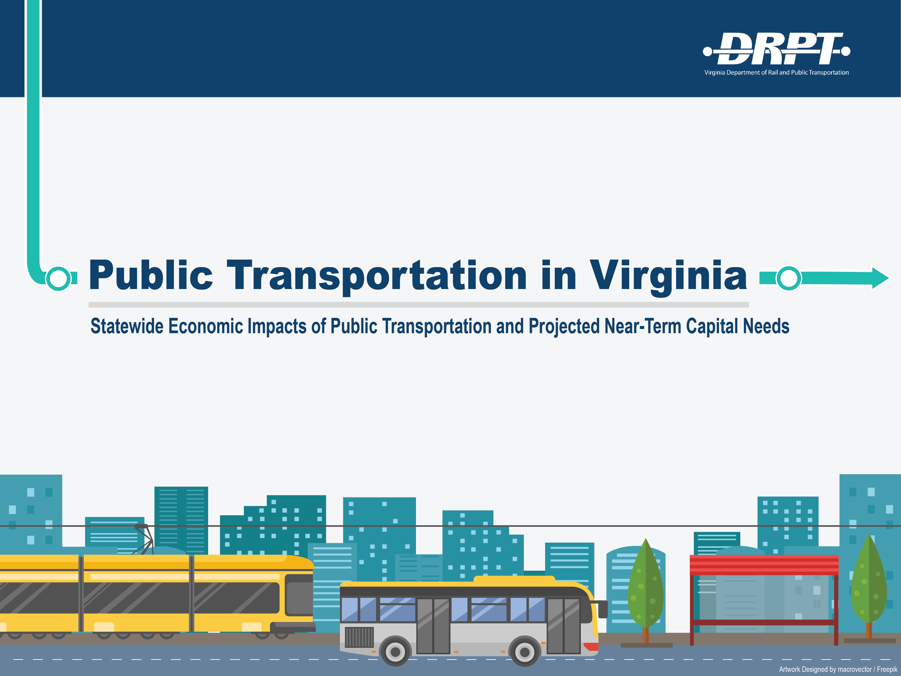

Slide 2
MERIT Transit Reforms Implemented
Capital Program Prioritization
  Methodology implemented with capital project funding in FY20
Performance Based Operating Assistance
  Transition Formula/Transition Assistance in FY20
Transit Strategic Plans
  Pilots nearing completion, several others underway
Special Programs updated using the MERIT methodology
  Demonstration, Technical Assistance, Transportation Demand Management, Senior/Human Service

Slide 3
Major Studies/Initiatives Completed
Virginia Breeze Intercity Bus Expansion Study
  Two routes identified for expansion, service to begin in Spring/Summer 2020
Coordinated Human Service Mobility Plan
  Identified priority areas for improvement in human service transportation
Integrated Mobility Plan
  Autonomous Bus and Autonomous Shuttle projects underway
Battery Electric Transit Buses
Economic Impacts of Transit
Transit Capital Needs Assessment

Slide 4

Transit Ridership in Virginia
Forty-one agencies provide transit services in urban, suburban, and rural communities throughout Virginia. Ridership in many parts of the state is growing for the first time in 5 years, in contrast with national trends. In 2019, transit accounted for:
172 Million
1 Billion
Annual Riders
Annual Passenger Miles Travelled
470,000
2.7 Million
Daily Riders
Daily Passenger Miles Travelled

Slide 5
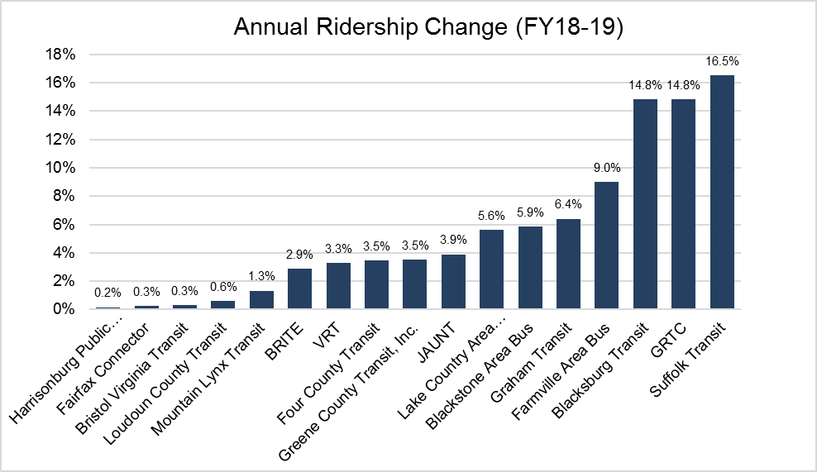
Ridership Trends

Slide 6




Economic Impacts of Transit
The presence of transit as a travel option in communities throughout Virginia has a large annual impact on the economy of the state:
Transit Supports:
Those Jobs Create:
28,940
$1.9 Billion
Jobs Statewide
In Labor Income
Generating:
And Brings Back:
$3.5 Billion
$607 Million
In Gross State Product
In Tax Revenues
Every dollar of public investment in transit generates $2.91 in economic activity statewide.

Slide 7
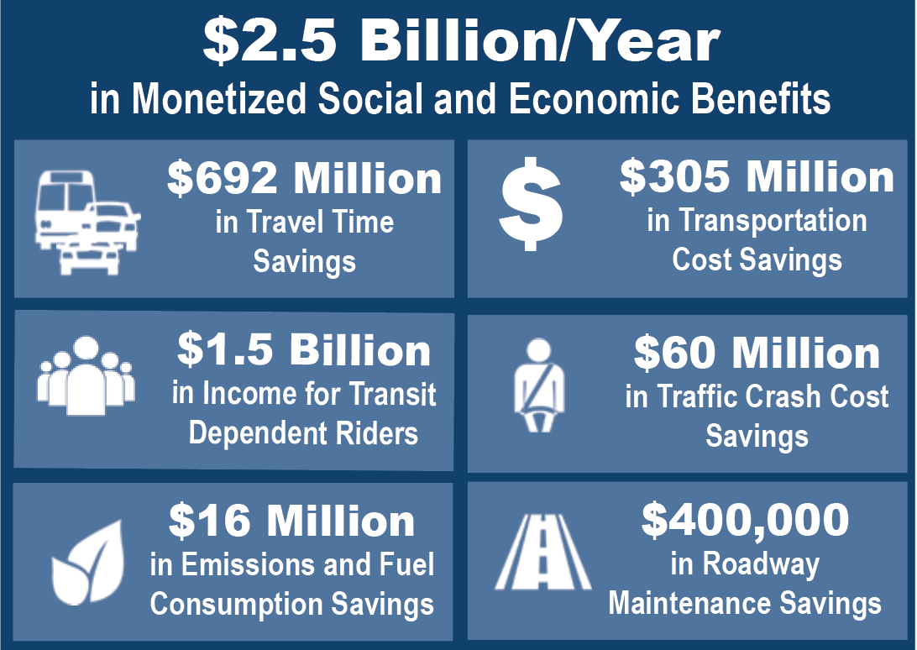
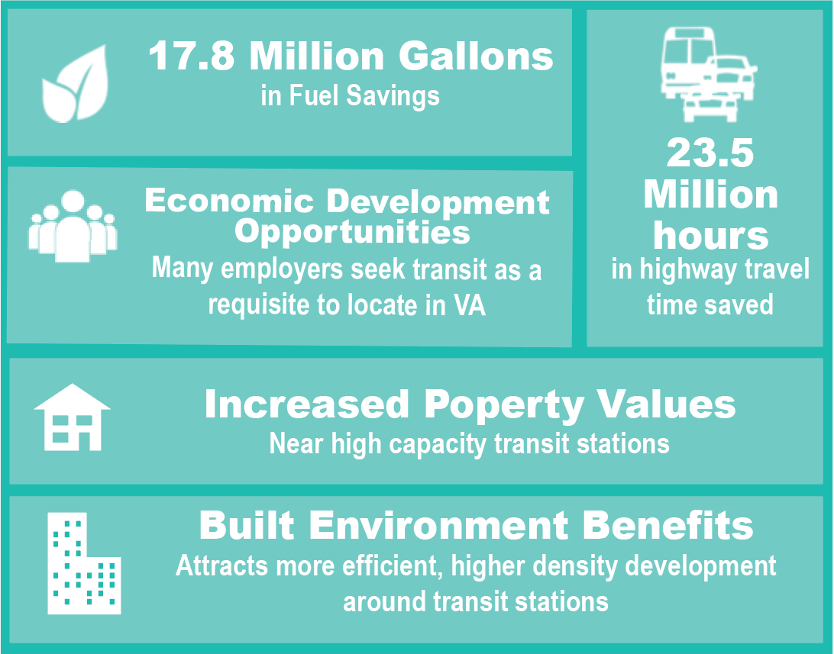
Economic Impacts of Transit
The presence of transit also brings an impressive amount of additional monetized and qualitative social and economic benefits annually:

Slide 8
Capital Needs - Fall 2019 Update
Each Fiscal Year, transit agencies submit a 5-year capital budget that is included in the Six Year Improvement Program
  Includes projected capital expenses with federal, state, and local shares
Fall 2019 Update: In order to improve the accuracy of these capital budget projects, DRPT staff engaged transit agencies throughout the state to:
  Account for recent changes in the use of the capital program – WMATA, SMART SCALE, Toll Revenues
  Reassess revenues – major de-obligated balances allocated, capital bonds programmed to projects
  Identify those “projects that will realistically be implemented” over the next 5 years with greater scrutiny and accuracy
Moving forward, Transit Strategic Plans will provide better forecasts of needs to support improved capital forecasts.

Slide 9
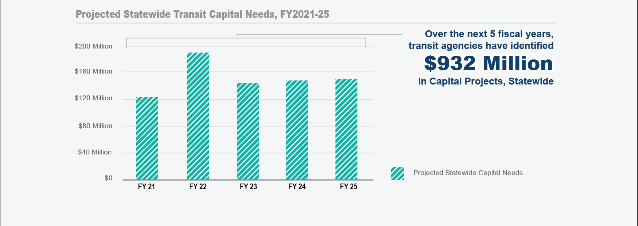
Statewide Capital Needs
Continued capital investment is needed to ensure that Virginia transit agencies have sufficient funds to replace aging assets when needed and expand services where appropriate.
NOTE: Capital Needs for Washington Metropolitan Area Transit Authority (WMATA) are not included

Slide 10
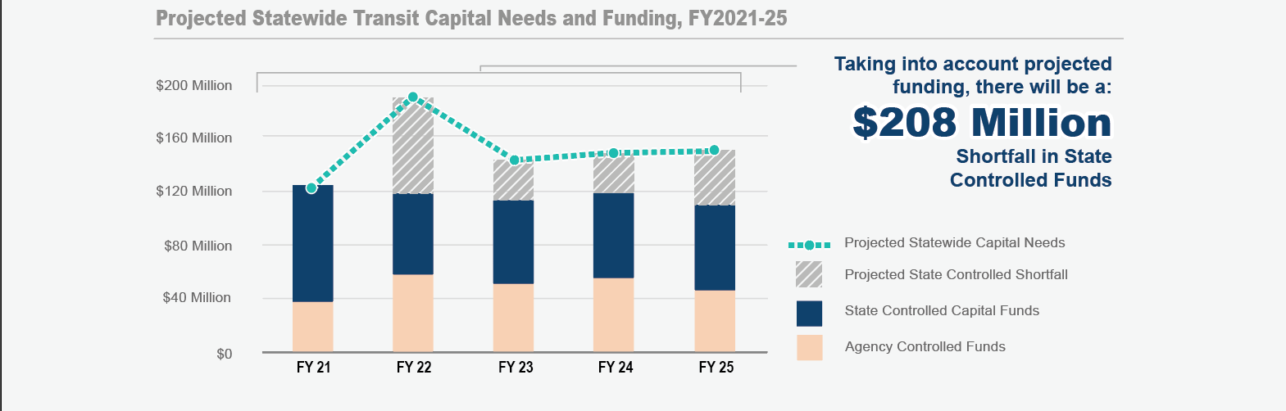
Statewide Capital Needs
However, state controlled capital funds are projected to fall short of the needs that statewide agencies have identified.
NOTE: Capital Needs for Washington Metropolitan Area Transit Authority (WMATA) are not included

Slide 11
Statewide Capital Needs
To make up for the anticipated $208 Million shortfall in statewide capital funds…
The state will need:
$42 Million per Year
in Additional Capital Revenues

Slide 12
Without Additional Resources
Identified needs are primarily for State of Good Repair (SGR)
Limits on the use of federal funding
Prioritization can be used to direct timing of funding, but the backlog of unfunded needs will increase over time
Limited resources can be redirected from major expansion projects (20% of available funds) to SGR, but will not fulfill SGR needs
More financial burden will fall on localities, which will need to provide additional resources or cut services

