Slide 1

Rail Industrial Access Program Application Briefing
Phoenix Packaging Operations, LLC
Pulaski County
Commonwealth Transportation Board, January 14, 2020
Jeremy Latimer, Director of Rail Transportation Programs
Department of Rail and Public Transportation

Slide 2
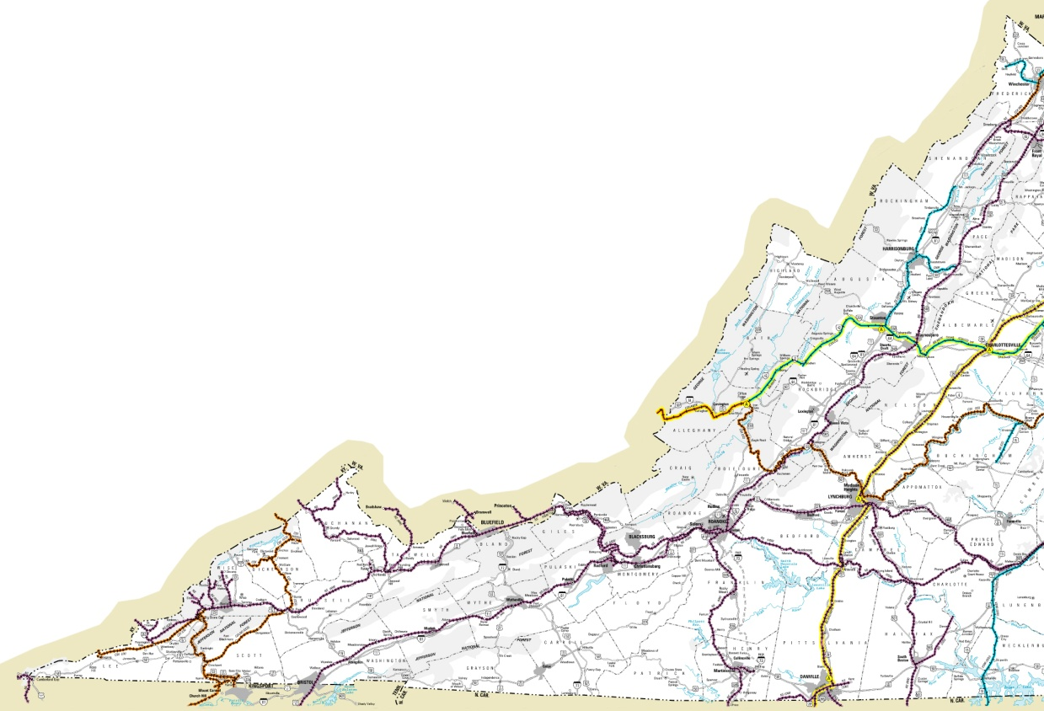
Project Location
Phoenix Packaging Operations, LLC, Pulaski County
Phoenix Packaging Operations site
Pulaski County

Slide 3
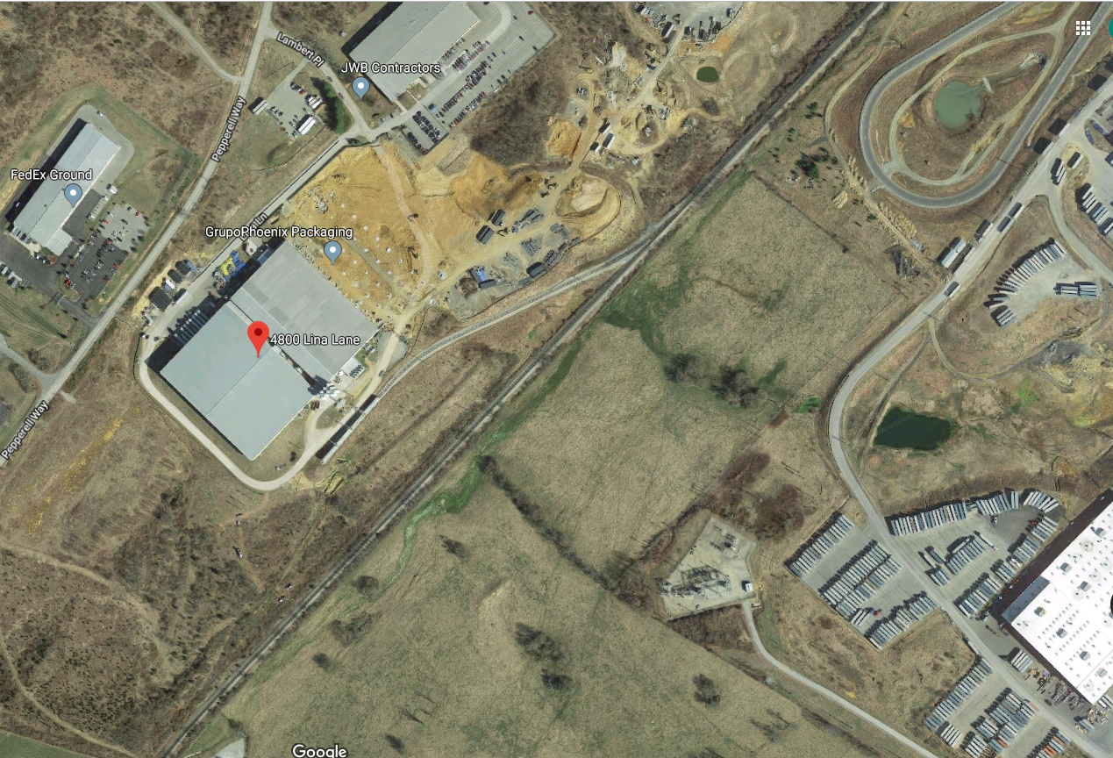
Project Location
NS Mainline
Extension of existing spur
New spur

Slide 4
Project Overview and Background
Coordination with VEDP on the expansion since 2017.
Phoenix has been working with the Port on incentives to increase shipments from the Port of Virginia.
Phoenix Packaging Operations, LLC designs and manufactures rigid packaging solutions for commercial food and beverages, healthcare, and disposable consumer product industries.
The expansion will serve national and international markets and will ship through the Port of Virginia.
The facility will be served by Norfolk Southern Railroad.

Slide 5
Application Summary
Application for $450,000 in Rail Industrial Access Funds
  Applicant will provide minimum 30% match
  $30M Total Estimated Capital Expenditure
  ($30M package of loans and incentives)
    New 176,000 square foot warehouse and manufacturing facility
    Build new rail spur
    Extend a former RIA grant funded rail spur
      $450,000 Grant in 2012
      Met requirements of 2012 grant – 154 annual carloads
    Approximately $1M Rail Project Cost
    Capital expenditures outside the $450,000 grant will be paid for by the applicant as well as other state and local grants and incentives
  Cost overruns responsibility of applicant

Slide 6
Public Benefits
Public Benefits:
  Additional 296 railcars annual commitment (currently 164 carloads per year)
    1,006 additional trucks off of Virginia highways annually (currently 558 annual trucks)
  145 new jobs associated with expansion
  96% of shipping will be by rail
Application scores 69 of 100 points
  Minimum 50 points needed to be recommended to CTB
Minimum threshold will be 10 new carloads

Slide 7
Questions?
Jeremy Latimer
jeremy.latimer@drpt.Virginia.gov
www.drpt.Virginia.gov
804-786-4440

