Slide 1

Transforming Rail in Virginia
Commonwealth Transportation Board, January 14, 2020
Michael McLaughlin, Chief of Rail Transportation Department of Rail and Public Transportation

Slide 2
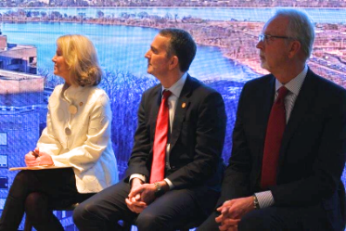
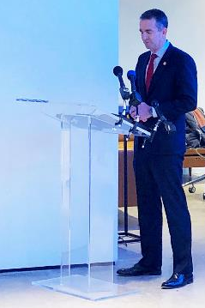
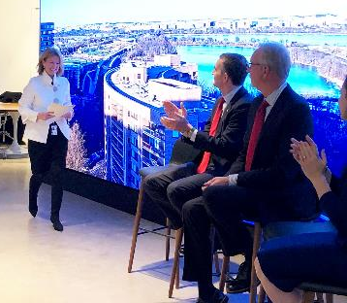
12/19/2019 Virginia-CSX Announcement
On December 19th Governor Northam and Secretary Valentine announced a $3.7B landmark deal with CSX that includes purchase of over:
350 miles of railroad right of way
225 miles of track

Slide 3
Major Features
Acquisition of ROW, track and passenger rights from CSX
Build-out of infrastructure in two phases
Completion of phases will result in additional VRE / Amtrak service
Path forward to full separation of freight and passenger service in future
Preservation of future rail corridors

Slide 4
Acquisition
  100+ miles of right of way and 39 miles of track from DC to Richmond along the “RF&P”
  30 miles of passenger rights from Richmond to Petersburg
  170+ miles of track on the Buckingham Branch from Doswell to Clifton Forge
  75 miles of abandoned track from Petersburg to Ridgeway, NC

Slide 5
Infrastructure – Long Bridge Corridor
  Construction of Long Bridge and 4th track in DC
  4th track in Arlington and Alexandria
  All passenger trains in VA travel through this corridor

Slide 6
Infrastructure – Franconia to Lorton
  3rd track from Franconia to Lorton
  Franconia-Springfield Bypass
Auto Train

Slide 7
Infrastructure – Six Sidings
  Sidings consist of a third track built adjacent to existing two tracks at the following locations:
  Potomac Creek
  Woodford - Milford
  Hanover
  Neabsco Creek - Woodbridge
  Aquia Creek
  Crossroads

Slide 8
Long Bridge
Approximately 1.5 mile corridor includes a new two-track bridge over the Potomac and fourth track in DC
Five additional structures over roadways and Washington Channel
Estimated cost: $1.9 Billion

Slide 9
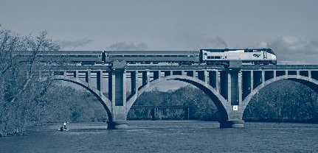

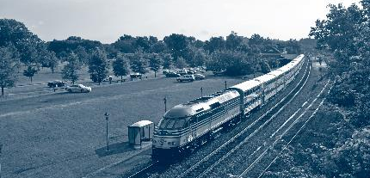

Service
  Provides Virginia with control and guaranteed VRE / Amtrak service
  Double state-supported Amtrak, with nearly hourly service from DC to Richmond
  Additional train to Norfolk with mid-day arrival/departure
  New round-trip train to Newport News
  Increase VRE service by 75% along the Fredericksburg line + new late night service offering
  Allows future ability to increase trains on the VRE Manassas Line

Slide 10
Amtrak Service Plan
6 additional round-trip trains connecting Virginia to the northeast by 2030

Slide 11
VRE Service Plan
5 additional round-trip VRE trains on the Fredericksburg Line by 2030
Includes late-night & weekend service

Slide 12
Next Steps
Finalize definitive agreements with CSX
    Conduct land survey and title work necessary for agreements
    Maintenance and operation agreement
    Transition Agreement
Develop service agreements with Amtrak and VRE
Refine financial plan and secure commitments from other state, Federal and local funding partners
Continue working with CSX and other stakeholders to advance rail projects in the corridor
    Alexandria / Arlington 4th Track Design
    Long Bridge Preliminary Engineering

Slide 13
Questions?
Michael McLaughlin
www.drpt.Virginia.gov
www.drpt.virginia.gov/rail/transforming-rail-in-virginia/

