Slide 1
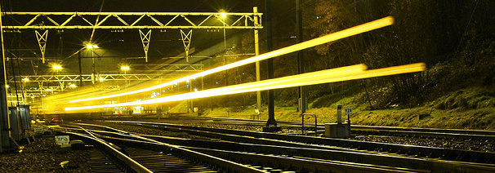
Federal Railroad Administration
Rail – Moving America Forward
VA-NC Interstate High Speed Rail Compact Meeting
Richmond, VA
January 7, 2014

Slide 2
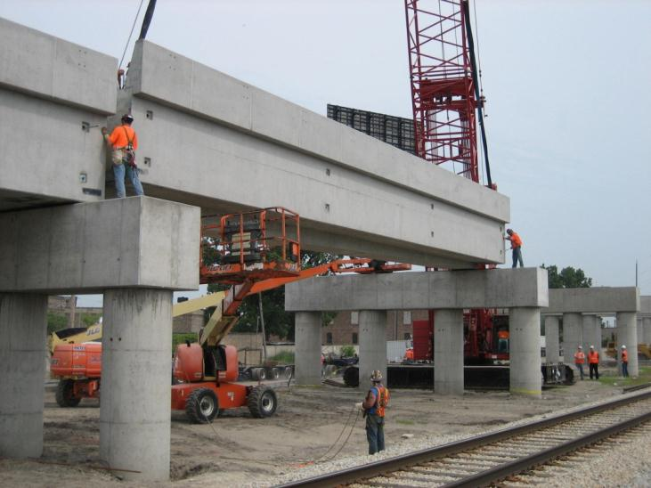
  Corey Hill, Director, Office of Passenger and Freight Programs, FRA
Federal Programs Update
Preparing for the Future
IL – Englewood Flyover under construction this summer
($126M HSIPR Project)

Slide 3
FRA Funding Highlights
$20
Billion in Grant and Loan Funding
99%
Of Grant Funding Obligated
10/16
Grant Programs Fully Obligated
52%
Of Obligated Funding Outlaid
$2.4
Billion Outlaid within Last Year

Slide 4
TIGER 2013 – Selected Rail Projects
$146
Million Selected
17
Projects Selected
16
States
Selection Highlights
Over 30% of TIGER 2013
funds rail
TIGER 2013 brings TIGER rail total to $800M in program history
582 applications from all
50 states
$9B in applications received for $474M in funding
Notes:
List of rail projects ($146 million):
State Street Station Expansion, Connecticut ($10 million award)
New Hampshire Northcoast Rail Corridor Improvements, New Hampshire, ($1.4 million award)
SEPTA-CSX Separation Project, Pennsylvania, ($10 million award)
Western Corridor Rail Rehabilitation, Vermont, ($9 million award)
South Florida Freight & Passenger Rail Enhancement, Florida, ($13.8 million award)
Oswego East Terminal Intermodal Connector Project, New York, ($1.5 million award)
Raleigh Union Station, North Carolina, ($10 million award)
Erick to Sayre Freight Railroad Rehabilitation, Oklahoma, ($1.8 million award)
Moving Central Texas, Texas, ($11.3 million award)
Springfield Rail Improvements, Illinois, ($14.4 million award)
White River Freight Railroad Bridge Replacement, Indiana, ($8.2 million award)
Kalamazoo to Dearborn Rail Improvements, Michigan, ($9.4 million award)
Port of Tucson: Container Export Rail Facility, Arizona, ($5 million award)
Pacific Surfliner Coastal Railway Bridges, California, ($14 million award)
Oklahoma Intermodal Transportation Hub, Oklahoma, ($13.6 million award)
Great Western Freight Improvement, Colorado, ($2.8 million award)
Tacoma Trestle Replacement, Washington, ($10 million award)

Slide 5
RRIF Update
33
Loans Issued
$1.7
Billion Obligated
12
Applications Under Review
Program Highlights
Investments in 26 states
72% of loans have been executed with Class II and III railroads
New pilot program to connect short lines to RRIF (Ohio RDC)
Program evaluation/improvements underway
Notes:
Applications under review: FRA is unable to comment on pending RRIF applications.

Slide 6
HSIPR Projects – Construction Underway
33
Construction Projects Underway
13
States
and DC
$2.4
Billion in Construction Initiated
Construction Highlights
Construction underway in all six key corridors (85% of funding)
Summer 2013 was the biggest construction season to date
80% of construction projects will be underway by Spring 2014
Project Status as of 12/18/2013
Notes:
HSIPR Projects – Construction Underway:
Piedmont Corridor 3rd & 4th Frequencies
Chicago to St. Louis HSR
Englewood Flyover
IL-Chicago-St. Louis Corridor Supplement SDP
Chicago to Detroit Corridor: Dearborn, MI Station
Chicago to Detroit Corridor: Troy, MI Station
Kalamazoo-Dearborn Service Development Program 2
Union Depot Multi-Modal Transit Hub
Union Station Access Improvements (Track 4)
Keystone Corridor Interlocking Improvements
Keystone Corridor: Grade Crossings
Kansas City to St Louis Corridor: Missouri Rail Crossing Safety Improvements
Kansas City to St Louis Corridor: Rail Bridge over Osage River
Crossing Signal Timing, Burlington Northern Santa Fe Fort Worth Sub
Cab Car Bicycle Storage (Rolling Stock)
Locomotive Emissions Upgrade (Rolling Stock)
Los Angeles to Fullerton Triple Track
San Onofre-San Diego PTC Implementation
Moorpark-San Onofre Signal and Communication System Improvements
Phase 1 HSR Program - PE/NEPA/CEQAs and Fresno/Bakersfield HSR Design/Build
New Haven to Hartford to Springfield Corridor
New Haven - Springfield Track Construction
New Haven-Springfield
Knowledge Corridor - Restore Vermonter
Adirondack Corridor: Ballston Spa Capacity Improvements
Empire Corridor South: Grade Crossing Improvements - CSXT Milepost 75 to 143
Portland - Seattle - Vancouver
Port of Vancouver Grade Separation
Tukwila Station Construction

Slide 7
HSIPR Projects – Completed Projects
39
Projects
Completed
19
States
$333
Million Completed
Project Completion Highlights
Completed Projects:
  19 Construction Projects
  9 Corridor Plans
  6 State Rail Plans
  5 Engineering Designs
Project Status as of 12/18/2013
Notes:
HSIPR Projects – Completed Projects:
Ottumwa Sub Crossover Improvements
Chicago to St. Louis Double Track NEPA
Wadsworth Bridge Replacement
Chicago to Detroit Corridor: Battle Creek, MI Station
Milwaukee to Madison High-Speed Rail
Chicago to Milwaukee Corridor: Milwaukee Station Platform
Chicago to Milwaukee Corridor: Truesdell Crossovers
Portal Bridge
Tampa to Orlando High-Speed Rail Express
Interstate Rail Passenger Network Compact
Macon to Jacksonville Feasibility Study
Lawrence: PE and FD for Station Improvements
Kansas Service Development Plan (SDP)
Missouri State Rail Plan
Kansas City to St Louis Corridor: Webster Universal Crossover
Oklahoma State Rail Plan
Oklahoma City Depot Control Signaling and Power Switch Installment
Capitol Corridor: South Terminal Station Improvement
Pacific Surfliner Corridor: MOW Spurs
Pacific Surfliner Corridor: Railroad Crossover Program
Capitol Corridor-YoloXover (Yolo West Crossover)
Capitol Corridor: Track Relocation
Pacific Surfliner Corridor: Strategic Assessment
California State Rail Plan
Colorado State Rail Plan
Nevada State Rail Plan
Downeaster Portland North Project
Empire Corridor West: Buffalo-Depew Station Improvement
Vermonter New England Central Railroad Route Improvements
Atlanta to Birmingham Feasibility Study
Idaho State Rail Plan
Pacific Northwest Corridor: Union Station Roof
King Street Station Rehabilitation

Slide 8
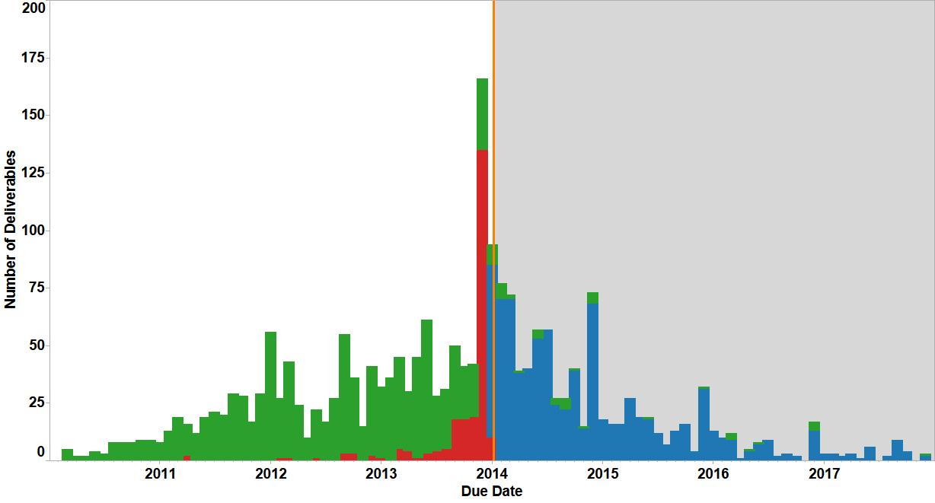
Keeping Projects On Schedule: Deliverable Submission
Deliverables Due to FRA by Month (2010-2017)
238
Overdue Deliverables
Deliverable Status
Overdue
Awaiting Document
Received
50%
Are for Construction
Deliverable Status as of 1/06/2014

Slide 9
Increased Monitoring, Increased Support
What We Heard
What We Did
  Need for additional guidance on FRA requirements and Federal regulations (from grantees and OIG)
  Published State Rail Plan guidance
  Offered webinars: Buy America, Invoicing, and Reporting
  Unforeseen funding obstacles
  Developed policies and procedures for alternative payment methods
  Delays resulting in changes to scope, schedule and budget
  Updated materials and guidance on amendments
Notes:
Common issues: schedule delays, issues with accurate and timely reporting, financial management or budget issues, questions on compliance with policies such as Buy America, and general project management issues.
These were also areas in which many grantees requested additional training or technical assistance.
In response to these findings, FRA has refined the process for amending a grant’s scope, schedule or budget, provided grantees with trainings on Reporting, Invoicing and Buy America compliance, and are planning to make additional trainings available in FY 2014. In addition, FRA monitoring identified significant findings where grantees had struggled with repeated schedule delays or compliance issues and allowed FRA to work closely with the grantees to resolve these issues and ensure the grant continues on schedule.

Slide 10
Monitoring and Technical Assistance Contract (MTAC)
Increased Oversight
Improved Technical Assistance
More frequent, higher-quality monitoring reviews
Offerings based on grantee feedback, monitoring, and industry needs
Improved understanding of unique project challenges
One-on-one technical support, webinars, workshops and conferences
MTAC
Program
Faster deliverable reviews
Technical guidance development

Slide 11
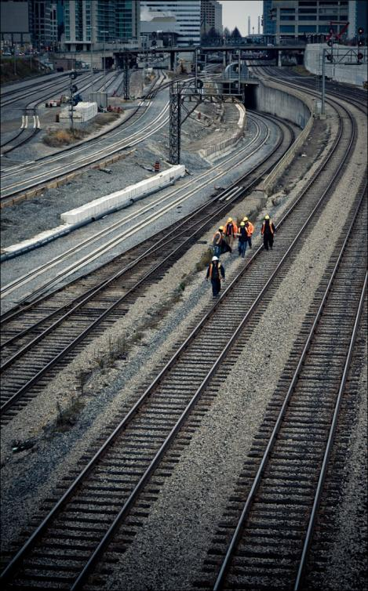
Rail Planning Pipeline Assessment
Identifying the next round of potential investmentst

Slide 12
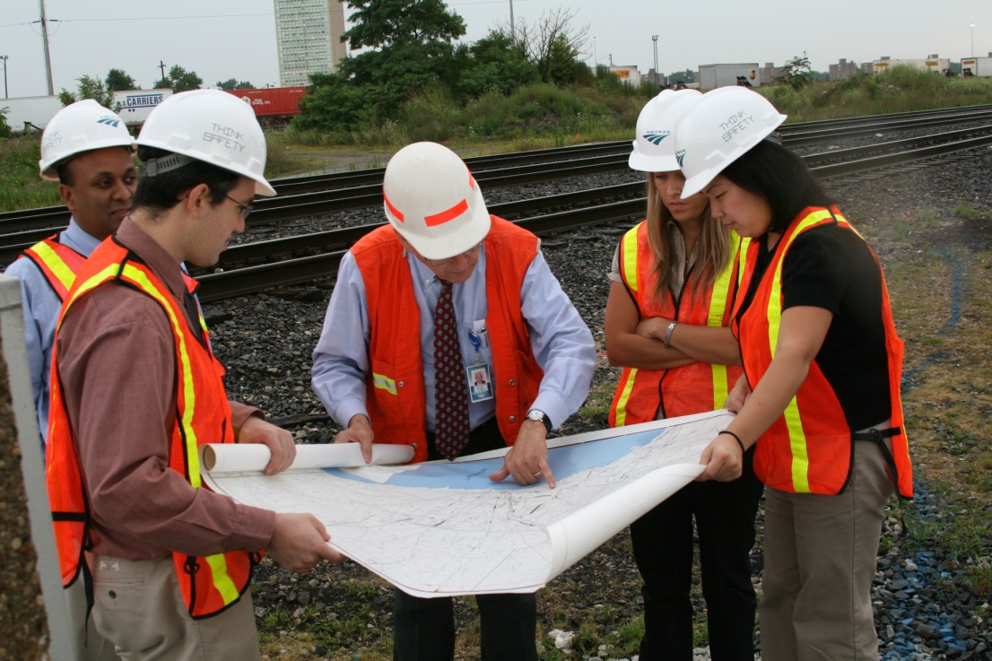
  Passenger rail development pipeline
Since 2009, $59M in Federal funds + additional State/private funds have been building a “pipeline” of future projects.
Prepare for future funding availability – what are the best market-based investments?
Determine priorities for next round of planning – what potential markets are still “missing”?
Identify national vision – where is rail heading in the U.S.?
Notes:
Pipeline is stronger now than ever before.

Slide 13
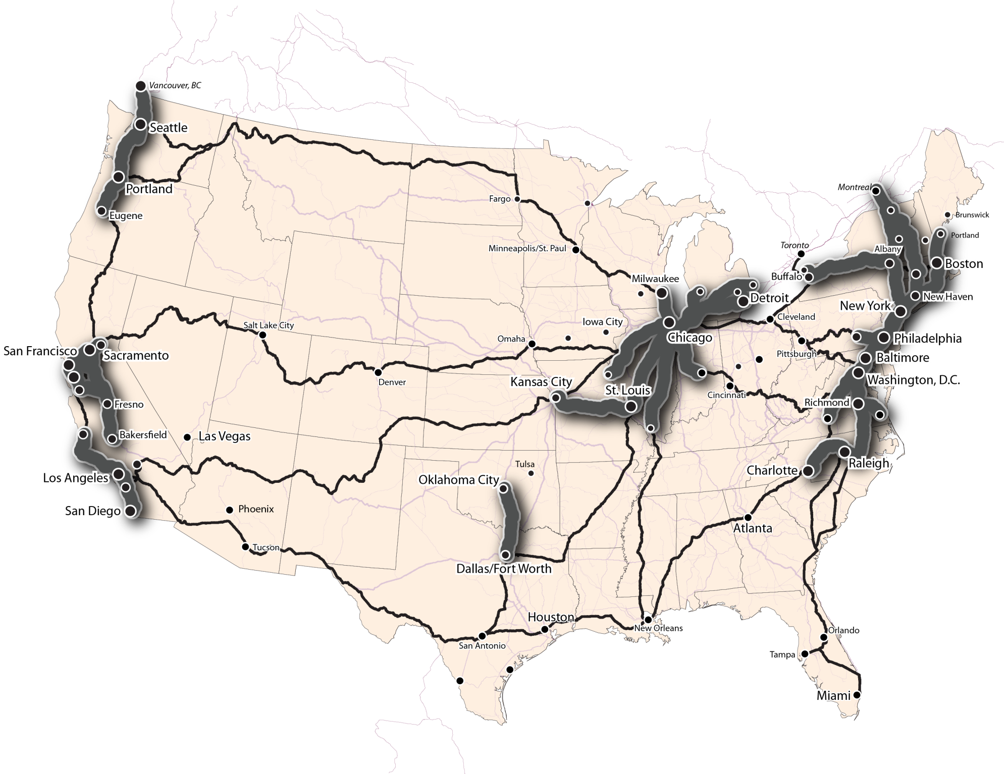
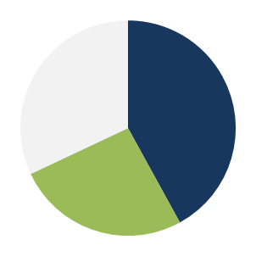
  BASELINE: Pre-PRIIA (2008)
Cumulative Population
Served
no
service
42%
Corr.
26%
Long-Dis

Slide 14
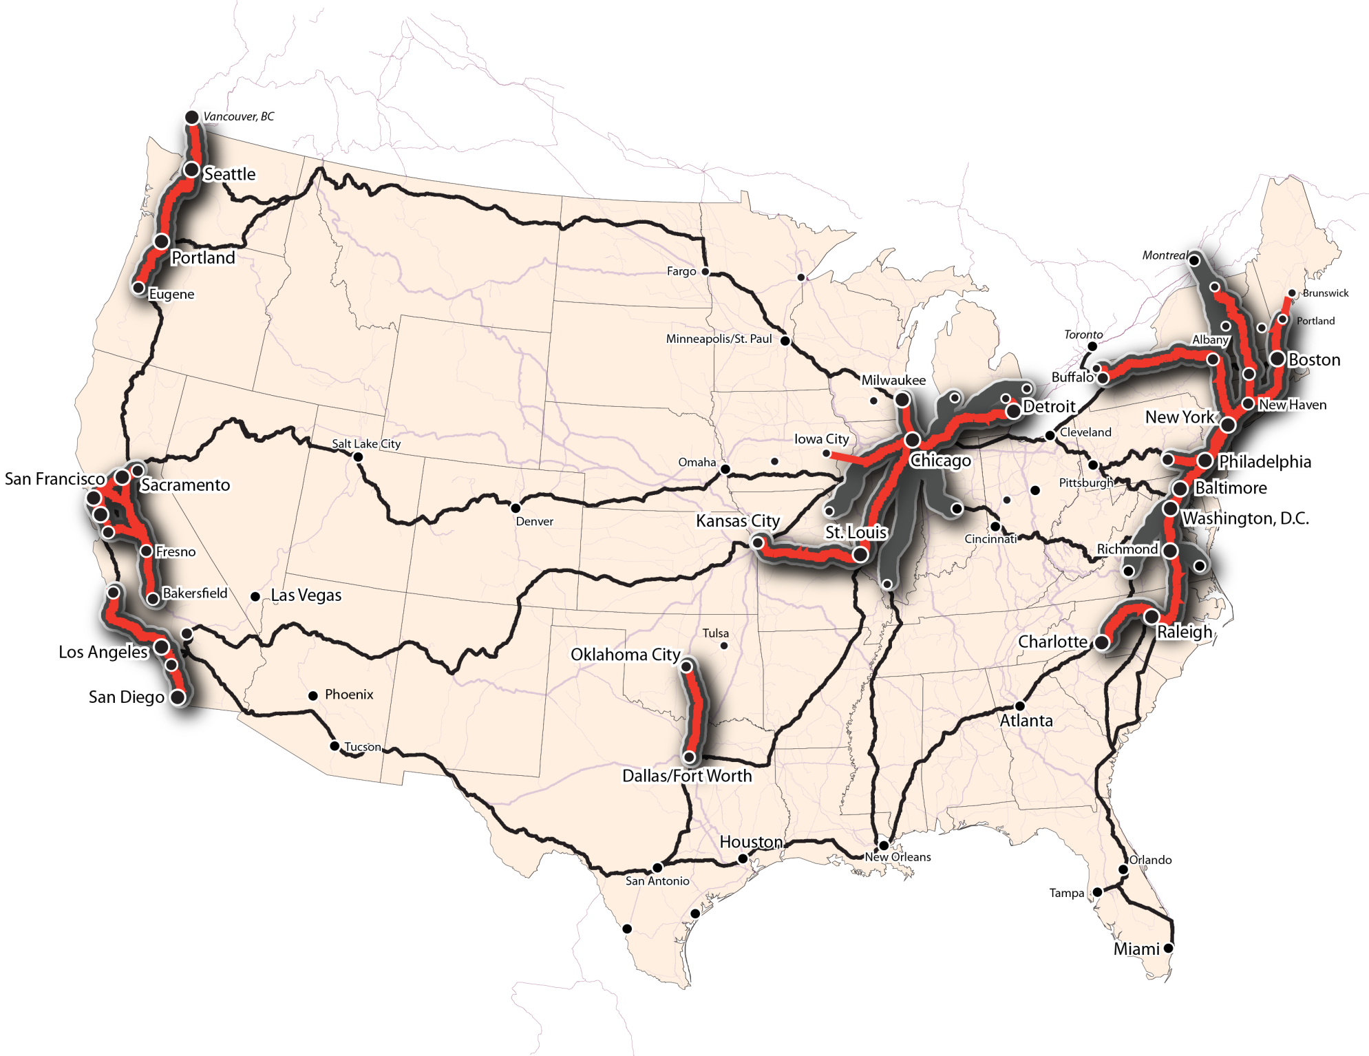

  BASELINE: Completion of Current Grants (2018)
Cumulative Population
Served
no
service
43%
Corr.
23 states + D.C.
3,750 miles
120M people (39%)
26%
Long-Dis
Notes:
24 million Americans with access to significantly higher-quality rail service (“upgrade” from Feeder to Regional)

Slide 15
  Pipeline “categories”
Initial Phases Under Construction?
Planning/Environmental Complete for Future Phases?
I
Yes
Yes
II
No
Yes
III
No
Under Development

Slide 16

  PIPELINE CATEGORY I: initial phases funded; prerequisites complete for future phases
Cumulative Population
Served
no
service
43%
Corr.
14 states + D.C.
2,500 miles
100M people (31%)
26%
Long-Dis

Slide 17
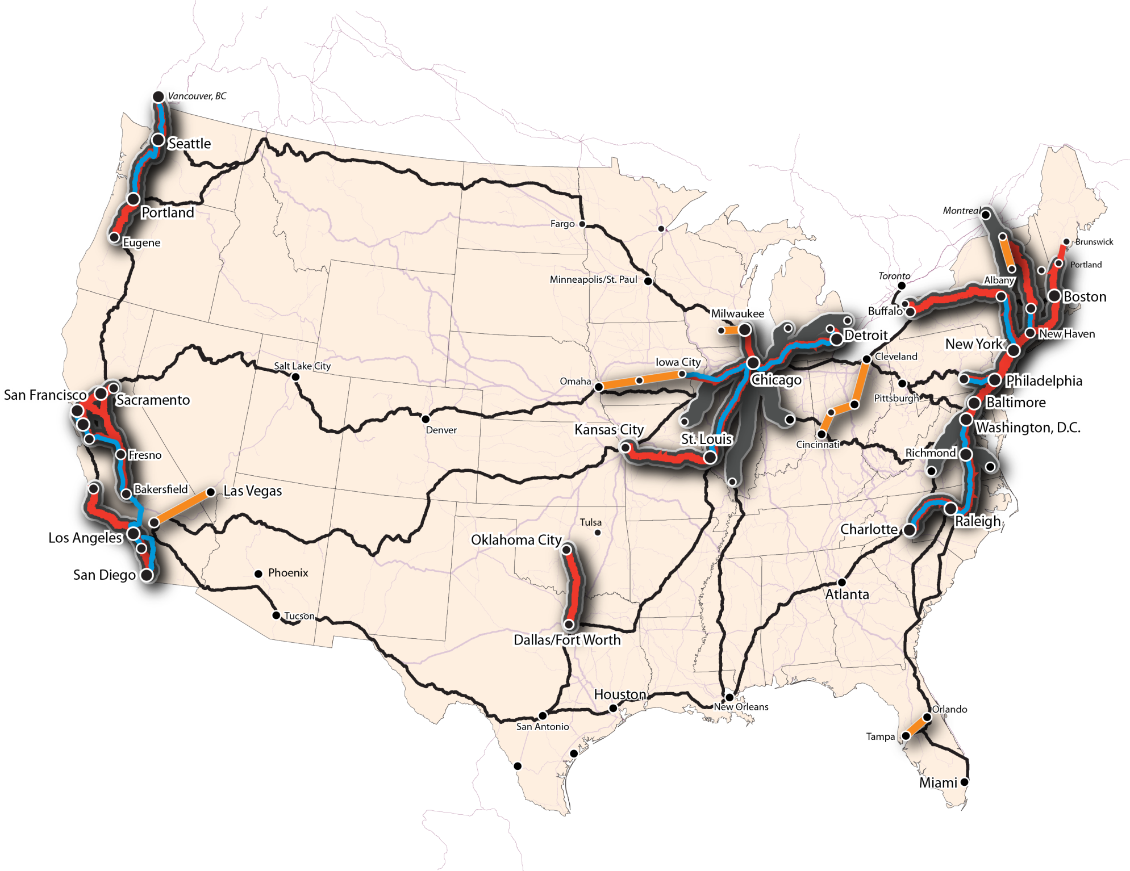
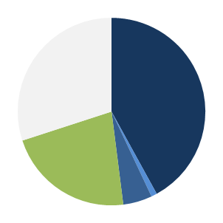
  PIPELINE CATEGORY II: not currently funded, but prerequisites complete
Cumulative Population
Served
no
service
48%
Corr.
9 states
1,000 miles
20M people (6%)
22%
Long-Dis

Slide 18

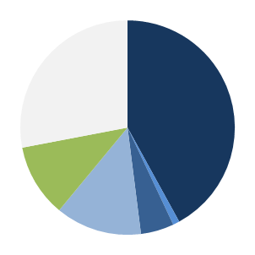
  PIPELINE CATEGORY III: prerequisites under development
Cumulative Population
Served
no
service
25 states + D.C.
5,500 miles
135M people (44%)
11%
LD
61%
Corr.

Slide 19
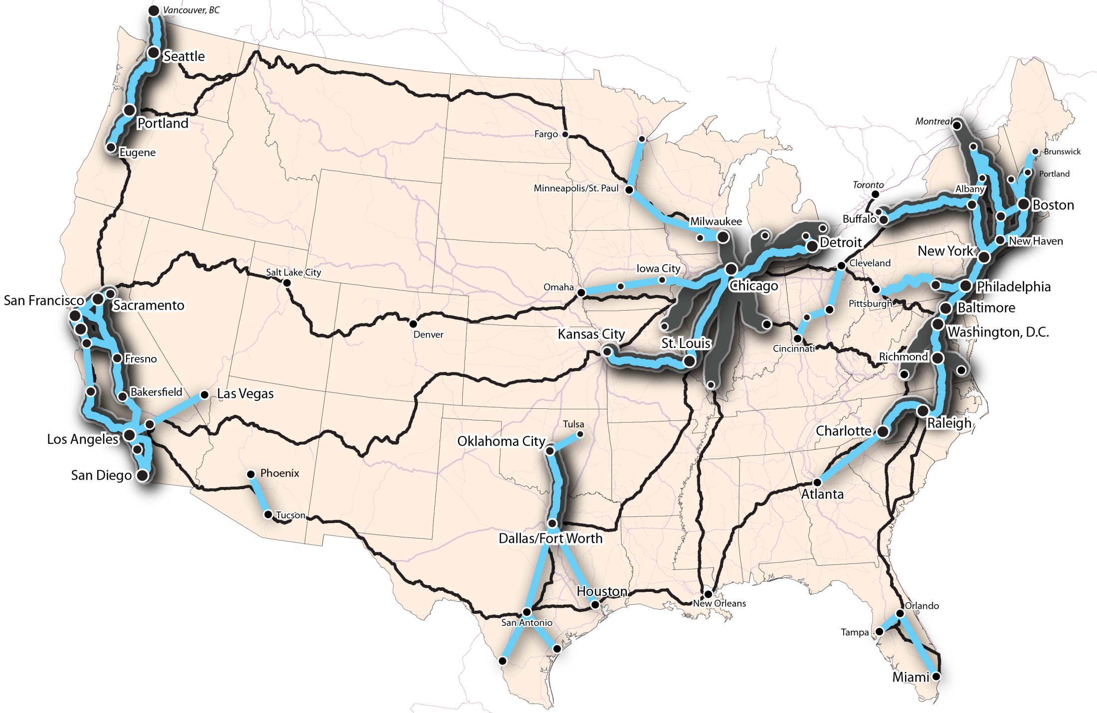
10,500 corridor miles
225M (72% of U.S.) people served (190M by corridor trains; 35M by long-distance trains only)
Existing network
Potential network improvements/additions

Slide 20
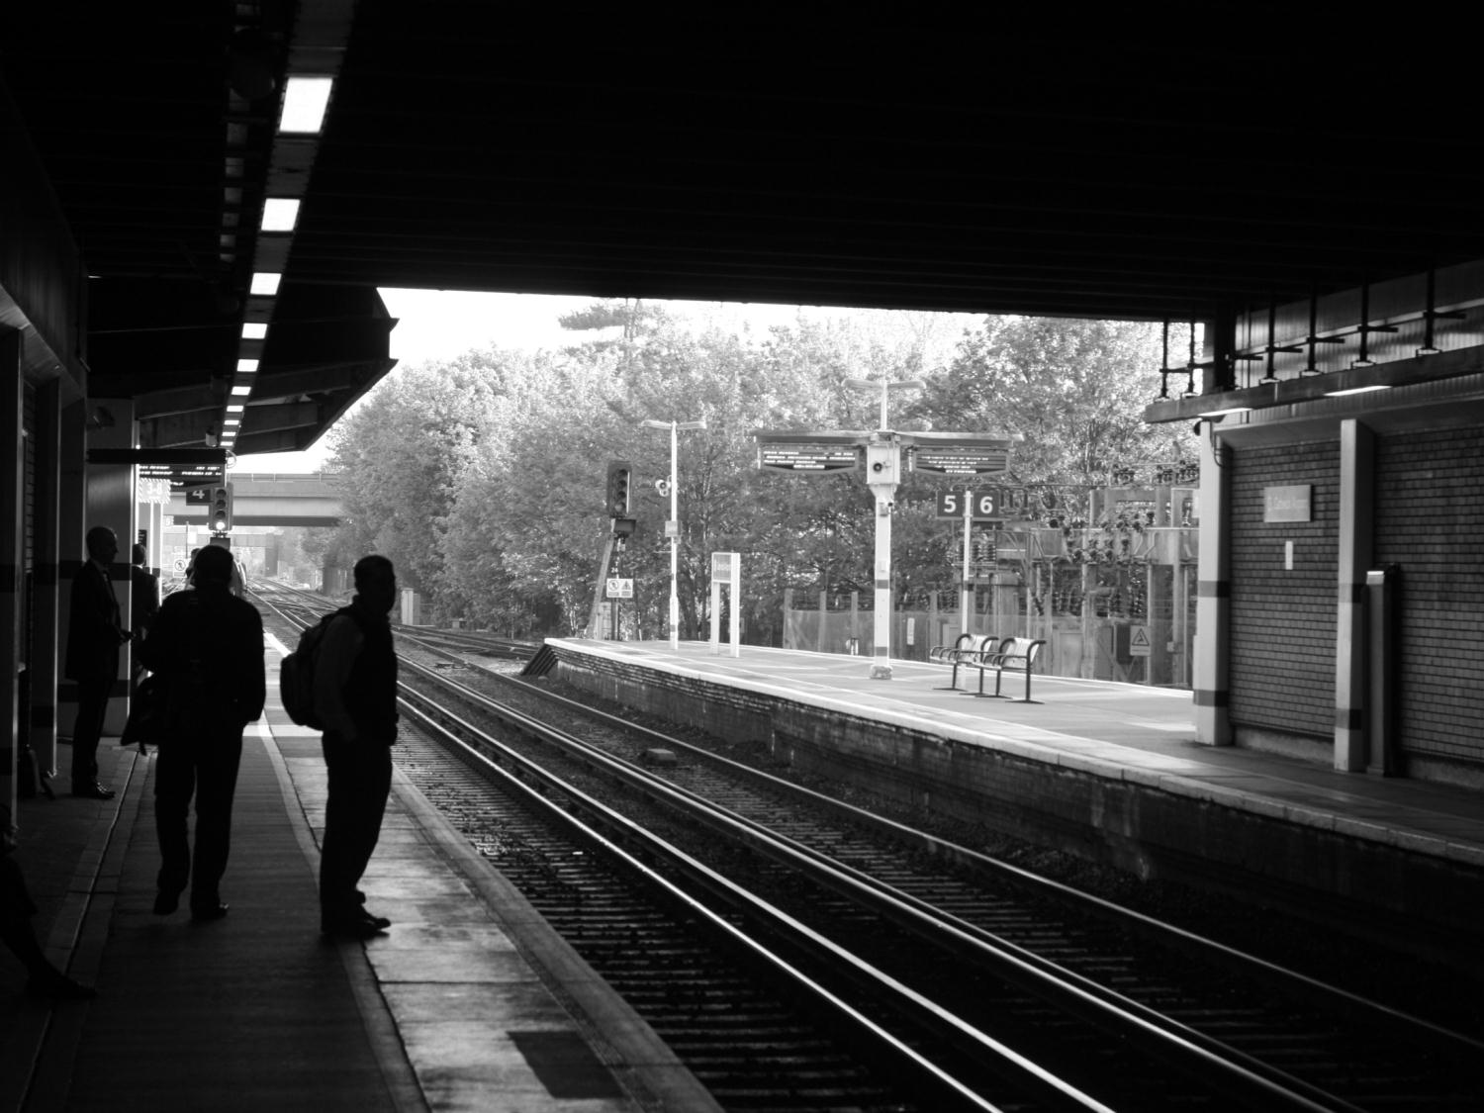
Thank You!

