Slide 1
VA-NC Interstate High Speed Rail Compact
Current Projects and Initiatives
March 21, 2016
Paul C. Worley, Rail Director

Slide 2
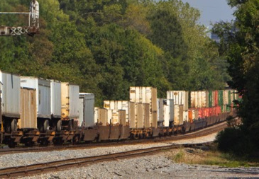
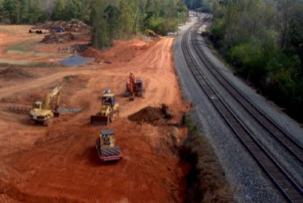
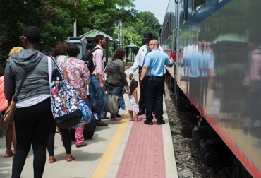
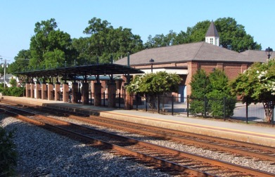
Rail Division Mission
The mission and goals for NCDOT are not specific to any single transportation mode. They apply to all NCDOT programs that impact the state’s multimodal transportation network, including rail.
The NCDOT Rail Division’s mission is the “…safe and
efficient movement of people and goods on North Carolina’s
railroads through freight, passenger and safety programs,
supporting job creation and economic growth.”

Slide 3
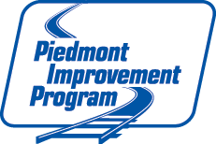
Piedmont Improvement Program Funding
2010 – NCDOT was awarded $520 million in FRA ARRA grants to fund improvements along the rail corridor between Charlotte and Raleigh.
Projects benefit Passenger and Freight:
Safer and more reliable train service
Increased railroad capacity
Job growth and commercial development opportunities
Better connectivity between Raleigh and Charlotte and towns in between
Better equipment and stations to support North Carolina’s
Piedmont and Carolinian train service
Introduction of a 3rd and 4th Frequency

Slide 4
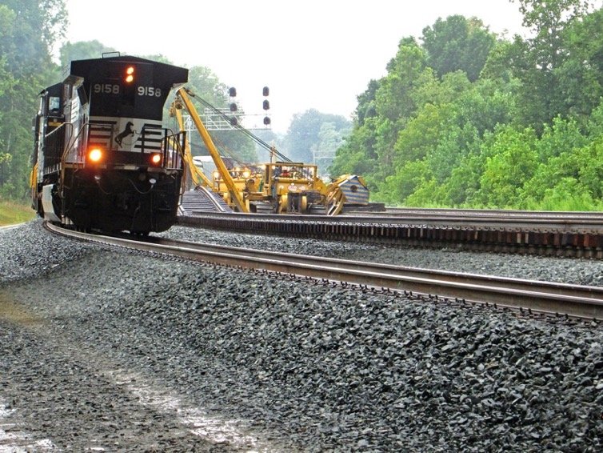
Piedmont Improvement Program (PIP)
2010-2017 – $520M Federal ARRA Funding
5 Station Improvement Projects
2 Locomotive & Rail Car Maintenance Facility Projects
NC BYTRAIN Passenger Coaches, Locomotives, Cab Control Units
12 Grade Separations
23 Public Crossing Closures
15 Private Crossing Closures
2 Passing Sidings (5 miles)
3 Double Track Projects
(26 miles)

Slide 5
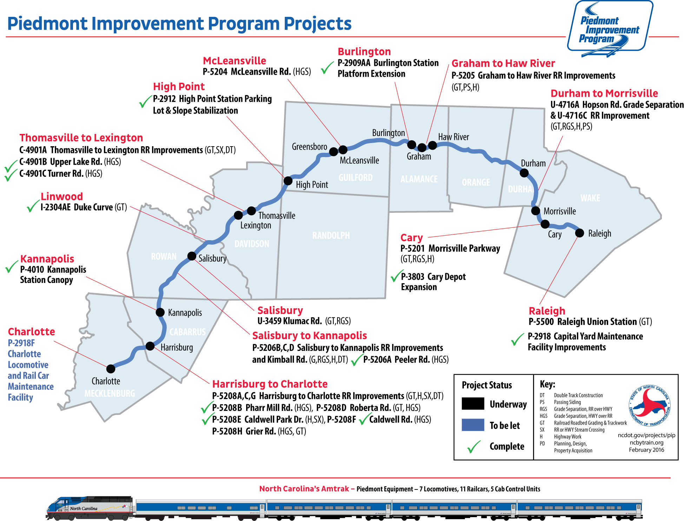

Slide 6
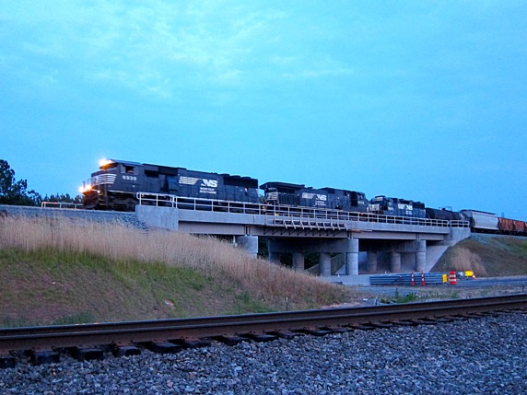
Piedmont Improvement Program – Project Status
Work to date:
6 bridges completed
21 at-grade crossings closed
Station improvements complete
  Cary, High Point, Kannapolis, Burlington
Raleigh Maintenance Facility expansion
complete
5 locomotives rebuilt, 10 railcars refurbished
What we expect to complete in 2016?
The remaining 6 bridges and 17 crossing closures
All passing sidings between Greensboro and Cary
Majority of the second track construction between Charlotte and Greensboro
In 2017 all PIP Projects will be complete
All remaining projects between Charlotte and Greensboro
Charlotte Maintenance Facility and support tracks
First train across newly opened bridge over Hopson Road
First train across newly opened bridge over Hopson Road

Slide 7
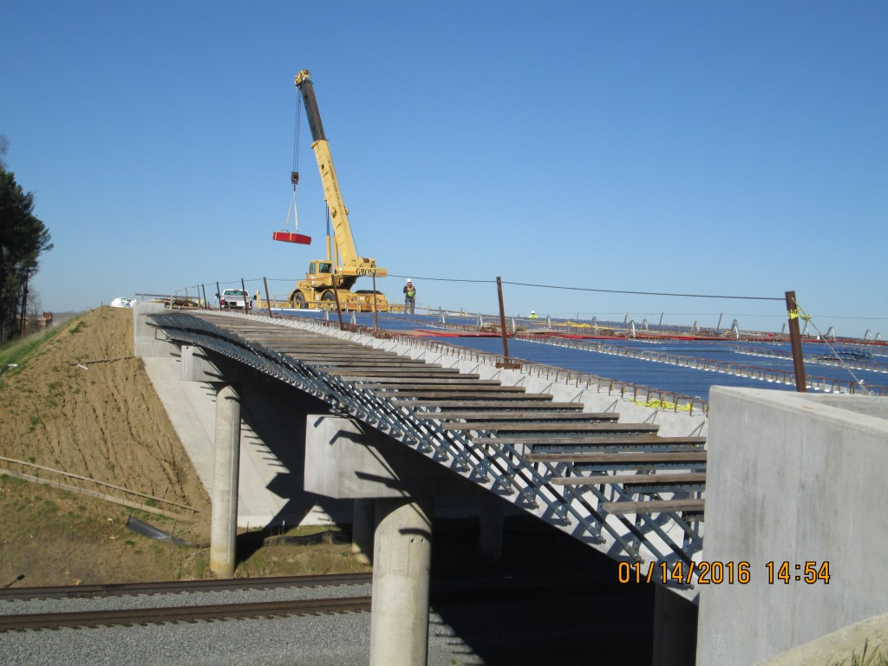
Piedmont Improvement Program
Notes:
Roberta Road Bridge

Slide 8
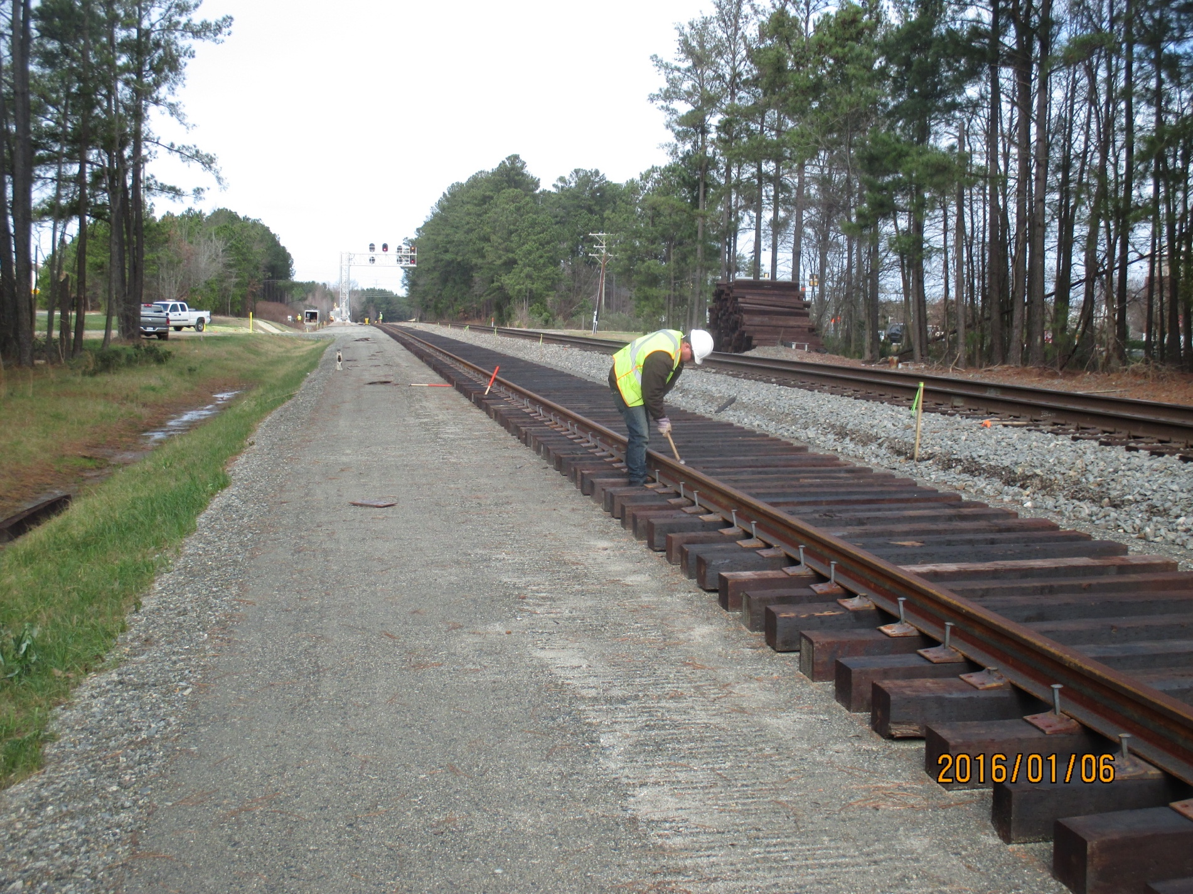
Piedmont Improvement Program
Notes:
Nelson to Clegg Passing Siding

Slide 9
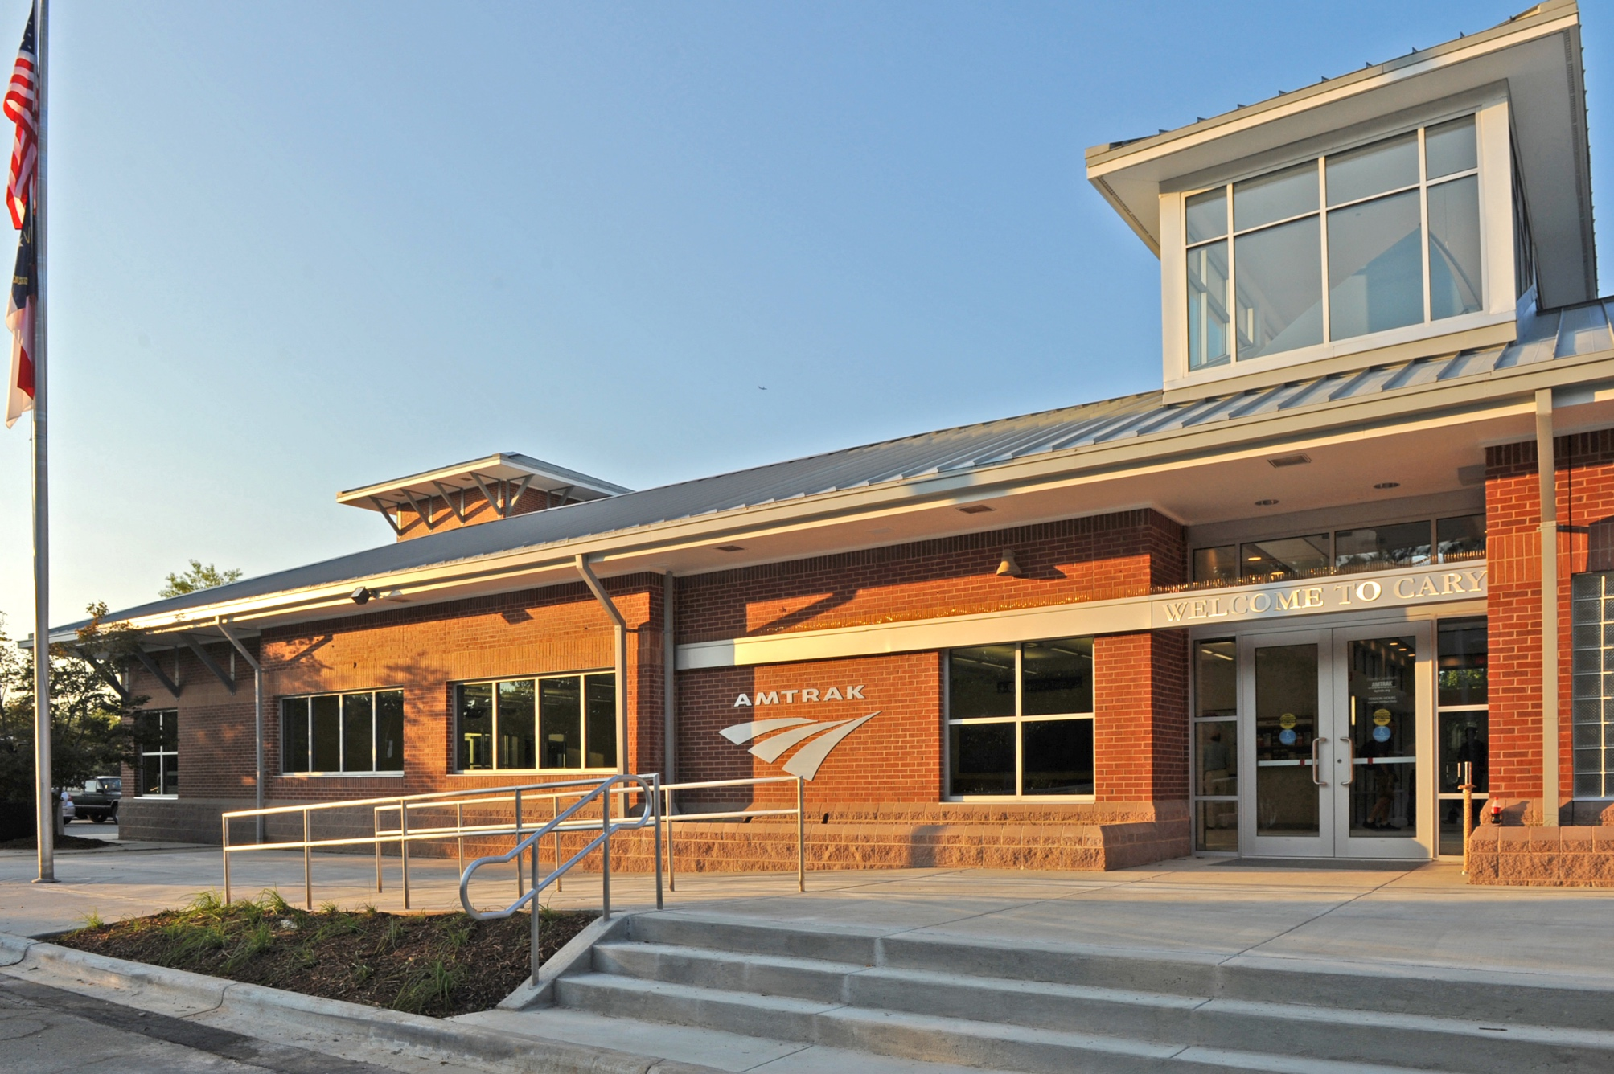
Piedmont Improvement Program
Notes:
Cary Station

Slide 10
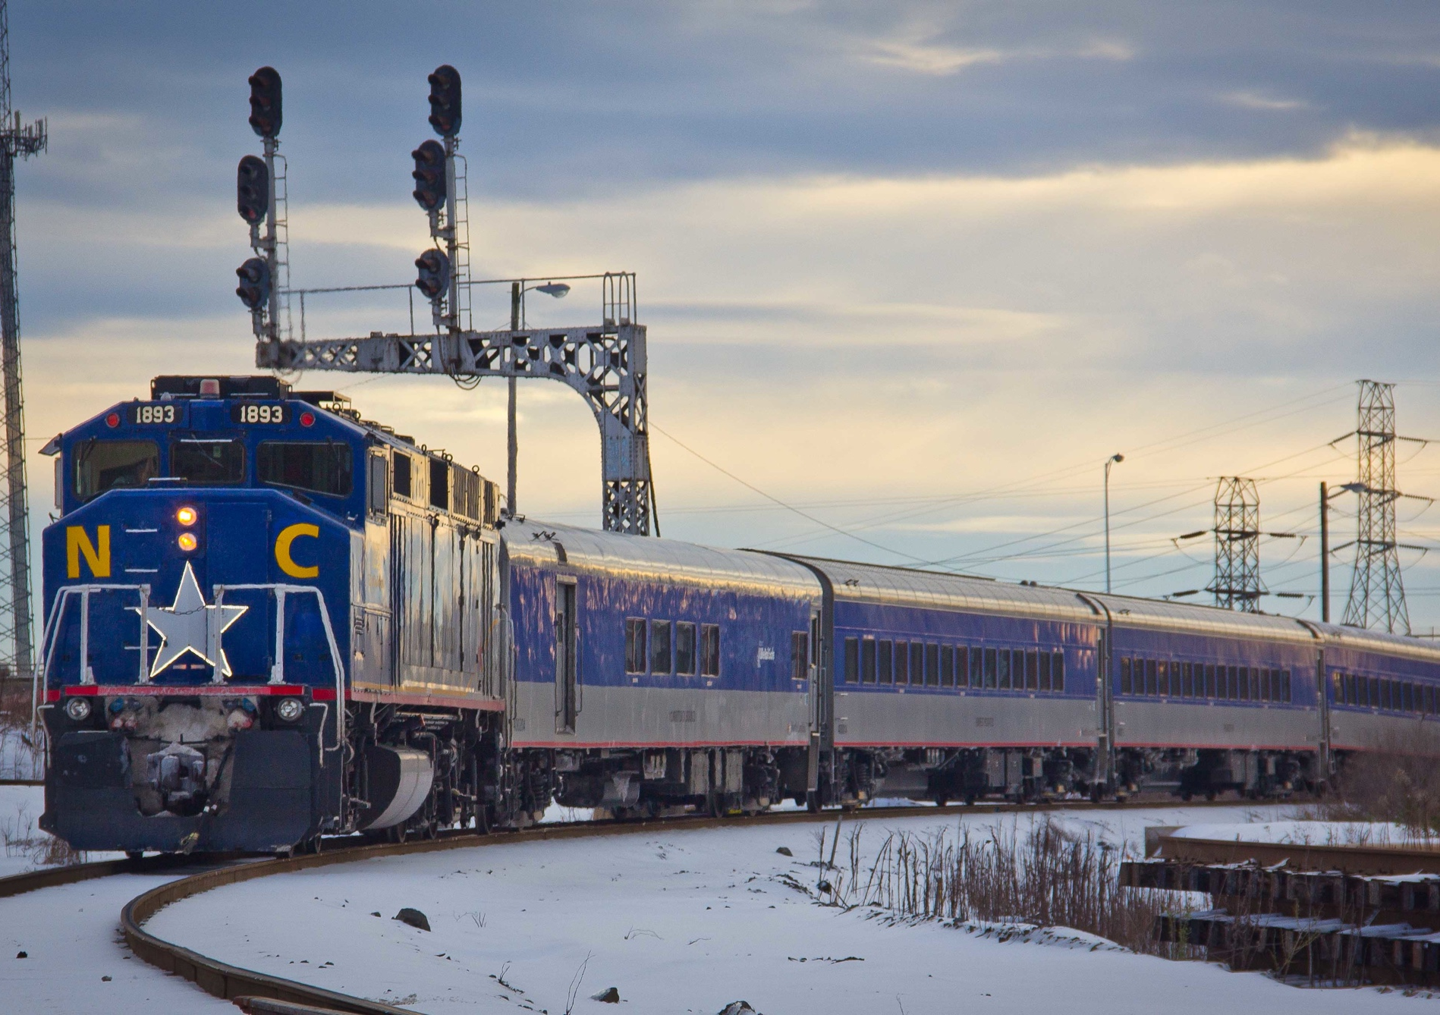
Piedmont Improvement Program
Adam Schultz Photo
Notes:
Charlotte

Slide 11
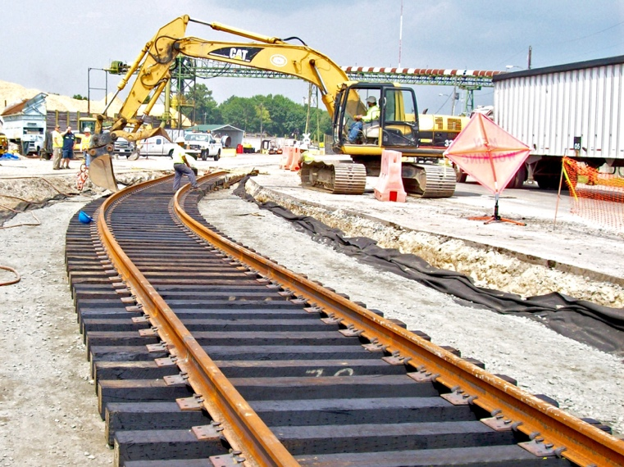
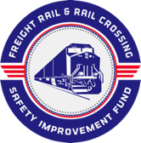
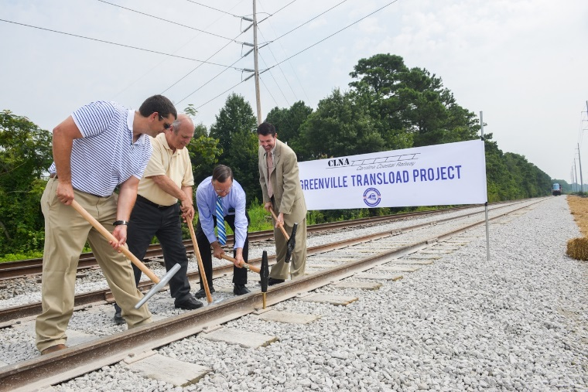
Freight Rail & Rail Crossing Safety
Improvement Fund
Established 2013 by the General Assembly
using annual NCRR dividends
$26.M allocated to date
$19.2M SFY 2014
$3.75M SFY 2015
$3.75M SFY 2016
Program goals:
Make North Carolina’s railroads safer
Meet the needs of rail customers in
small urban and rural areas

Slide 12
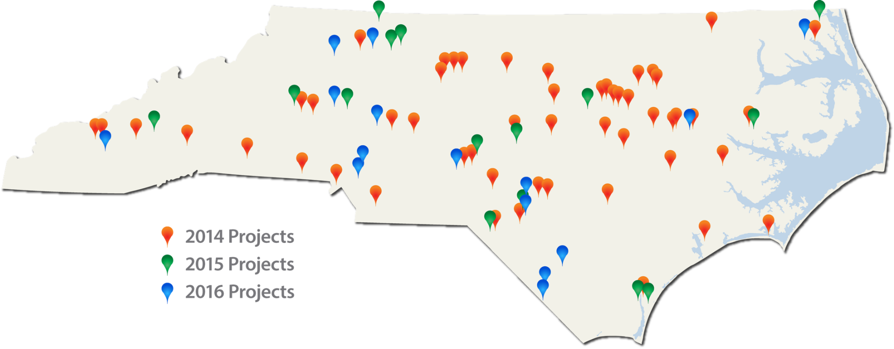
Freight Rail & Rail Crossing Safety
Improvement Fund
Bringing jobs to people
Diverting freight from highways to rail

Slide 13
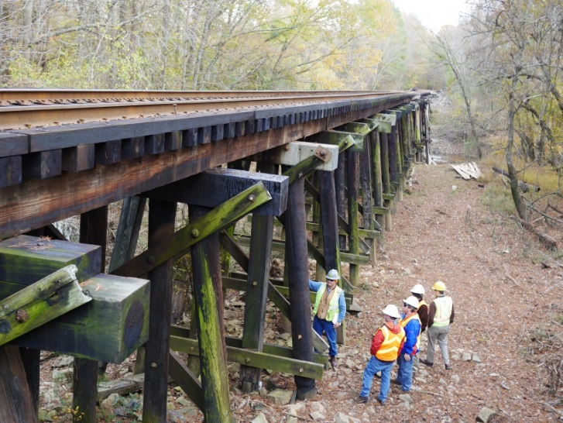
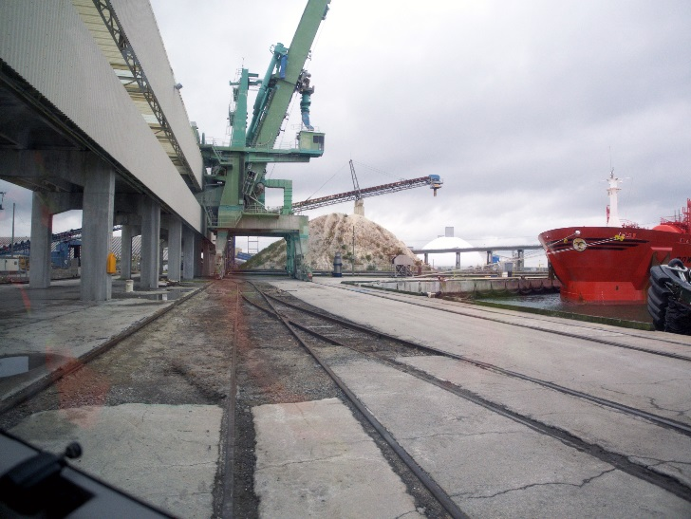
Future Freight Challenges
Additional short line railroads could begin service as Class I’s focus on core business
Railroad bridges represent a significant financial concern
2015 State Rail Plan identified:
  20-year private bridge need - $35M
  Highway/railroad grade separation need thru 2040 - $320M
Inability to keep pace with infrastructure needs presents a risk to statewide and regional economic development and job creation
Notes:
These types of improvements do not quality under STI

Slide 14
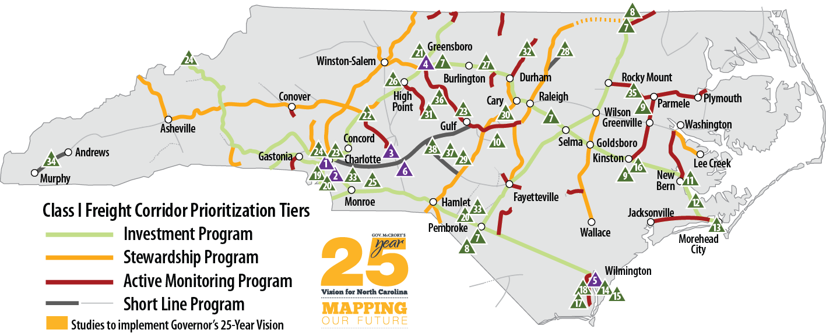
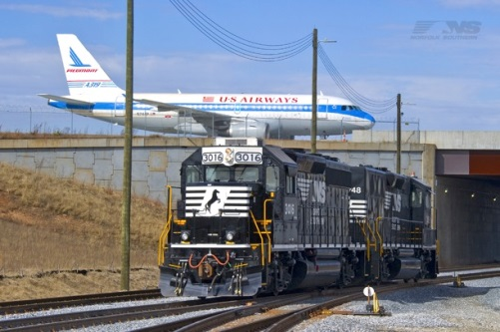
NC’s Rail Plan – Freight Recommendations
Intermodal facilities and service improvements
Port related access and infrastructure needs
Emerging and growing industries
Mega-site access and infrastructure needs
Mainline capacity and operational improvements
Corridor preservation and reactivation of strategic
connections (Note SA Line)
Traffic Separation Studies
Notes:
The majority of the freight recommendations are consistent Governor McCrory’s 25 Year vision.
The remainder are aligned with regional and local planning and economic development goals and are related to the 25 Year Vision.
Examples of projects on the Class I network include the Stouts siding in Union County, east of Charlotte on the CSXT network that will help make the movement of freight and intermodal on that line more efficient; the conversion of the former NS Intermodal yard in Charlotte to a bulk transfer facility. Projects that either added new carloads to the system or resolved bottlenecks on busy lines scored well in the P3.0 system.
Examples of projects identified on short lines include bridges, rail, ties and surfacing, transload, and yard projects. A specific example would be a potential grade separation at the North Gate to the Port of Wilmington, which would eliminate conflicts between rail movements serving the port and trucks entering the bulk port facility and adjacent private terminals. SHORT LINES ARE IMPORTANT as they connect our ports and other industries to the greater Class I system.

Slide 15
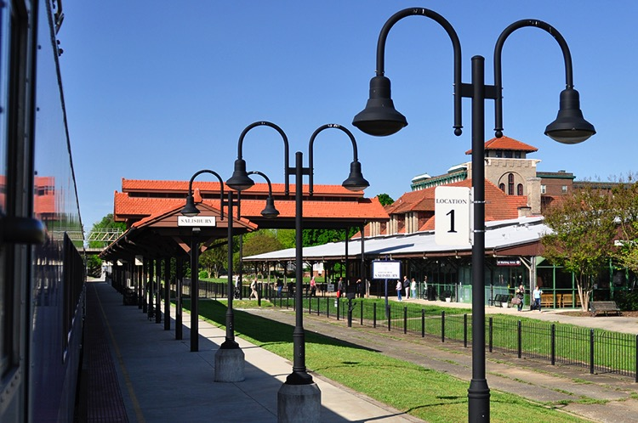
NC’s Rail Plan – Passenger Recommendations
Southeast Corridor
Implement 4th and 5th Piedmont frequencies
Add stops and improve travel times
Construct multimodal stations – Charlotte Gateway & Raleigh Union
Raleigh to Richmond ROD anticipated spring 2016
Secure S Line corridor and complete service planning
New Markets
Utilize Thruway Bus to grow
markets/ridership
Incrementally develop WNC
and SENC service
Conduct studies for future
market connections
Notes:
Based on ridership projections, additional frequencies to the existing Piedmont help reduce the subsidy per passenger. With full SEC implementation, revenues exceed costs, based on forecasted ridership and revenue. This could make it a potential P3 opportunity.
NEPA for Raleigh to Richmond is nearing completion. The FEIS has been approved and the ROD is being prepared.
Continue to work to develop markets using Thruway Bus
Final routes have not been determined for Southeastern Service

Slide 16
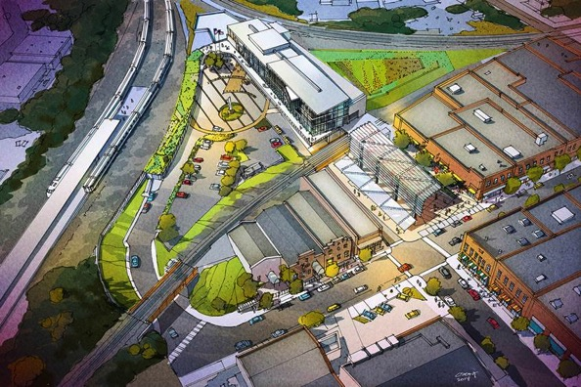
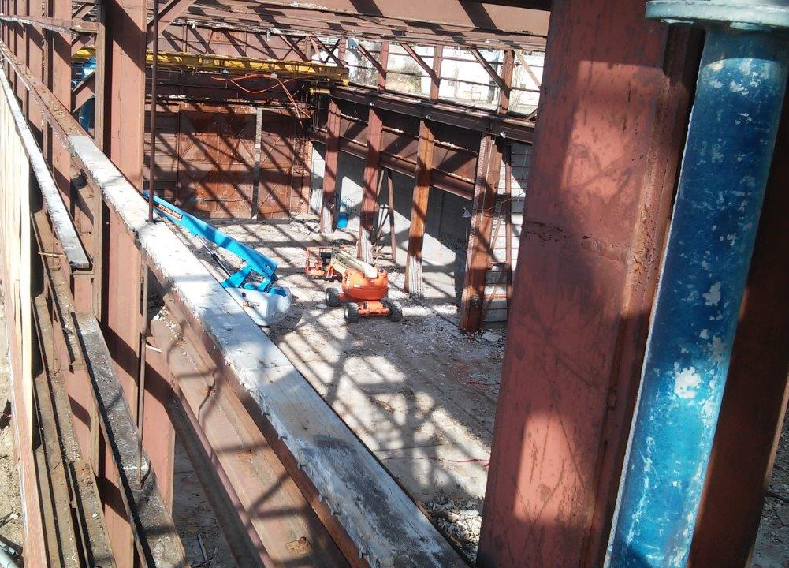
Good Stations + Right Location Impact Ridership
Building the Bookends of NC By Train Service
Construction underway on Raleigh Union Station (RUS) – a new train station in a renovated downtown warehouse – set to open late 2017
Planning and design is underway for a multi-modal transportation center in downtown Charlotte – Charlotte Gateway Station – which will consolidate a variety of transportation options in a central facility
Projects funded through Federal/State/Local partnerships
RUS Visualization
Work has started on RUS
Notes:
Book ends of the corridor

Slide 17
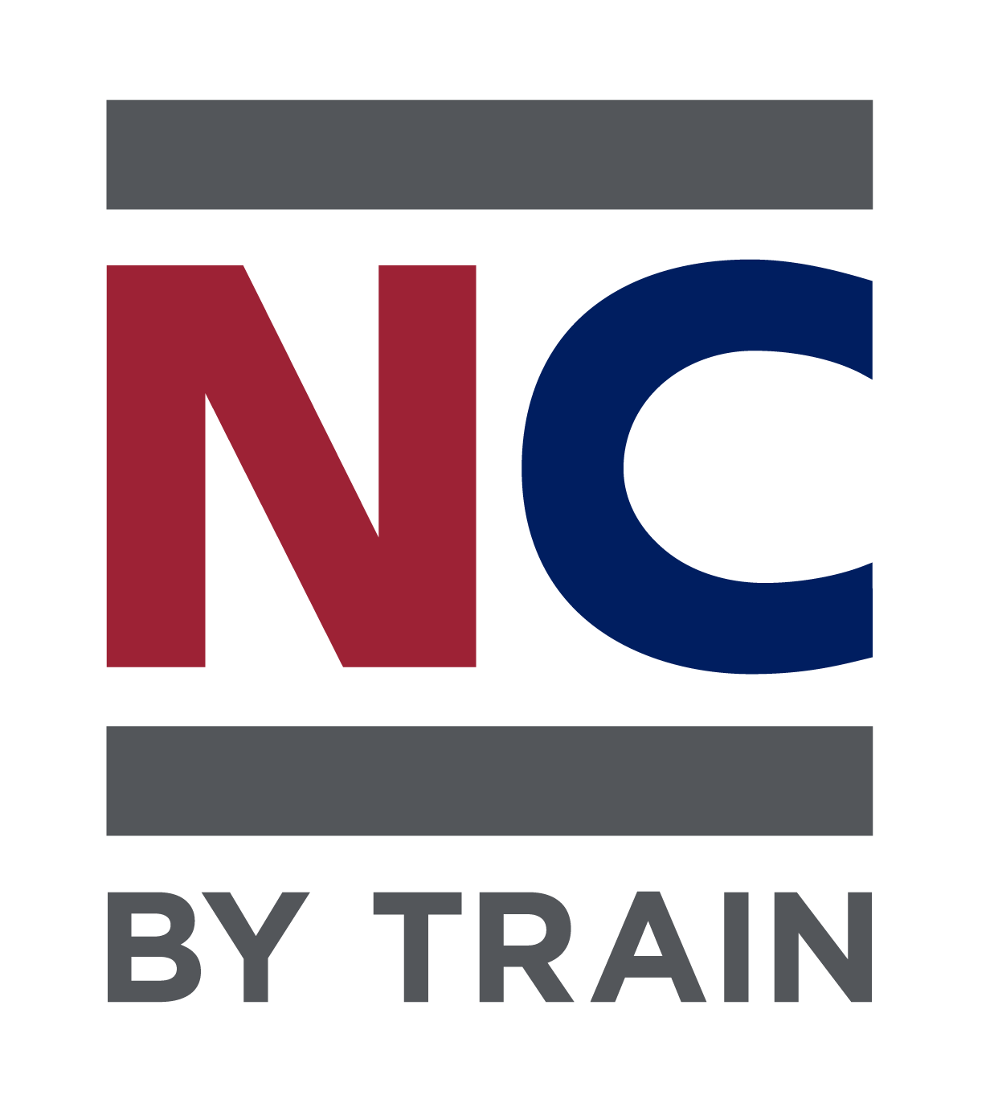

New Marketing Initiatives
New campaign developed for our passenger train service –
new direction, new materials
Target audiences identified:
  Millennials under 30 with no kids
  Retirees
  Event goers

Slide 18
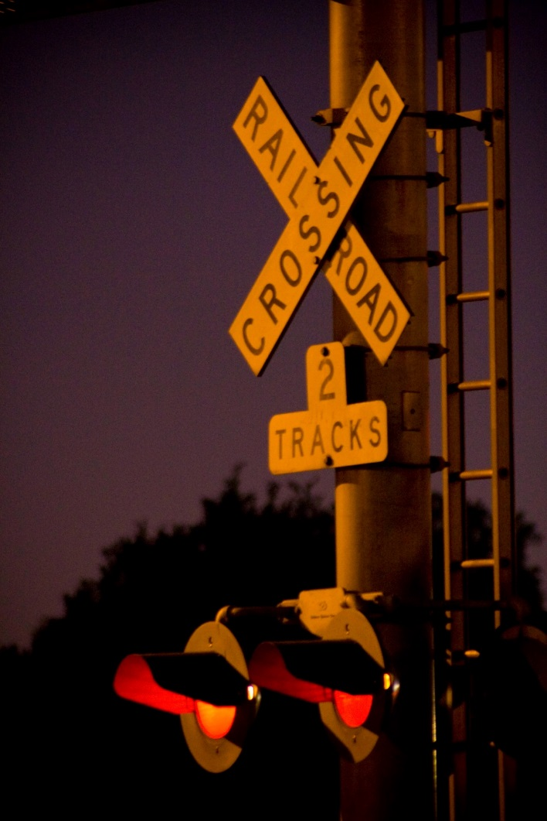
Focus on Rail Safety
Crossing safety improvements and programs
Building grade separations
Closing crossings
Improving crossings – gates, signals and
surfaces
Using new technology – dual matrix radar –
getting positive results
Sealed Corridor Program
Piedmont Improvement Program
Freight Rail & Rail Crossing Safety Improvement Fund
Adam Schultz Photo

Slide 19
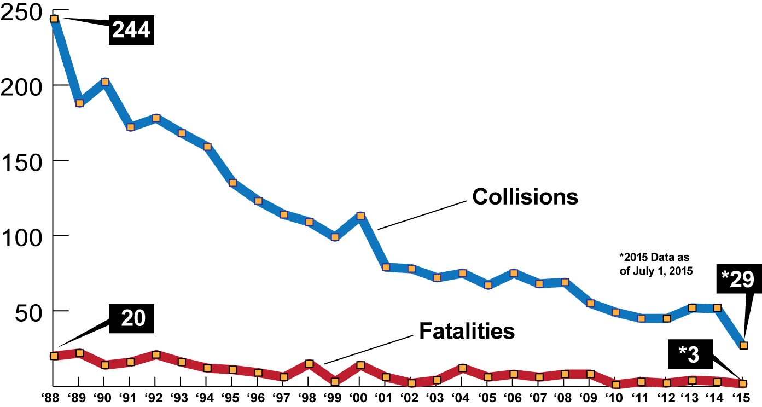
Crossing Improvements have made NC Railroads Safer

Slide 20
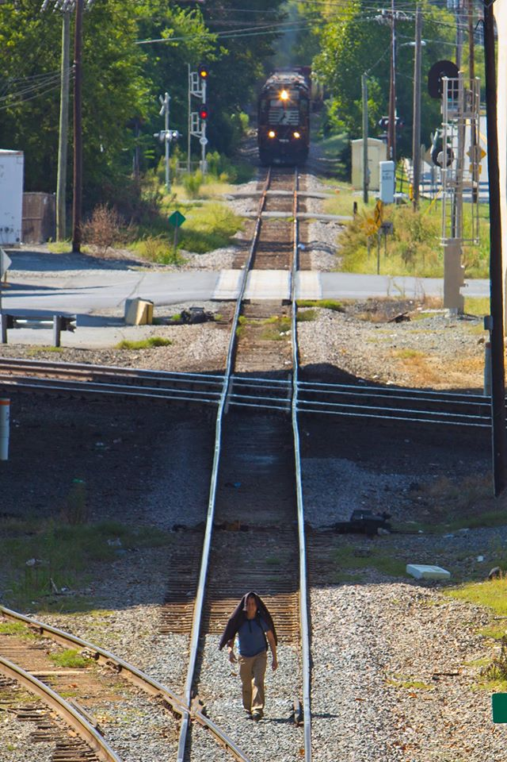
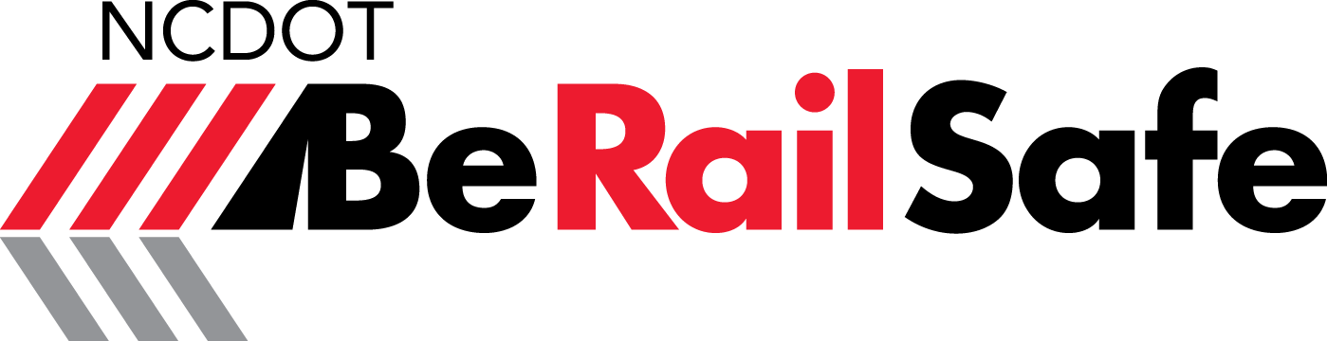
BeRailSafe Initiatives
Reaching out to the public – events, school system partnerships
Providing safety education training for first responders
Partnering with Operation Lifesaver and railroads
New study begins in 2016 to pinpoint most problematic locations on Piedmont Corridor – will address ways to target and modify trespasser behavior
Adam Schultz Photo
Notes:
More trains, more people

Slide 21
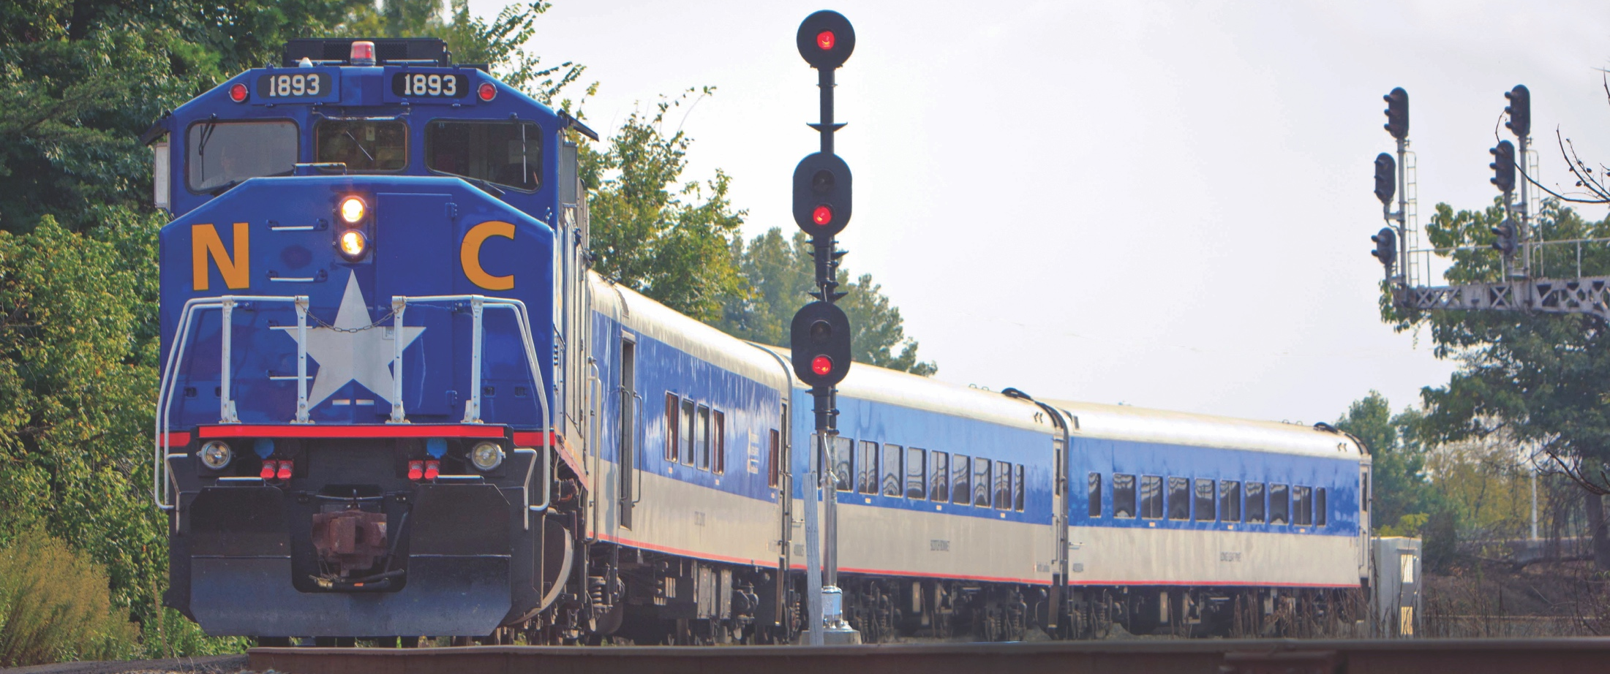
TIGER and FASTLANE Grants

Slide 22


TIGER and FASTLANE Grants
TIGER
  $500M in funding
  Minimum grant $5M in urban areas
  80 / 20 cost share in urban areas
  Minimum grant $1M in rural areas
  100% federal funding available in rural areas
  Applications due April 29
FASTLANE
  $800M in funding
  Freight highway network, rail, grade separations…
  Large projects ≥$100M
    Minimum grant $25M (large)
    Minimum grant $5M (small)
  60/40 cost share (half of 40% cost share can be other federal funds)
Notes:
More trains, more people

Slide 23
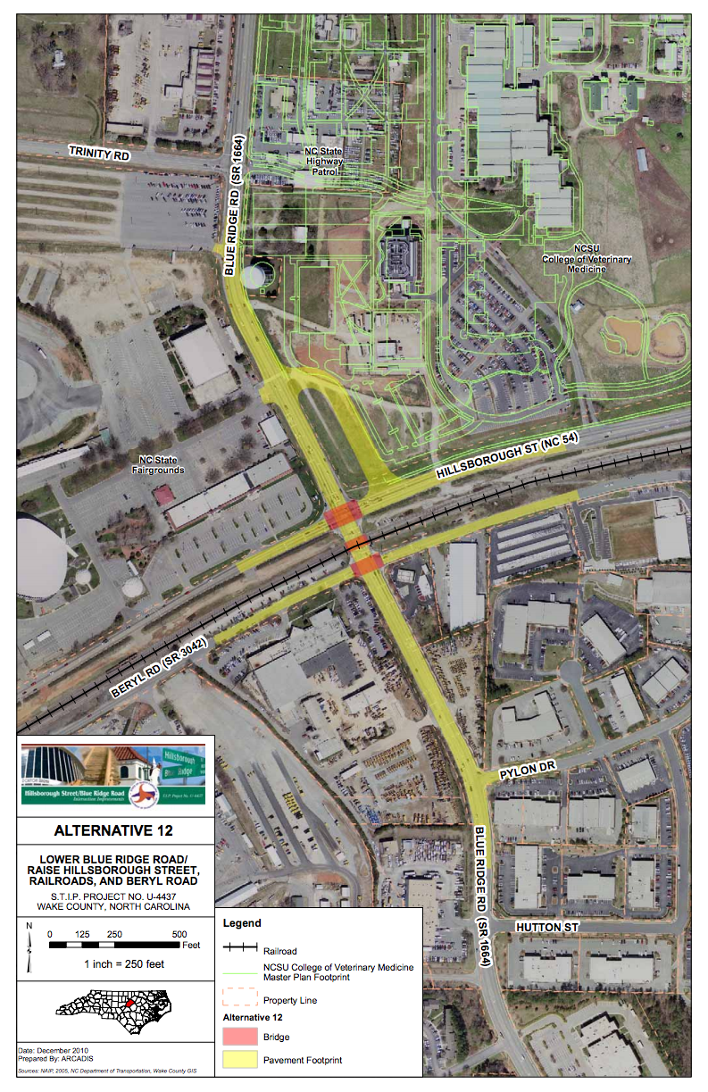
NCDOT TIGER and FASTLANE Applications
Blue Ridge Road Grade Separation
  Grade separates Blue Ridge Road and NCRR in Raleigh, NC
  Eliminates highway-rail conflicts and improves highway operations
  Norfolk Southern and CSX railroads
  Route also serves Piedmont and Carolinian passenger trains
  Total project cost - $26.6M
  Potential funding shares
    $15.98M (TIGER or FASTLANE)
    $5.33M (FHWA)
    $5.33M (NCDOT STI)
  MPO submitted project in STP P4.0
Adam Schultz Photo
Notes:
More trains, more people

Slide 24
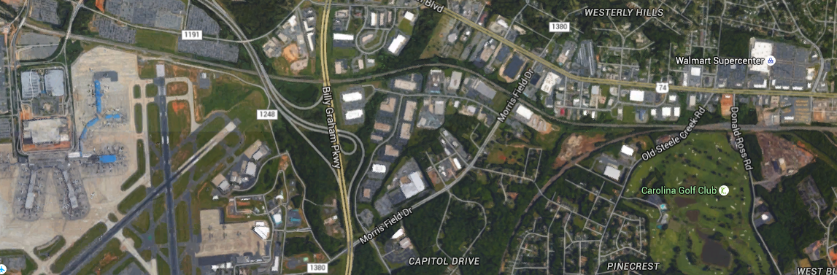
NCDOT TIGER and FASTLANE Applications
Charlotte Wye
Improve access to NS Intermodal Facility and improve fluidity on the network for freight and passenger trains
Will enhance ability to turn passenger trains
Total project cost - $10M
Potential funding shares
  $5M (TIGER or FASTLANE)
  $4.5M (NCDOT)
  $0.5M (Other Non-Federal)
Notes:
Rail Division will be helping with a third grant application for Beatty’s Ford Road / I-85 Interchange in Charlotte. A FASTLANE grant will be pursued. There is no rail involvement.

Slide 25
Thank you. Questions?

