Slide 1
Virginia Rail Program Update
Jennifer Mitchell
Agency Director
Virginia-North Carolina High Speed Rail Compact
Commission Meeting
March 21, 2016

Slide 2
Virginia Funding Programs for Rail
DRPT Rail Funding Sources - FY16
$188.1 M

Slide 3
Rail Programs in Virginia
Rail Enhancement Fund (REF): ~ $18M / Year (beginning FY17)
  Supports highway congestion relief through freight and joint benefit projects
  Dedicated revenue source: 3% tax on gross proceeds from motor vehicle rental
Industrial Access Railroad Tracks Fund: ~ $1.5 – 3.0M / Year
  Shares combined revenues of road, rail, and airport access fund
  Gets trucks off of Virginia highways and supports economic development
Shortline Railway Preservation & Development Fund: ~ $3.0M / Year + Bond Funds
  Preservation and development of shortline “last mile rail service”
Intercity Operating and Capital Fund: Approx. $55M / Year
  Supports Virginia funded intercity passenger rail service
  Dedicated revenue source as of FY14: 0.05% state and local sales tax

Slide 4
Rail 2016-2021 SYIP by Programs
($ in millions)
Six Year Improvement Program: Rail
Notes:
Access is not listed because it is an application-based program as opposed to a set funding distribution (has historically averaged about a million a year)

Slide 5
Virginia’s State Rail Plan
DRPT developed a Statewide Rail Plan annually under the former Local Rail Freight Assistance (LRFA) and Federal Railroad Administration program guidelines for State Rail Plans. Following the end of the LRFA program, from 1995-2004, DRPT paused its Rail Plan Development.
2004
2008
2008
2009
2013
State Rail Plan re-initiated on a 4 year cycle
State Rail Plan under PRIIA guidelines
Rail Resource Allocation Plan - added feature
Technical Update – to meet 49 CFR 26615
State Rail Plan and Resource Allocation Plan Update 2013
2016
State Rail Plan update planned

Slide 6
State Rail Plan:
Passenger and Freight Rail Initiatives
Virginia’s State Rail Plan identifies passenger and freight rail improvements in various corridors
Phase 1 projects are funded in the state’s Six-Year Improvement Program (SYIP)
Total cost of planned improvements through 2040 exceeds $6.9 billion
DRPT will work with its stakeholders to update the rail plan in FY17 to include strategic initiatives and market developments and to reflect REF policy changes and updates
2015 FAST Act mandates multimodal statewide freight planning by 2017 to include all Class I railroads, as well as some short lines; DRPT to integrate rail into new federal planning mandates on top of the existing PRIIA mandate

Slide 7
Passenger Rail Project Prioritization
Each year DRPT issues a Notice of Funding Availability establishing priority initiatives for IPROC funds
Operating costs for state-supported intercity passenger rail services are highest priority
Projects are scored against prioritization criteria using minimum thresholds for population served, network benefits, and leveraged funds

Slide 8
IPROC Prioritization
Network Benefit
Regional Economic Benefit
Independent Utility
Other Funding Support
Regional Social Benefit
Regional Environmental Benefit
Financial Performance of Proposed Improvement
Schedule Improvements

Slide 9
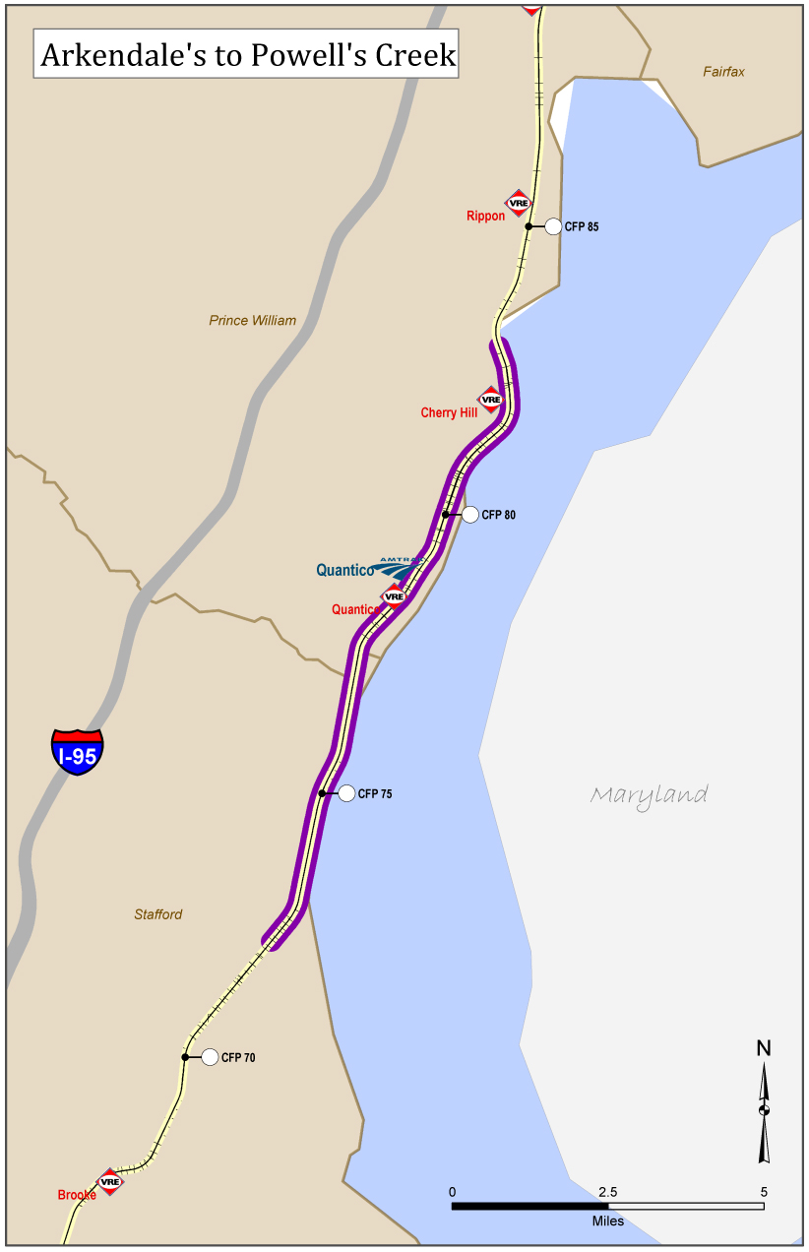
DRPT Projects:
Shared Use Corridor Improvements
Acca Yard
Improvements to accommodate two more trains to Norfolk and second Lynchburg frequency
Arkendale to Powell’s Creek
$75M 100% Federal ARRA Stimulus Funded Project
$30M IPROC Funds
11 Mile Third Track Design Build Project

Slide 10
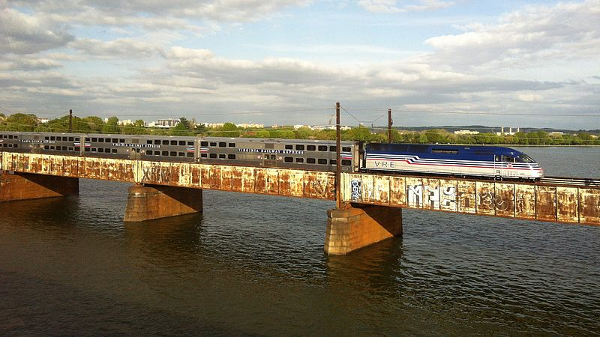
Shared Use Corridor Improvements
Long Bridge critical piece of overall I-95 corridor strategy as its major regional freight & passenger bottleneck; Congestion on the Long Bridge affects the entire SE
Long Bridge eligible for new federal freight discretionary grant program funds as well as existing TIGER program

Slide 11
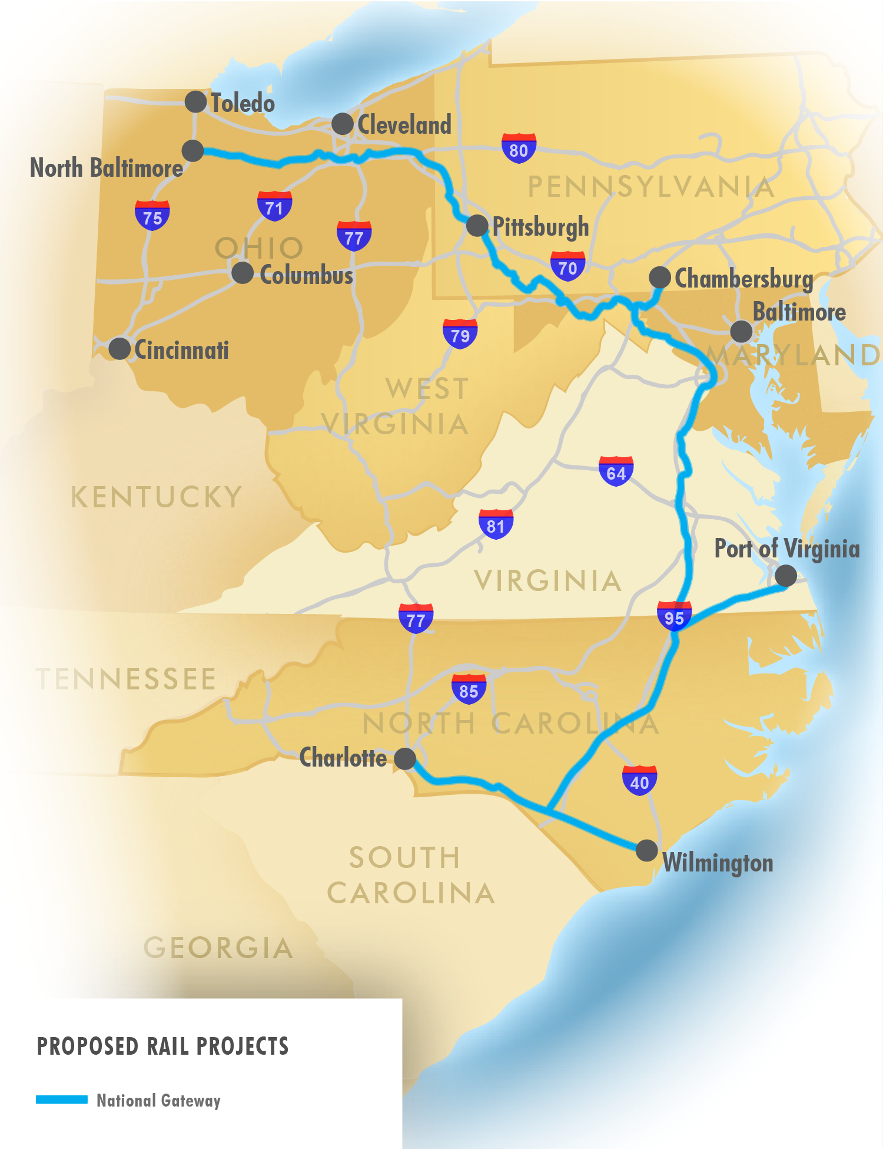
Shared Use Corridor Improvements
CSX National Gateway
Double stack clearances
Virginia Avenue Tunnel
Kilby Yard (complete)

Slide 12
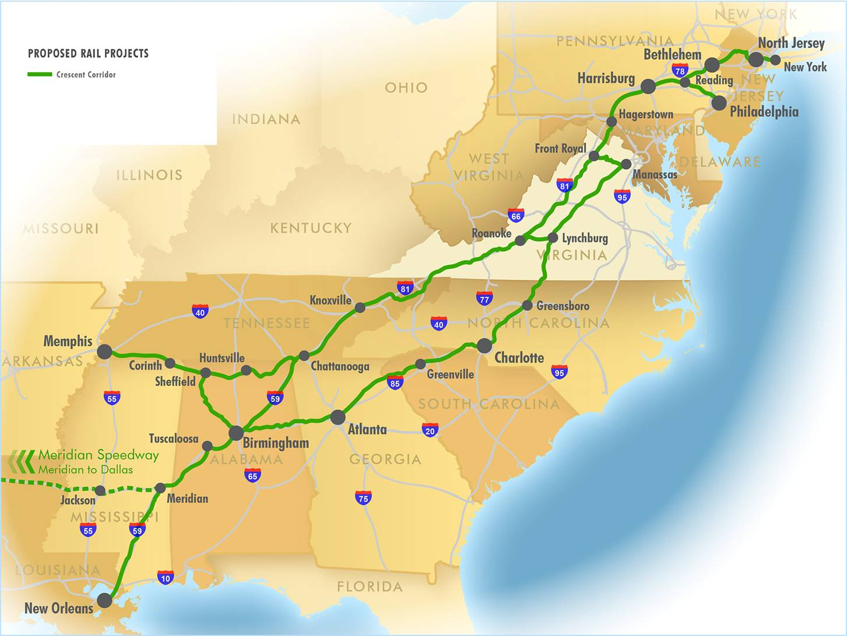
Shared Use Corridor Improvements
Norfolk Southern Crescent Corridor
Tunnel clearances
Multiple sidings, passing and double track

Slide 13
Shared Use Corridor Improvements
Port of Virginia Projects
Funded
Craney Island Connector NEPA and PE
NIT marshalling yard expansion
APM terminal yard and marshalling yard expansion (CWRY and Port project)
Future Phases - unfunded
  Construct Craney Island Connector

Slide 14
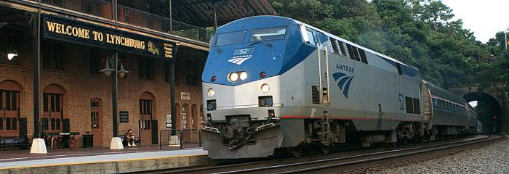
DRPT Projects:
Passenger Rail
Extension to Roanoke
  Phase 1 construction began in November 2014 and completed August 2015
  Phase 2 is underway and 30% design complete
  Anticipated operation date during 2017
Additional Lynchburg Frequency
  Second train offering daily roundtrip service between Lynchburg and DC
  Anticipated operation date during 2017

Slide 15
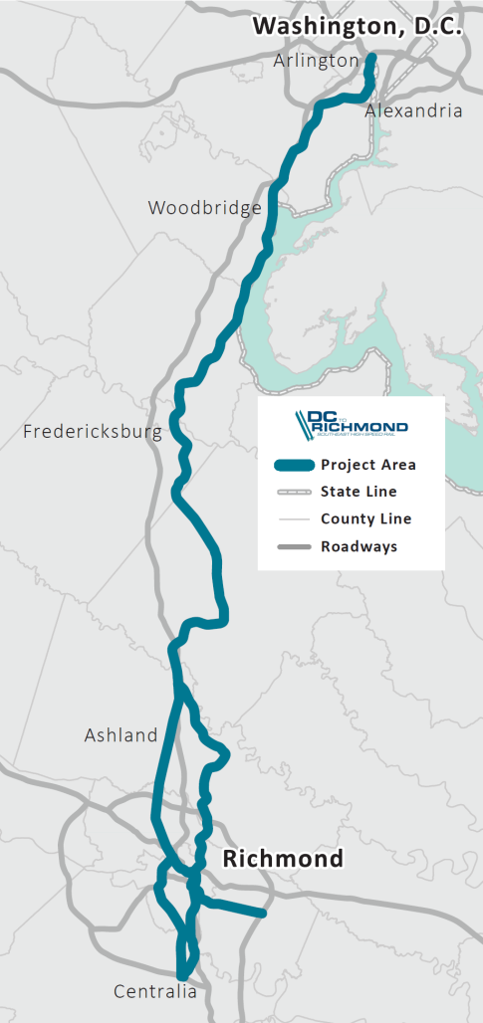
DC2RVA:
Higher Speed Rail Study
123-Mile Corridor
Northernmost Segment of the SEHSR Corridor
Connects to the Northeast Corridor
Preliminary Engineering and Environmental Review
Ridership and Revenue Review
Station Area Improvements
Service Frequency
15
Notes:
Connects to NEC, which is the only current true high-speed rail corridor in the United States.

Slide 16
Project Overview: Tier II EIS
Tier II Environmental Impact Statement (EIS)
Summarize broader issues discussed in the Tier I Study.
Focus on site-specific impacts and mitigation for individual elements of the larger study.
Incorporate further public/agency input.
Quantify impacts and analyze potential mitigation measures.
Documentation and decisions lead to permitting, final design, right-of-way acquisition, and construction.
16

Slide 17
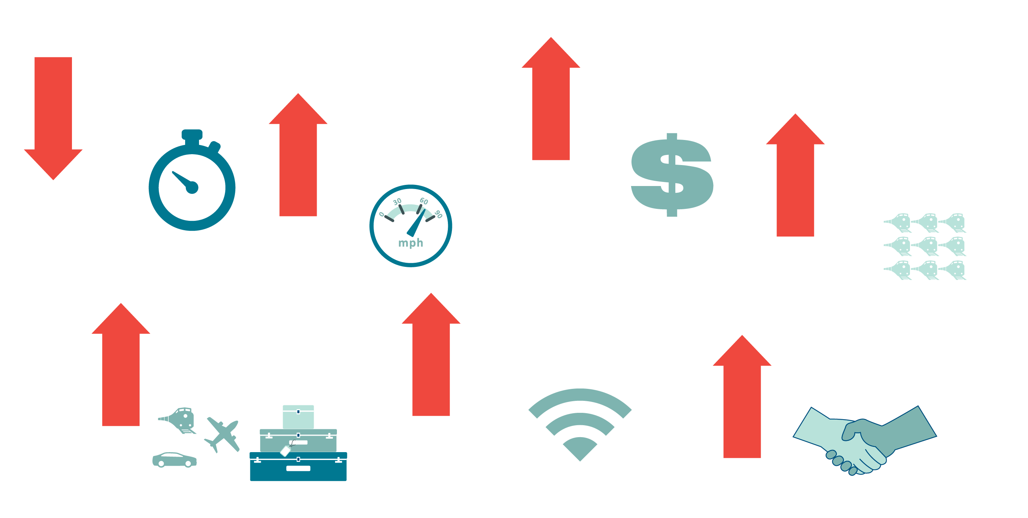
Proposed Rail Service
Higher speed rail could result in:
17
Notes:
We are in the early stages of evaluating service options for the project, but we have three ultimate goals: we want to improve reliability and decrease travel times, and we want to increase train frequencies in order to make intercity passenger rail a competitive option for travelers. The 2002 Tier I EIS, which set the framework for our Tier II EIS, stated the purpose of the high speed rail program was ultimately just that, to provide a competitive travel option. And while higher speeds is an obvious part of that, making the system more efficient by focusing on these three service goals will go a long way in helping to satisfy our overarching purpose.

Slide 18
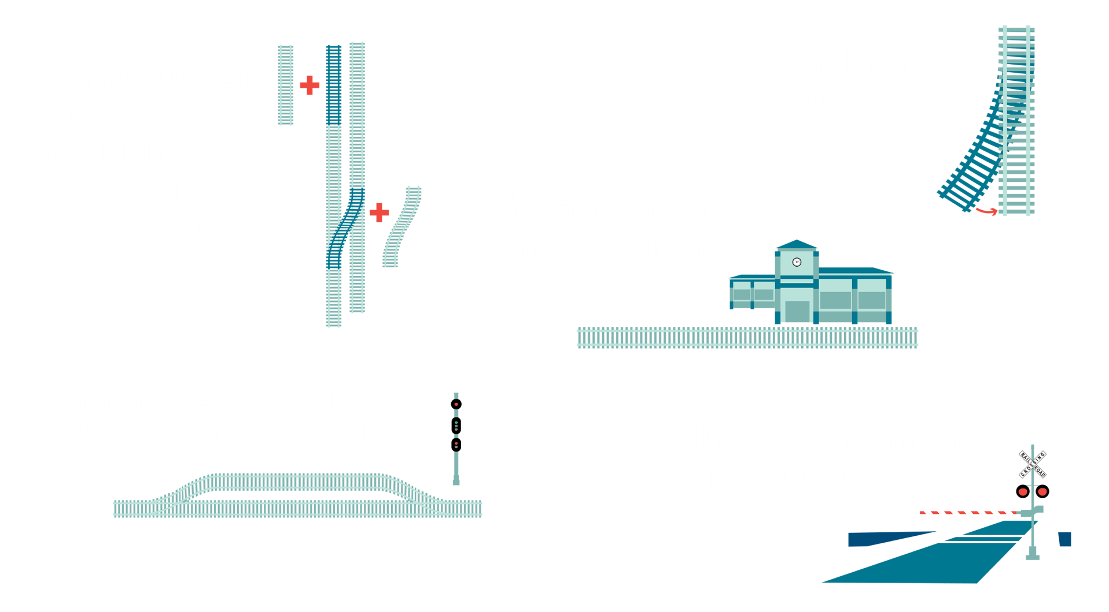
Improvement Concepts
18

Slide 19
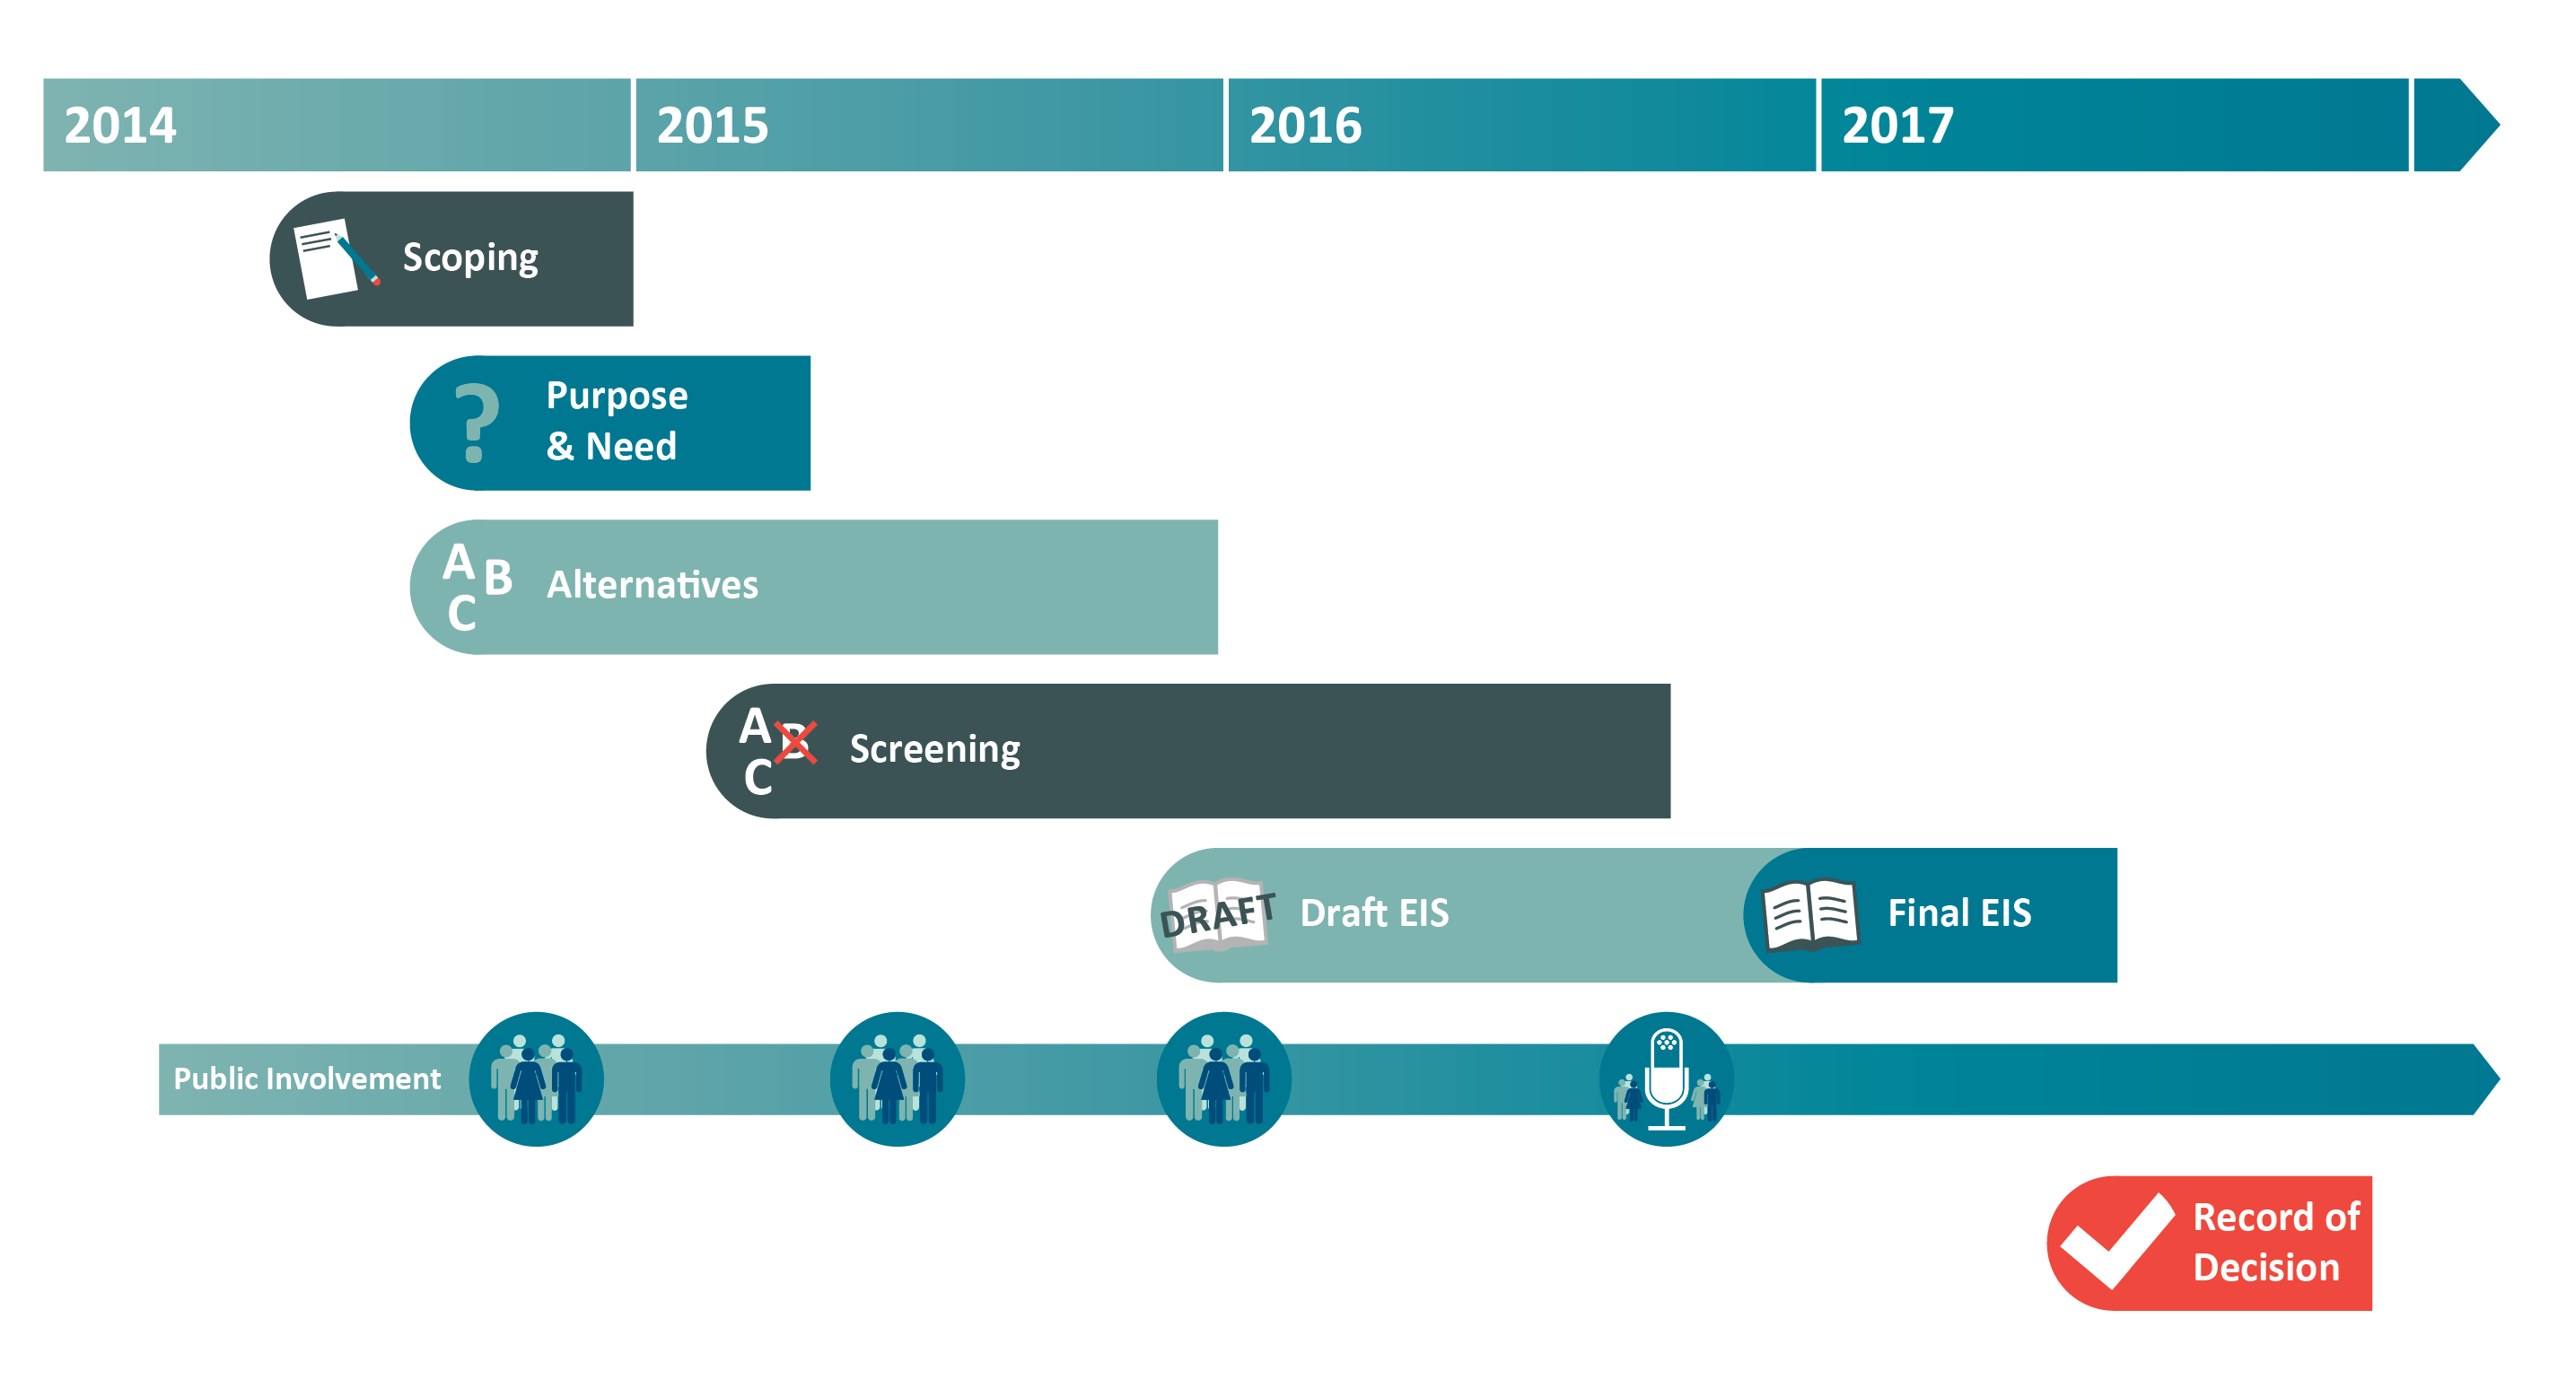

DC2RVA Where Are We Now?
19

